Slide 1
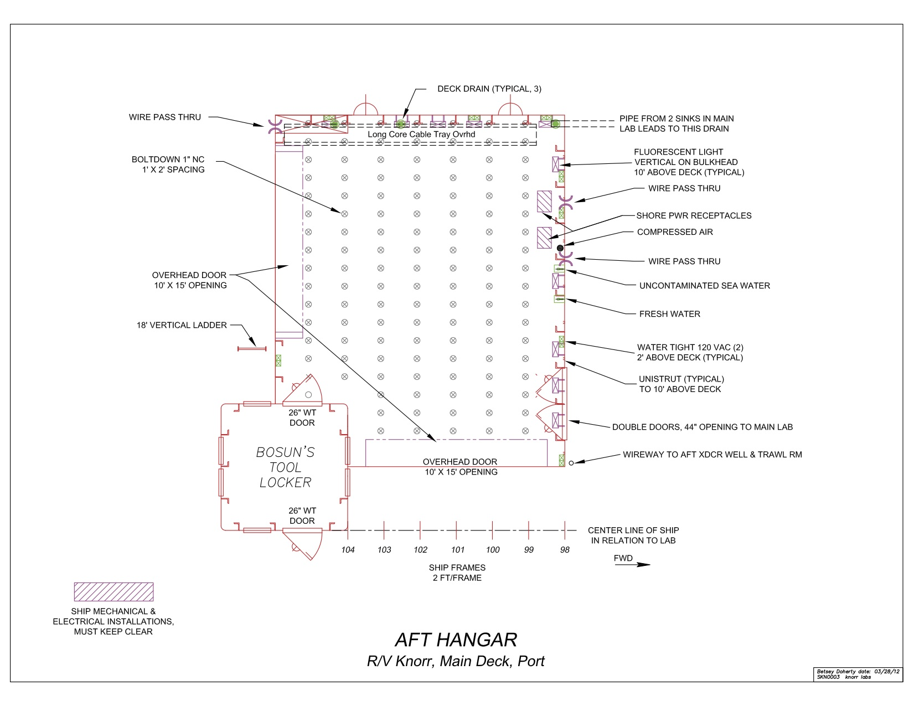
Justin’s table/bench

Slide 2
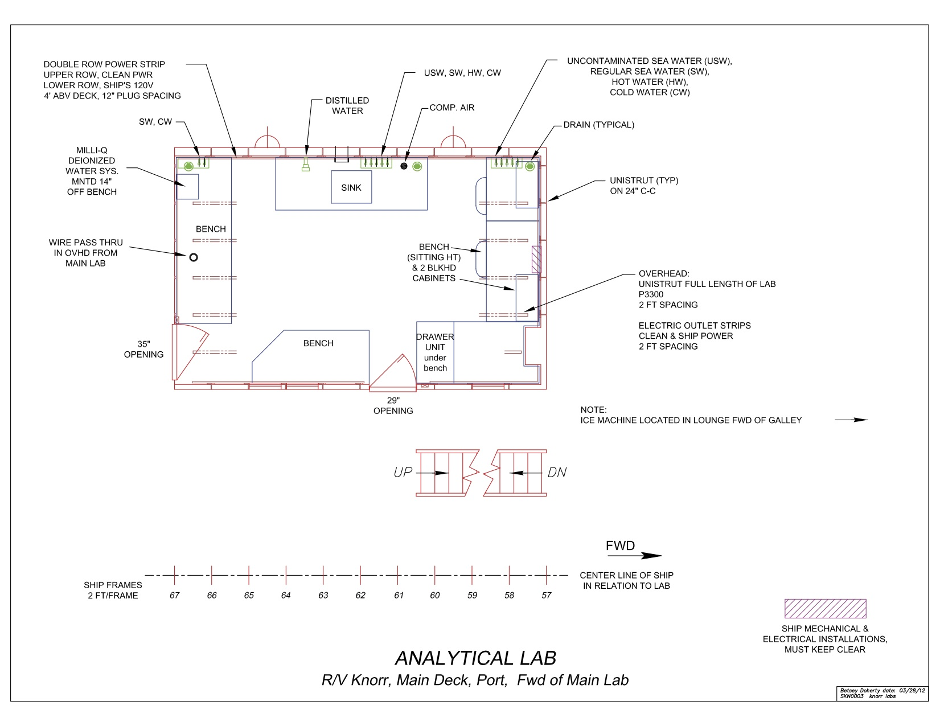
Stanley / Howard
McLane setup

Slide 3
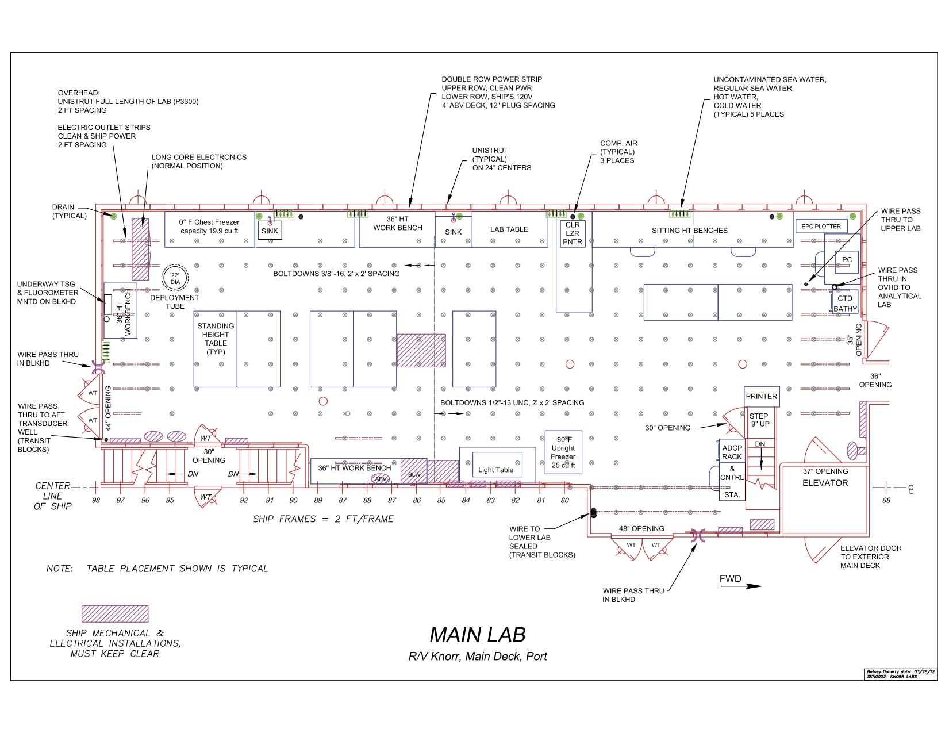
KUJ Fridge &
Freeze dryer
KUJ / Longnecker
SeaFlow
Laptops
Hennon
Arnosti /
Hoarfrost
Buchwald
Bhatia & T-Beltran
KUJ
W&C
Eggleston
VanMooy
LIZ ChiefSci
VanMooy

Slide 4
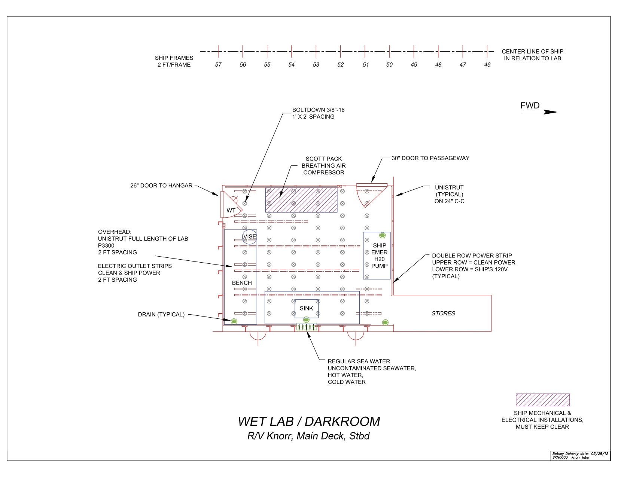
Dyhrman / Alexander
Close & Hurley

Slide 5
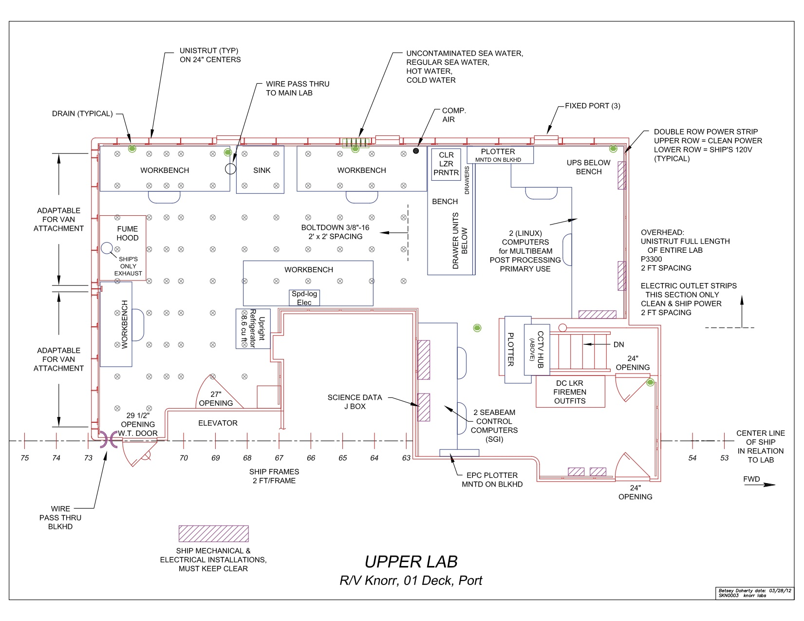
KUJ/Johnson
Van 1
Markham
Prokes
KUJ/VM
VanMooy
Van 2
VanMooy

Slide 6
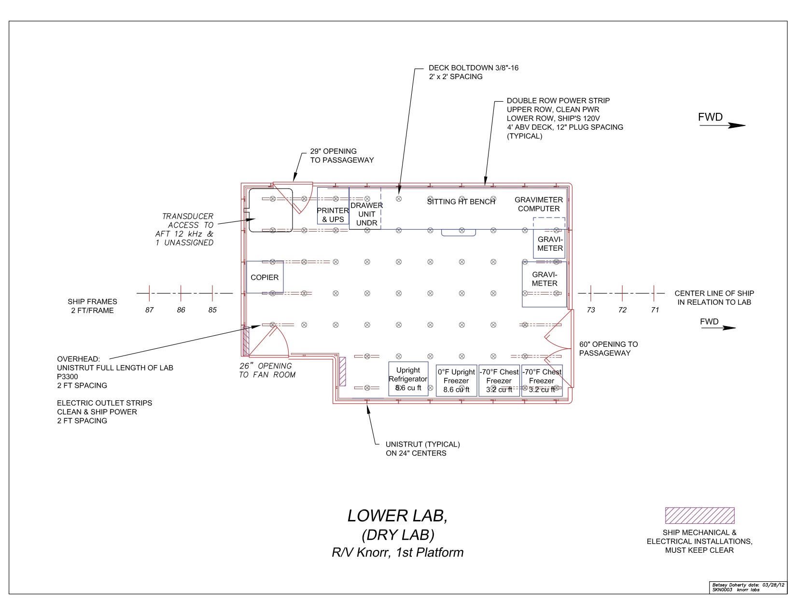
Microscopes
Arnosti Incubators?

