Slide 1
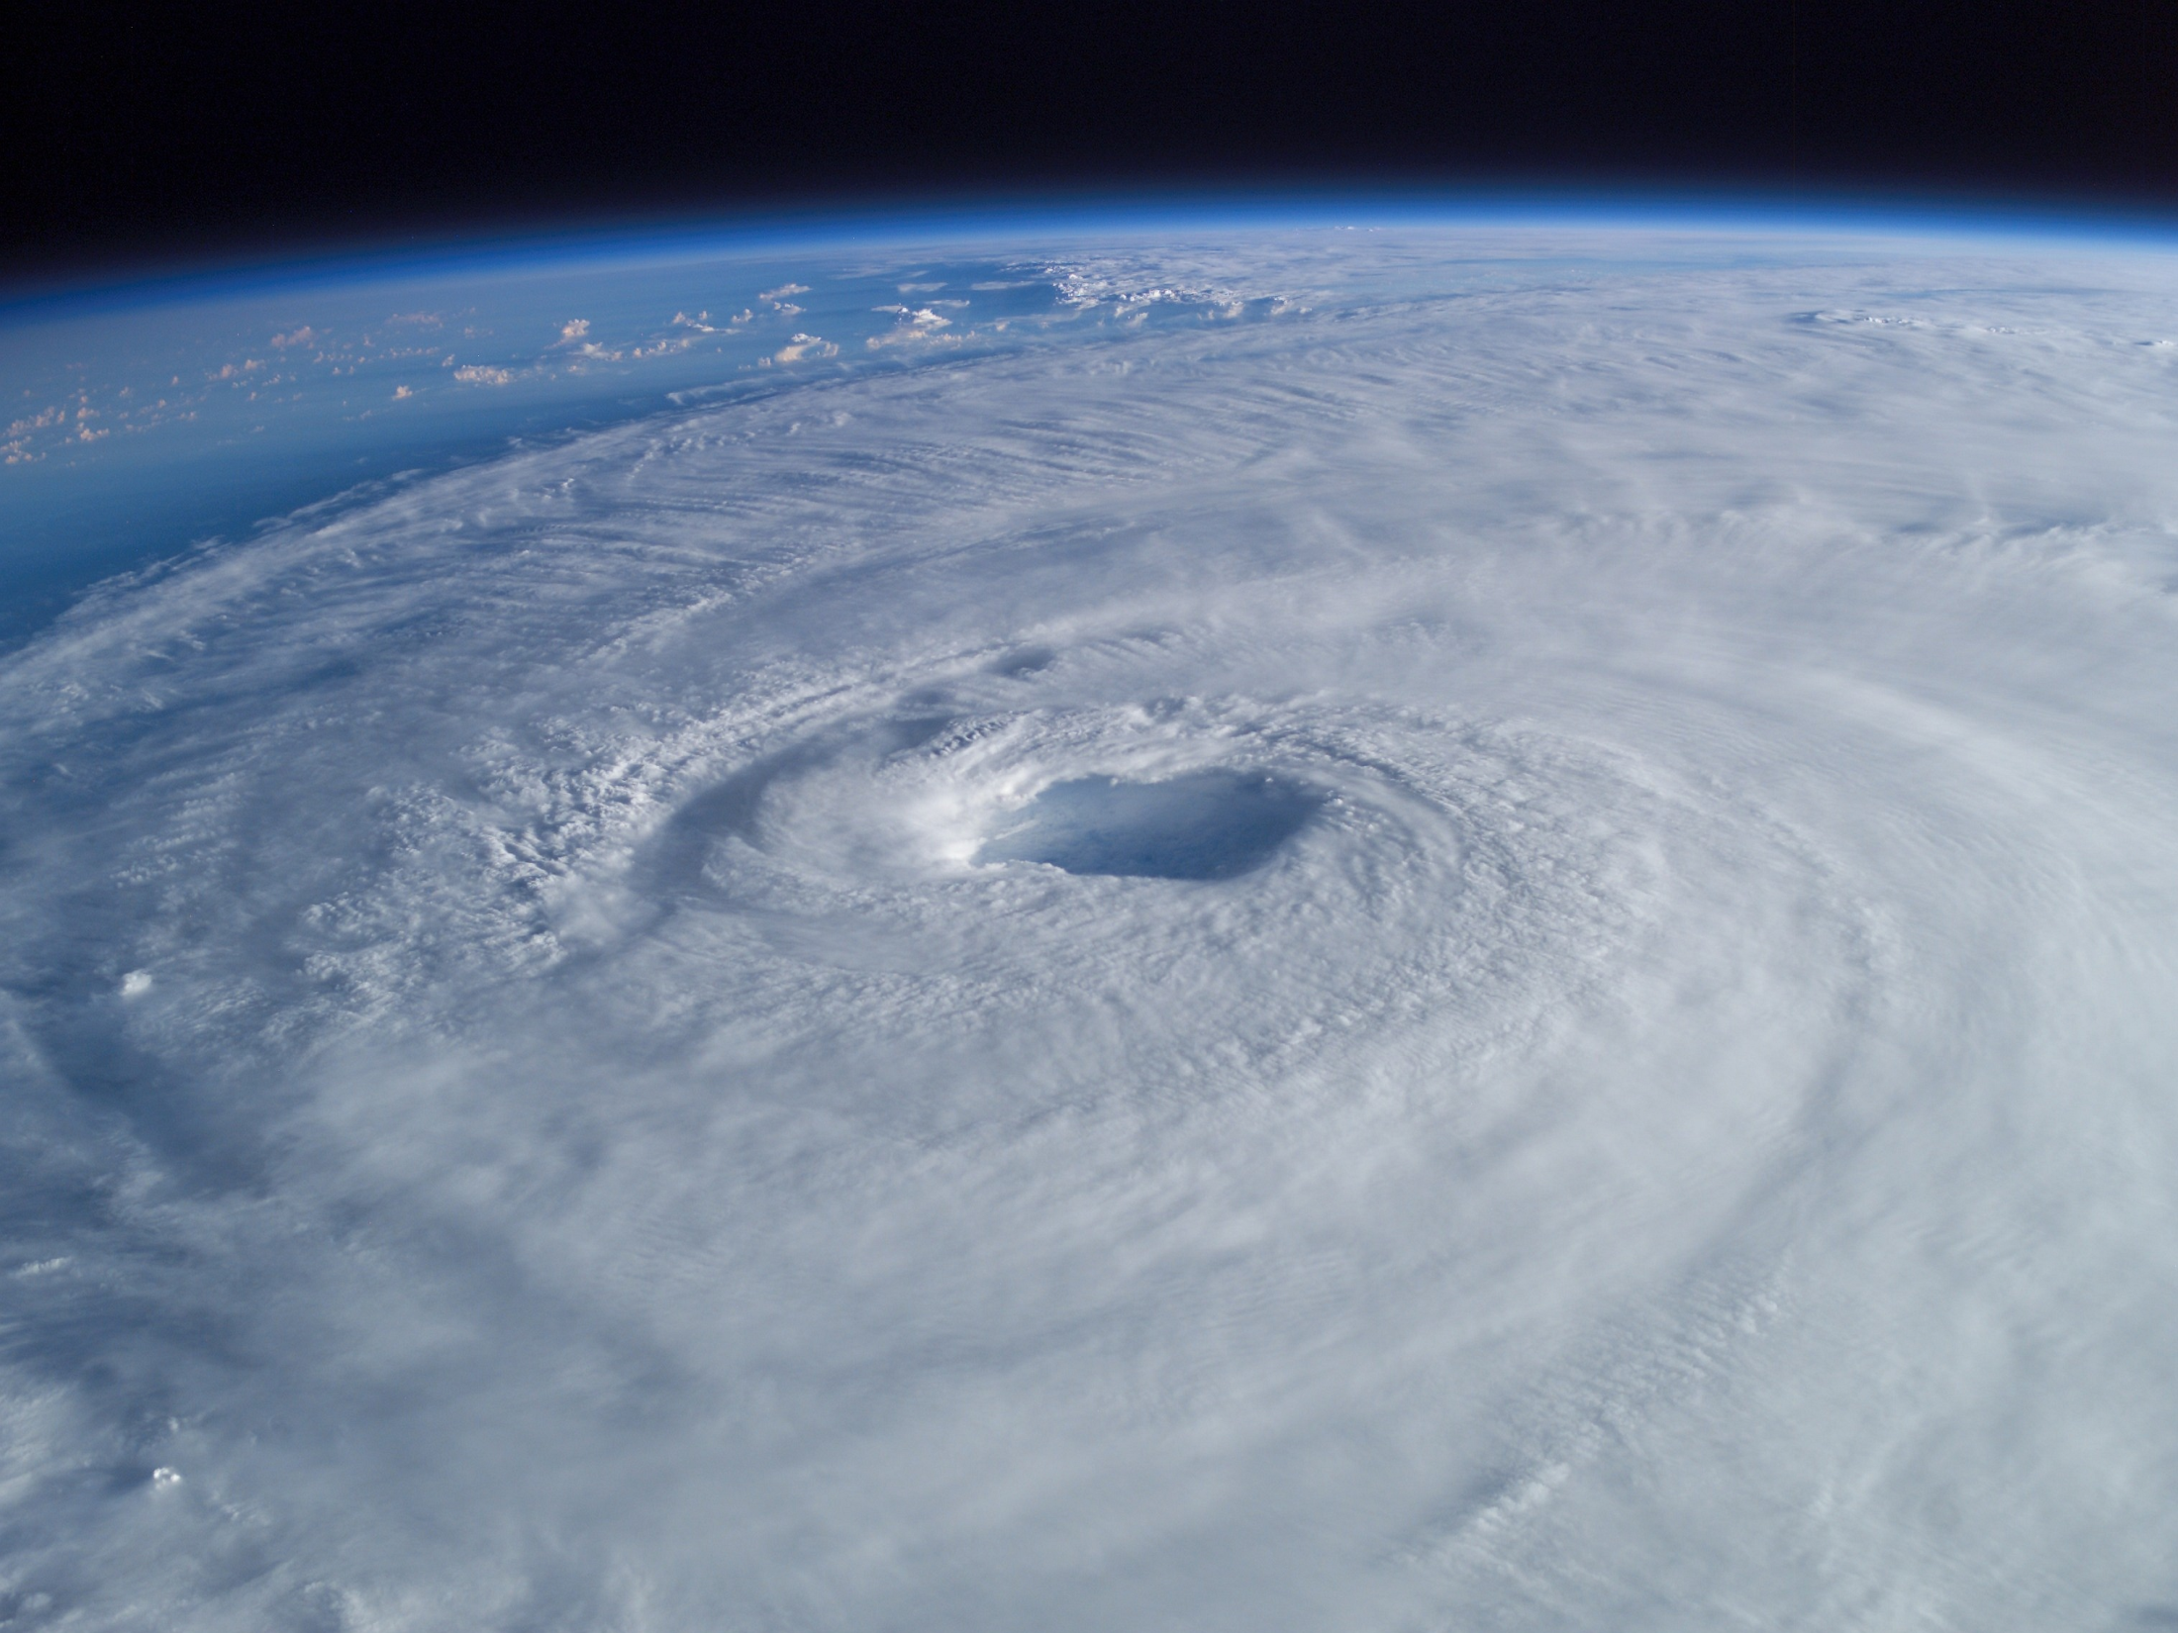
A Perfect Storm: The Collision of Tropical Cyclones,
Climate Change and Coastal Population Growth
Jeff Donnelly
Woods Hole Oceanographic Institution

Slide 2
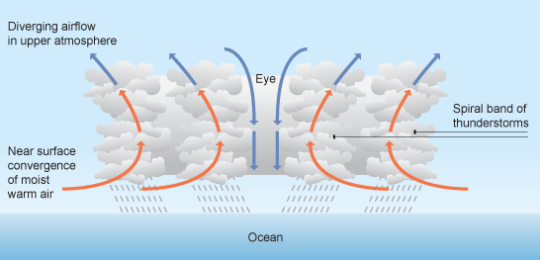
What is a tropical cyclone?
Conditions for genesis
Warm tropical waters > 26ºC, 80ºF
Minimal Wind Shear Aloft
Prior disturbance
Coriolis Deflection

Slide 3
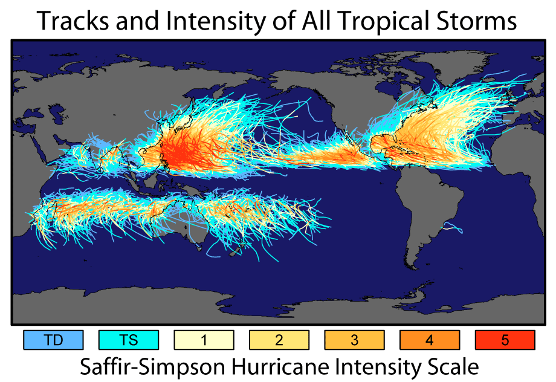
Where do they occur?

Slide 4
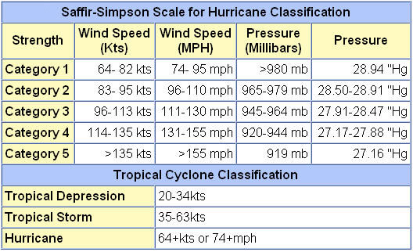
Intensity

Slide 5
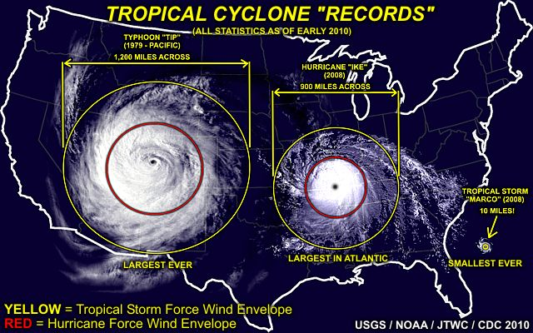
Tropical cyclones come in different sizes

Slide 6
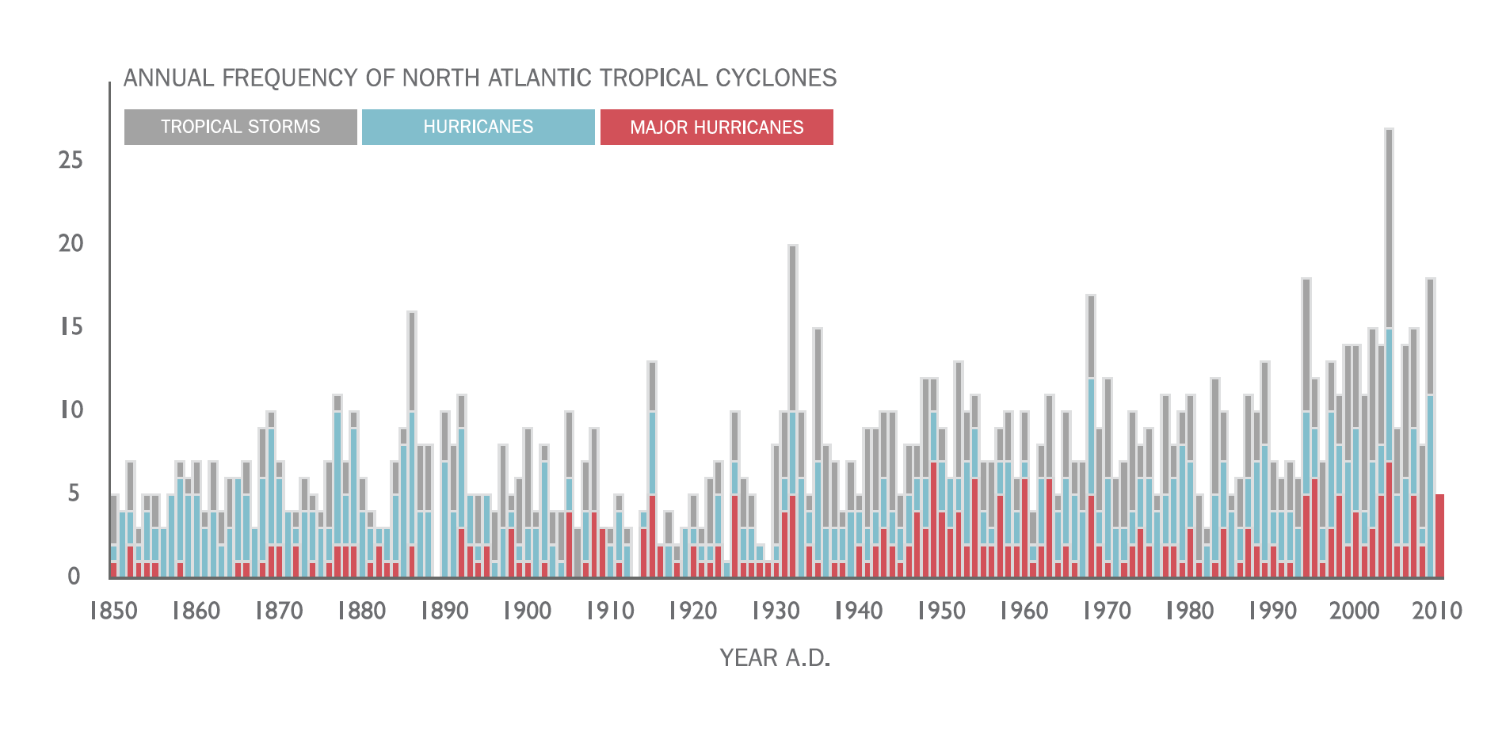
The instrumental record in the Atlantic
The NOAA “Best Track” Data
Notes:
- Apparent increase in the number of storms recorded.
- Actual trend in storm activity?
Increased ability to detect all storms?
Instrumental Record too short --→ need for longer records--→ sediment archives provide a valuable tool for extending modern climate records

Slide 7
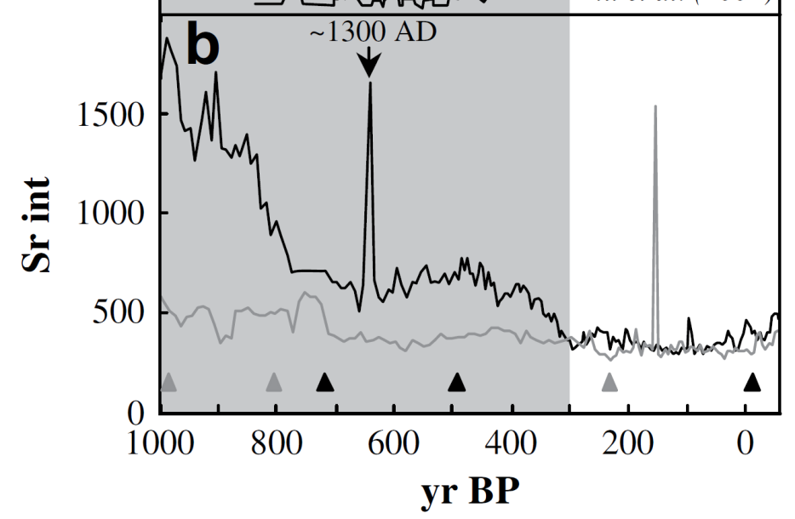
Historical Impacts of Tropical Cyclones
Divine Wind (Kamikaze)
typhoons of 1274 and 1281
Kublai Khan
Woodruff et al., 2009 QSR

Slide 8
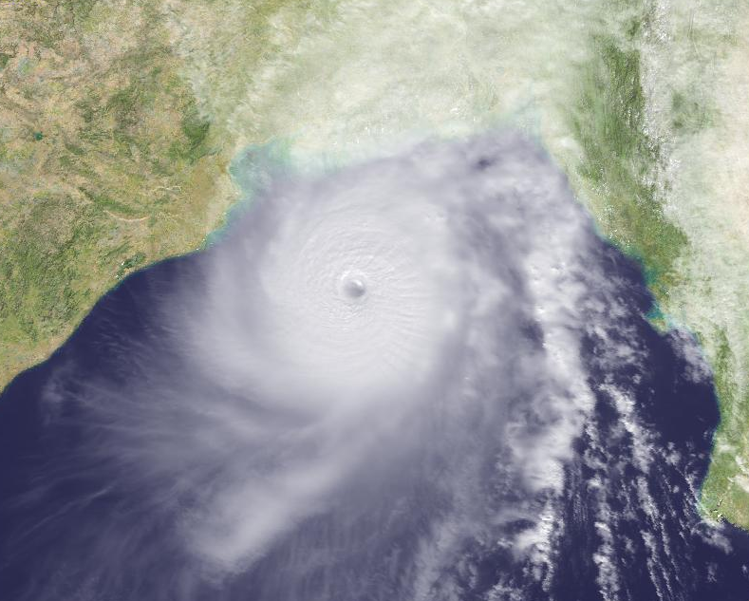
Bay of Bengal Cyclone Tragedies
1737 - 300,000-350,000 fatalities
1876 - 100,000 fatalities
1897 - 175,000 fatalities
1942 - 40,000 fatalities
1963 - 22,000 fatalities
1965 - 60,000 fatalities
1970 - 300,000-500,000 fatalities
(contributed to civil war and eventually Bangladesh independence)
1991 - 138,000 fatalities

Slide 9
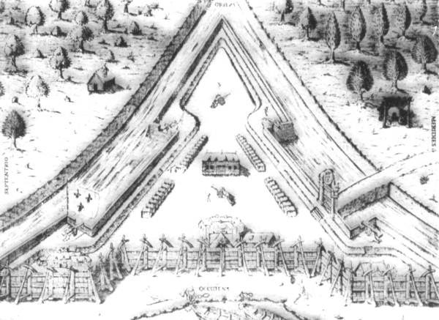
A French Florida?
French assault on St. Augustine Florida thwarted
by Hurricane in 1565 CE
Fort Caroline (Jacksonville), FL

Slide 10
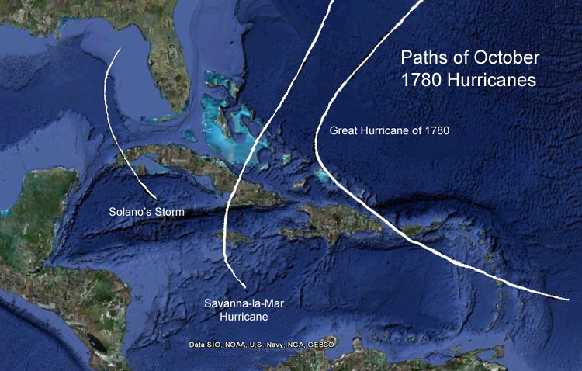
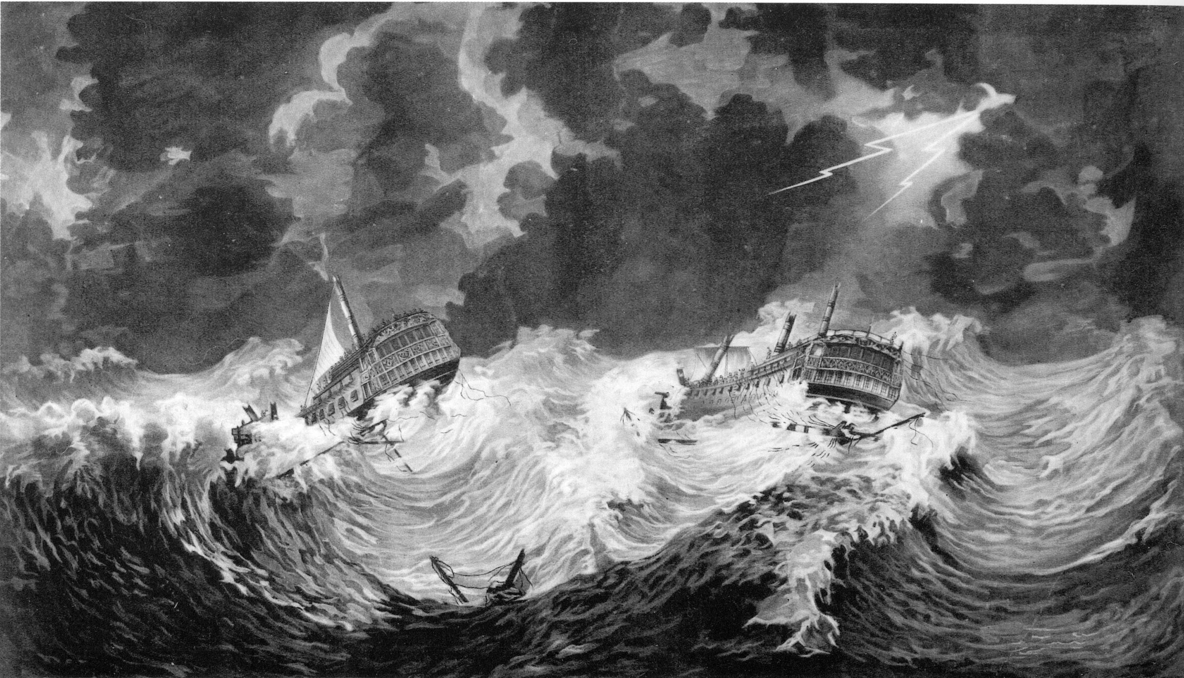
Infamous Atlantic Hurricanes
HMS Hector and HMS Bristol by William Elliott
More than 23,000 fatalities
in Great Hurricane of 1780

Slide 11
Infamous Atlantic Hurricanes
1900 Galveston, TX Hurricane
Category 4 at landfall
5,000-12,000 fatalities
No warning – weather service predicted track along eastern seaboard

Slide 12
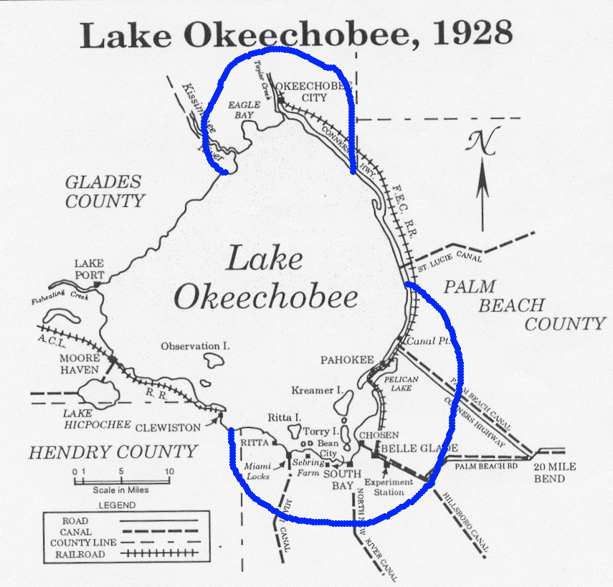
Infamous Atlantic Hurricanes
1928 San Felipe II or Okeechobee Hurricane
Category 5 in Puerto Rico/Category 4 at FL landfall
Over 4,000 fatalities total
2,500 at Lake Okeechobee

Slide 13
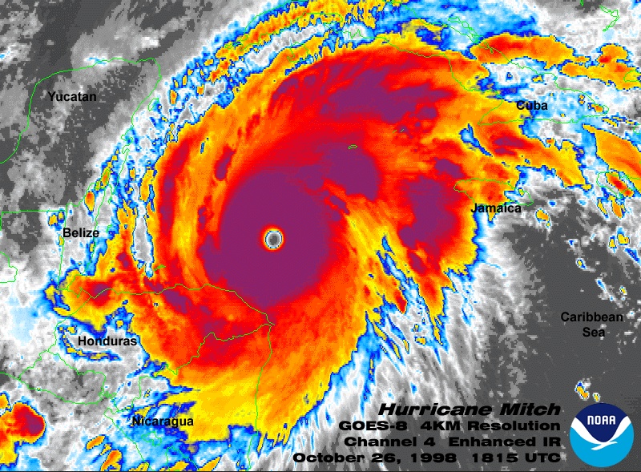
Infamous Atlantic Hurricanes
Hurricane Mitch in 1998
20,000 fatalities (mostly in Honduras)
Made landfall as a cat 1 but dumped nearly a meter of rain

Slide 14
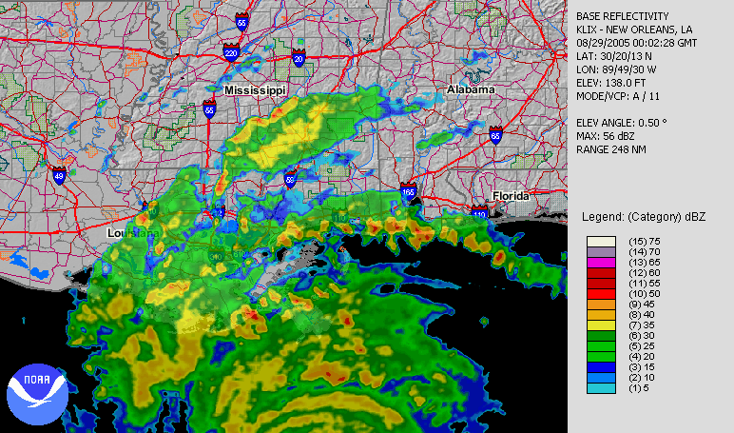
Infamous Atlantic Hurricanes
Hurricane Katrina 2005
1833 fatalities
81 billion dollars of damage

Slide 15
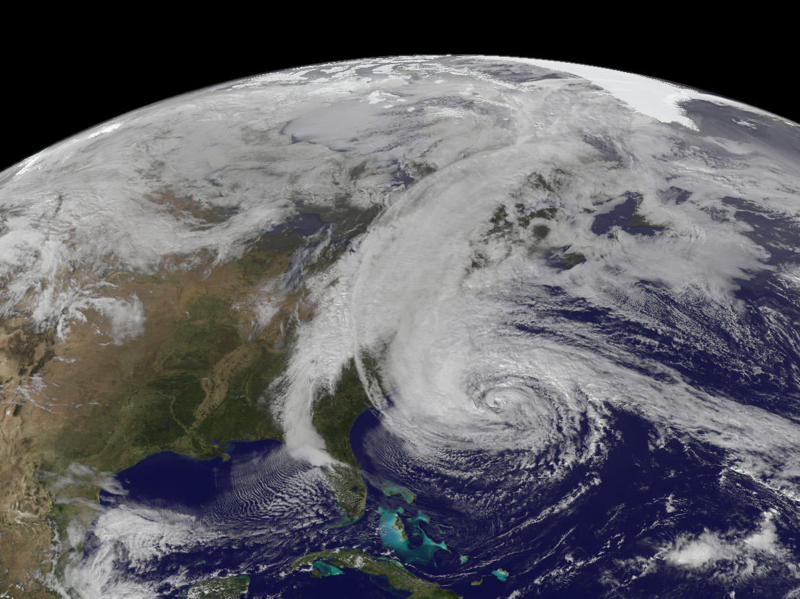
Infamous Atlantic Hurricanes
Hurricane Sandy 2012
68 billion in damage
148 fatalities

Slide 16
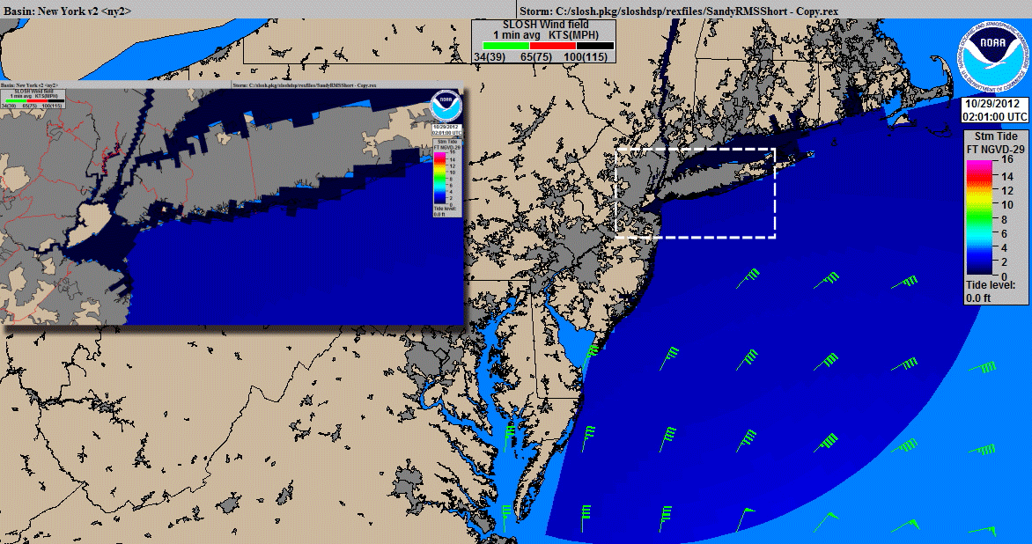
Hurricane Sandy SLOSH Simulation

Slide 17
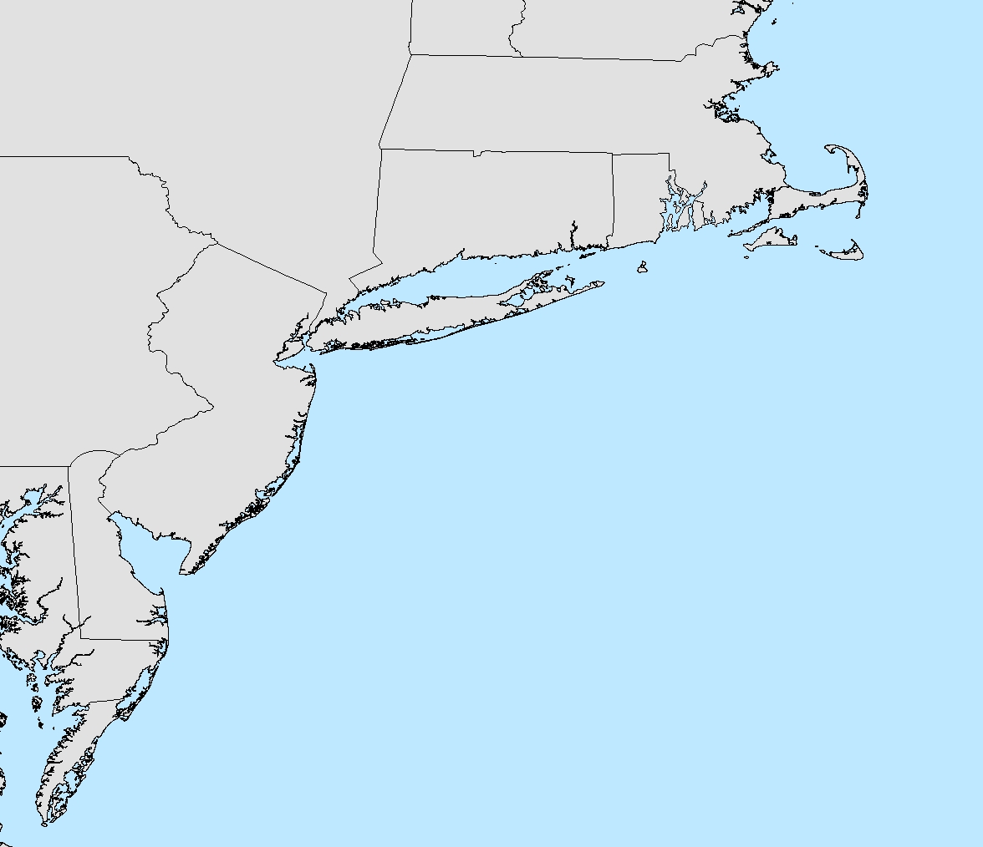
Historical Northeast US Hurricanes
Sandy

Slide 18
Historical Northeast US Hurricanes
1938
1954
1960
1944
1893
1815
1869
1635
1788
1821
1903
1991
1985
Sandy
1954
1869

Slide 19
Historical Northeast US Hurricanes
1938
1954
1960
1944
1893
1815
1869
1635
1788
1821
1903
1991
1985
Sandy
1954
1869

Slide 20
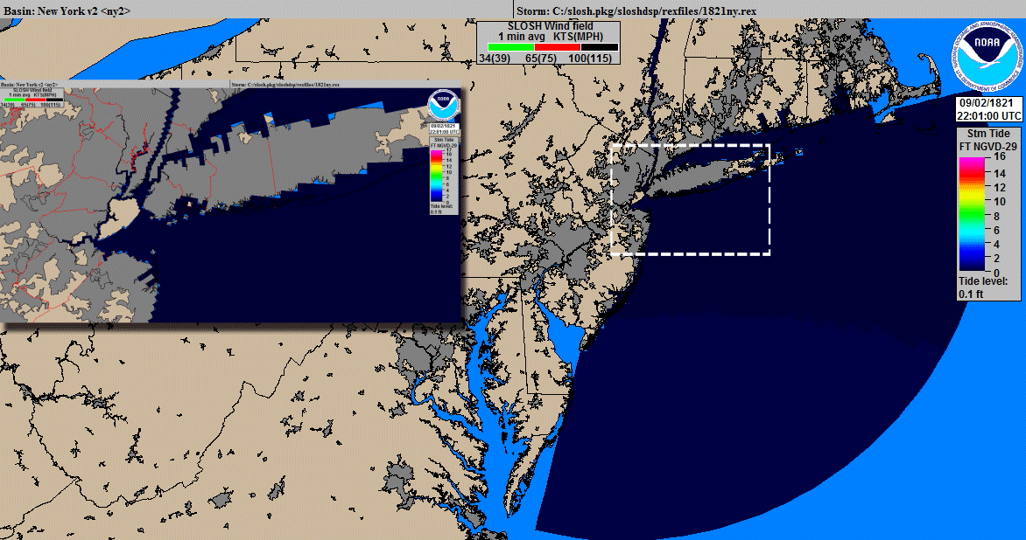
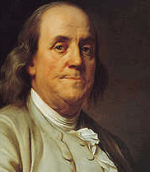
1821 Hurricane SLOSH Simulation
RMW = 46 km
Intensity = 51 m/s (115 MPH)
SLOSH input
Track: ~known
Translation speed: ~known (~65 km/hr (40 MPH))
Radius of maximum winds: ?
Intensity: ?
Ben Franklin
1706-1790
Though some inferences
can be drawn from damage

Slide 21
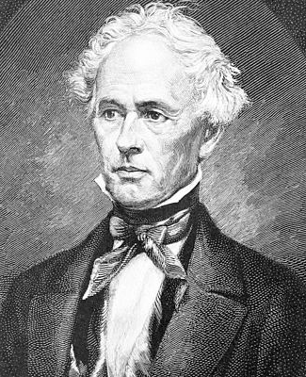
1821 Hurricane SLOSH Simulation
RMW = 46 km
Intensity = 51 m/s (115 MPH)
SLOSH input
Track: ~known
Translation speed: ~known (~65 km/hr (40 MPH))
Radius of maximum winds: ?
Intensity: ?
William C. Redfield
1789-1857
Though some inferences
can be drawn from damage

Slide 22
1821 Hurricane Storm Tide in NYC
15
Redfield (1831) -
Water rose 13 feet (4 m)
in lower Manhattan
4
10
3
predicted tide
surge+tide
2
5
Water level relative to mean sea level in 1821 (ft)
1
Water level relative to mean sea level in 1821 (m)
0
0
-1
-5
-2
-10
-3
0:00
4:00
8:00
12:00
16:00
20:00
24:00
Time September 3, 1821

Slide 23
1821 Hurricane vs. Sandy in NYC
1821
Sandy
4
4
predicted tide
3
surge+tide
3
predicted tide
surge+tide
2
2
1
1
Water level relative to mean sea level in 1821 (m)
Water level relative to mean sea level in 2012 (m)
0
0
-1
-1
-2
-2
-3
-3
0:00
4:00
8:00
12:00
16:00
20:00
24:00
0:00
4:00
8:00
12:00
16:00
20:00
24:00
Time September 3, 1821
Time October 29, 2012

Slide 24
1821 Hurricane vs. Sandy in NYC
1821
~4 m of surge
Sandy
~2.75 m of surge
4
4
predicted tide
3
surge+tide
3
predicted tide
surge+tide
2
2
1
1
Water level relative to mean sea level in 1821 (m)
Water level relative to mean sea level in 2012 (m)
0
0
-1
-1
-2
-2
-3
-3
0:00
4:00
8:00
12:00
16:00
20:00
24:00
0:00
4:00
8:00
12:00
16:00
20:00
24:00
Time September 3, 1821
Time October 29, 2012

Slide 25
Storm tides in lower Manhattan
4
3
Hurricanes
Winter Storm
Maximum Water Level above MSL (m)
2
1
0
1788
1821
1893
1938
1953
1960
1961
1968
1984
1985
1991
1993
1996
1996
1944
1950
1960
1962
1966
1987
1992
2012
Date

Slide 26
Storm tides in lower Manhattan
If 1821 hit at high tide
4
If Sandy hit at low tide
3
Hurricanes
Winter Storm
Maximum Water Level above MSL (m)
2
1
0
1788
1821
1893
1938
1953
1960
1961
1968
1984
1985
1991
1993
1996
1996
1944
1950
1960
1962
1966
1987
1992
2012
Date

Slide 27
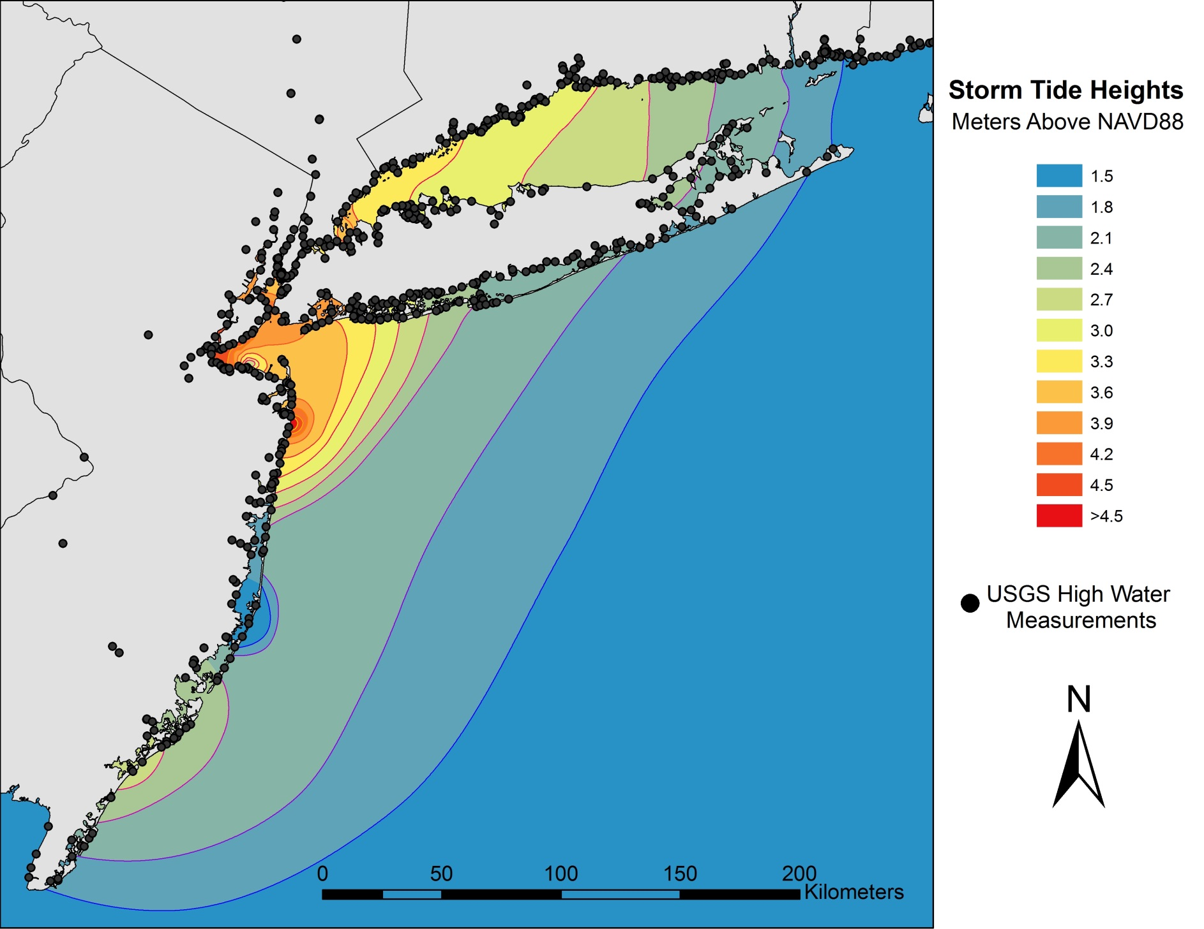
Hurricane Sandy Storm Tide

Slide 28
Hurricane Sandy Storm Tide
1821
1788

Slide 29
Hurricane Sandy Storm Tide

Slide 30
Hurricane Sandy Storm Tide
Long Beach

Slide 31
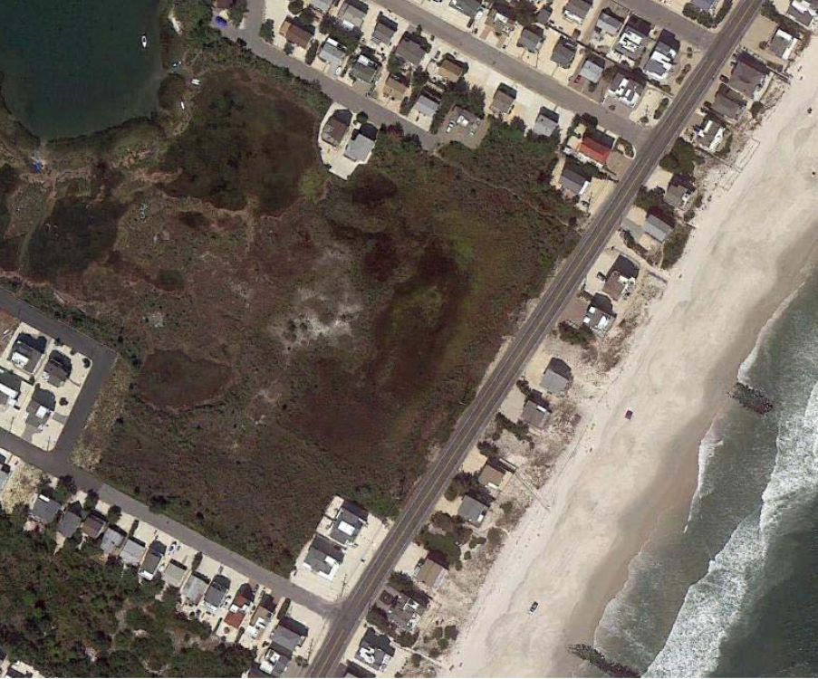
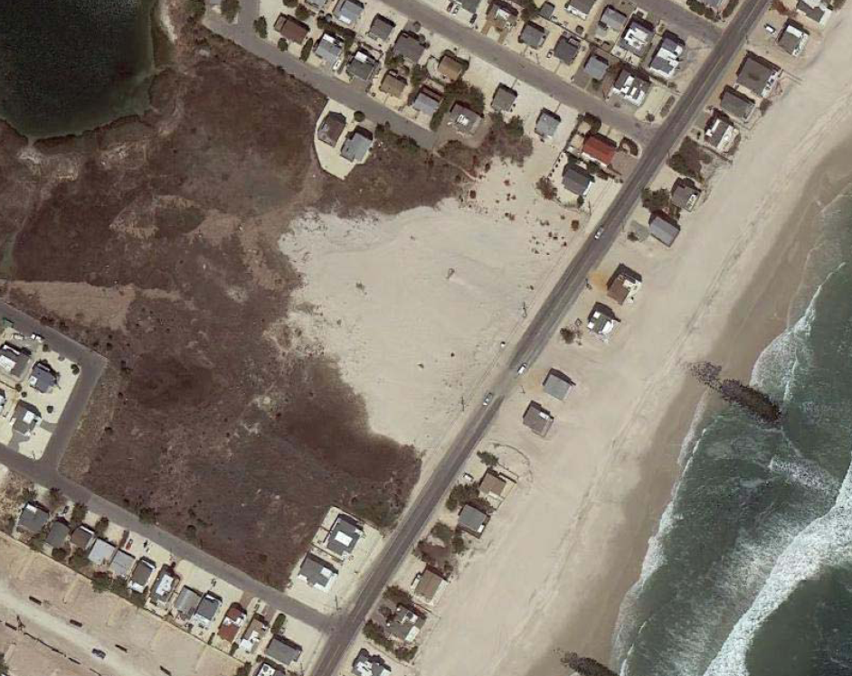
Long Beach Washover
Pre Sandy
Post Sandy

Slide 32
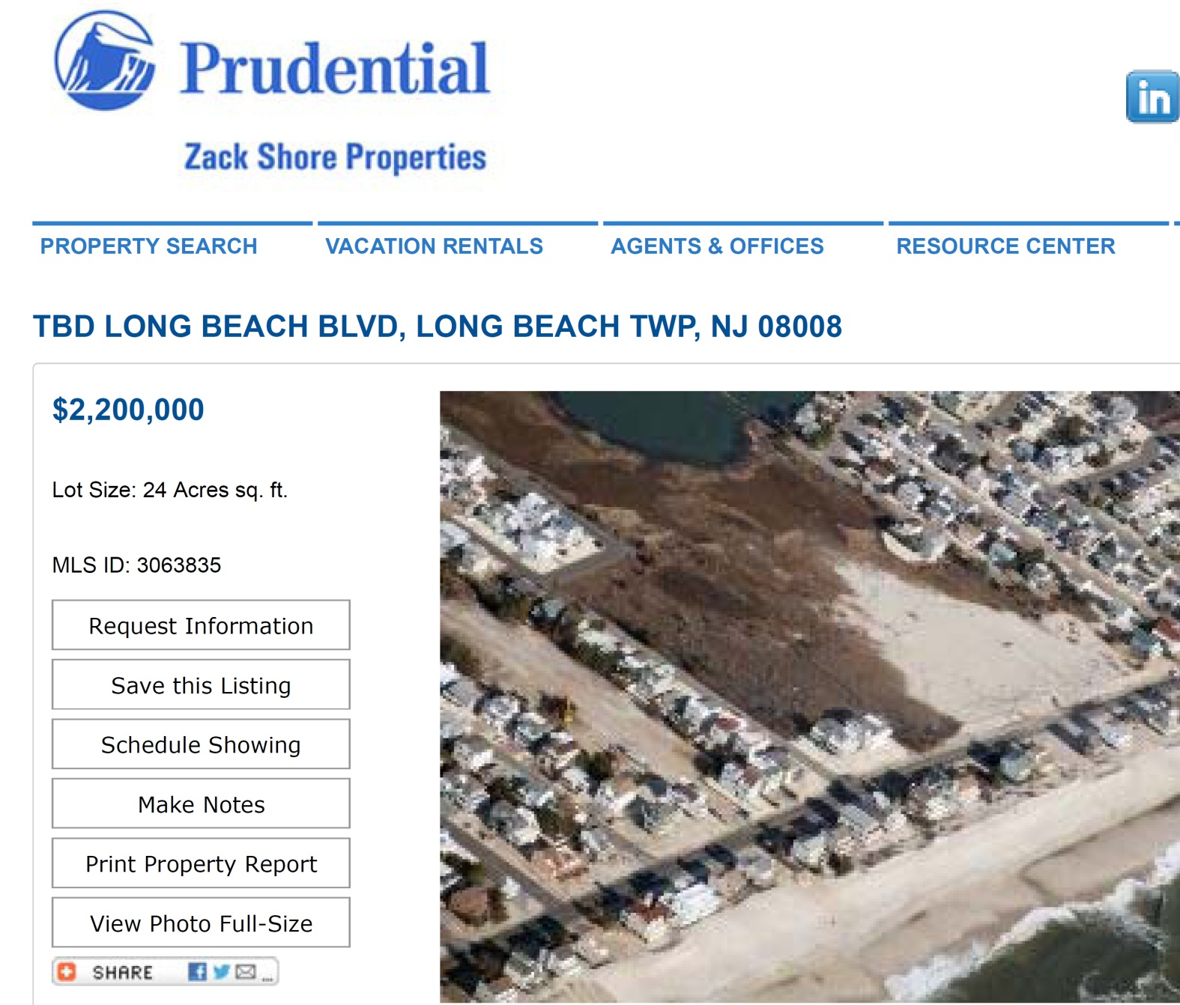
Long Beach Washover

Slide 33
Why so little sediment transport?
Sandy left little sedimentary evidence of her passage
in the 13 of 14 sites surveyed

Slide 34
Why so little sediment transport?
Sandy left little sedimentary evidence of her passage
in the 13 of 14 sites surveyed
Possible explanations
Change in sediment availability
Change in coastal geometry or armoring of coast
Character of storm insufficient for wide-spread
sediment transport
Relatively low wave heights?
Relatively low rate of water level rise?

Slide 35
Why so little sediment transport?
Sandy left little sedimentary evidence of her passage
in the 13 of 14 sites surveyed
Possible explanations
Change in sediment availability
Change in coastal geometry or armoring of coast
Character of storm insufficient for wide-spread
sediment transport
Relatively low wave heights?
Relatively low rate of water level rise?
Future work: hindcast wave/surge simulations of
historic storms (e.g., 1821) using ADCIRC/SWAN
and modeling sediment transport

Slide 36
Why so much damage from Sandy?

Slide 37
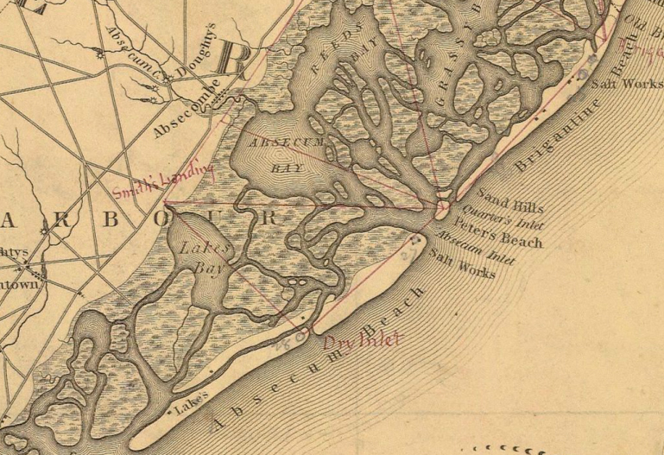
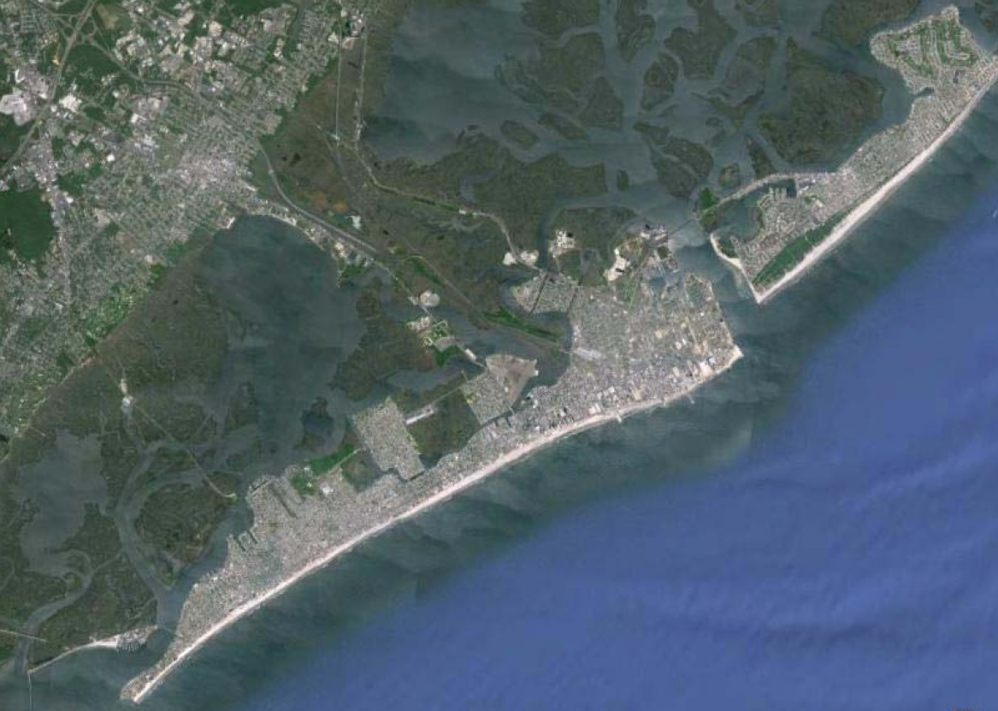
Why so much damage from Sandy?
Future home of
Atlantic City (ca. 1833)
today

Slide 38
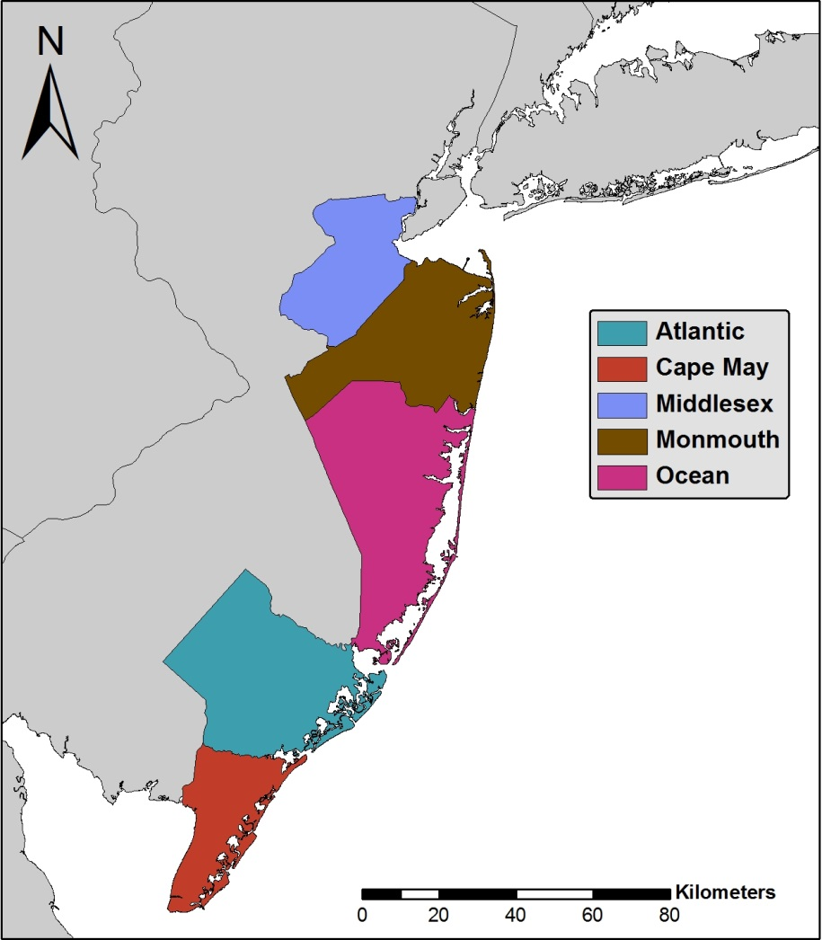
Why so much damage from Sandy?
Population growth
in NJ coastal counties
1000000
900000
Atlantic
800000
Cape May
Middlesex
700000
Monmouth
600000
Ocean
500000
Population
400000
300000
200000
100000
1821
1893
0
1800
1850
1900
1950
2000
Year
Source: New Jersey Department of Labor and Workforce Development

Slide 39
1900-2013 US Hurricane Damage in 2005 USD
200
150
Damage (billions of 2005 USD)
100
50
0
1901
1906
1911
1916
1920
1928
1933
1936
1941
1944
1947
1950
1953
1956
1959
1962
1965
1968
1971
1974
1977
1980
1983
1986
1989
1992
1995
1998
2001
2004
year
From Pielke et al., 2008

Slide 40
1900-2013 US Hurricane Damage in 2005 USD
But what if these storms were to strike today?
200
150
Damage (billions of 2005 USD)
100
50
0
1901
1906
1911
1916
1920
1928
1933
1936
1941
1944
1947
1950
1953
1956
1959
1962
1965
1968
1971
1974
1977
1980
1983
1986
1989
1992
1995
1998
2001
2004
year
From Pielke et al., 2008

Slide 41
1900-2013 US Hurricane Damage in 2005 USD
Damage accounting for increased wealth and population
200
150
Damage (billions of 2005 USD)
100
50
0
1901
1906
1911
1916
1920
1928
1933
1936
1941
1944
1947
1950
1953
1956
1959
1962
1965
1968
1971
1974
1977
1980
1983
1986
1989
1992
1995
1998
2001
2004
year
From Pielke et al., 2008

Slide 42
1900-2013 US Hurricane Damage in 2005 USD
Damage accounting for increased wealth and population
1926 Miami
200
2005 season
150
1900 Galveston
1915 Galveston
Damage (billions of 2005 USD)
100
1938 New England
1992 Andrew
Sandy
2004 season
50
0
1901
1906
1911
1916
1920
1928
1933
1936
1941
1944
1947
1950
1953
1956
1959
1962
1965
1968
1971
1974
1977
1980
1983
1986
1989
1992
1995
1998
2001
2004
year
From Pielke et al., 2008

Slide 43
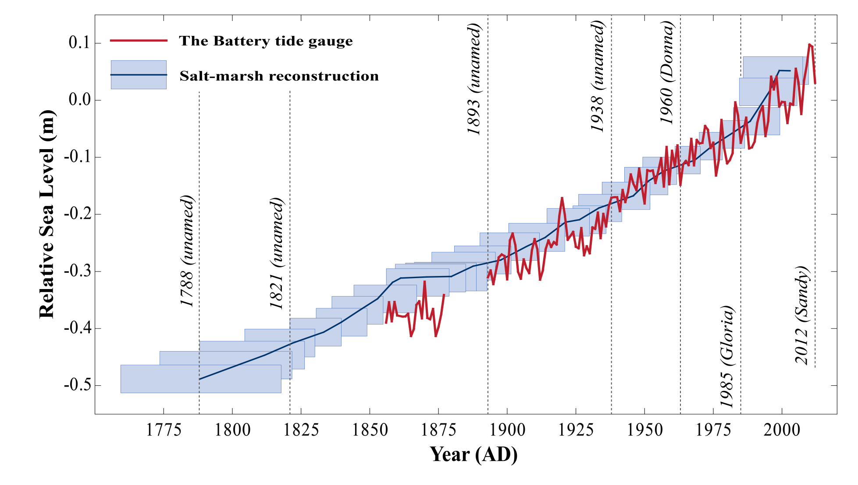
Sea-Level Rise
0.5
0
-0.5
feet
-1
-1.5
From Kemp and Horton, 2013 Journal of Quaternary Science

Slide 44
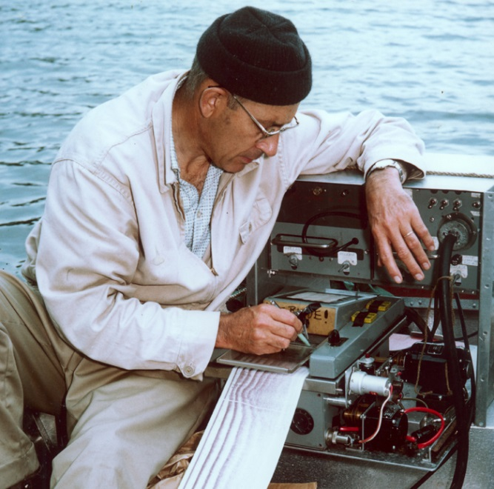
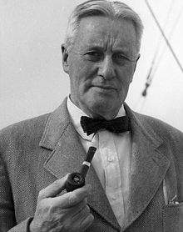
Sedimentary Records of Hurricane Strikes
K.O. Emery
Alfred C.
Redfield

Slide 45
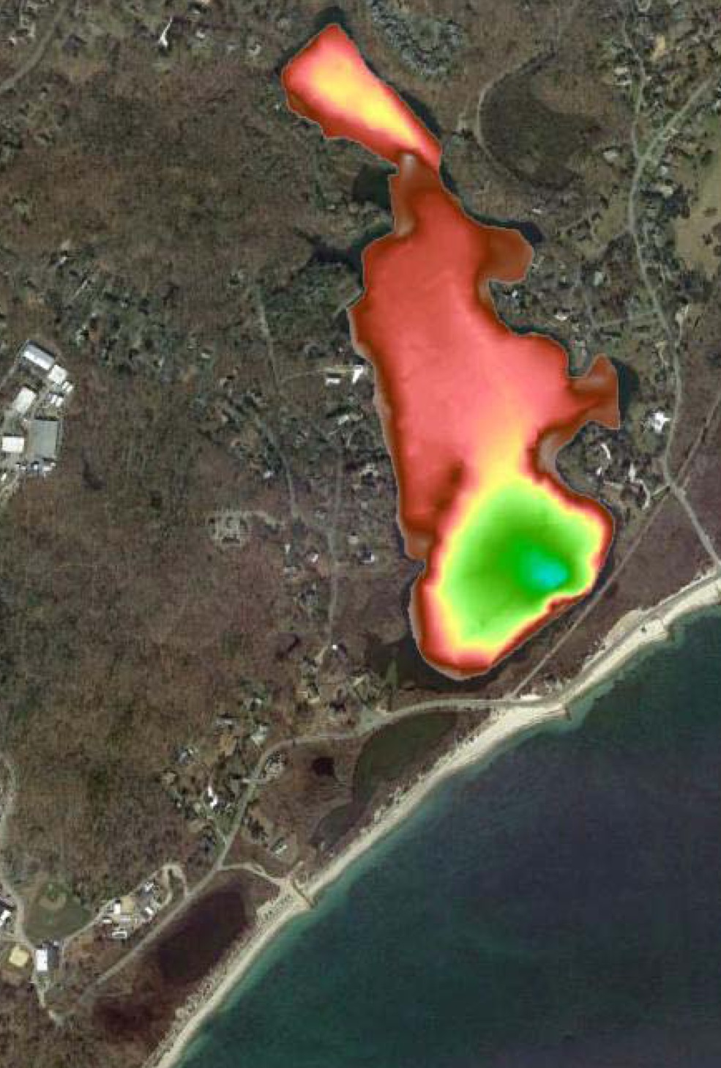
Sedimentary Records of Hurricane Strikes
K.O. Emery
Alfred C.
Redfield
WHOI

Slide 46
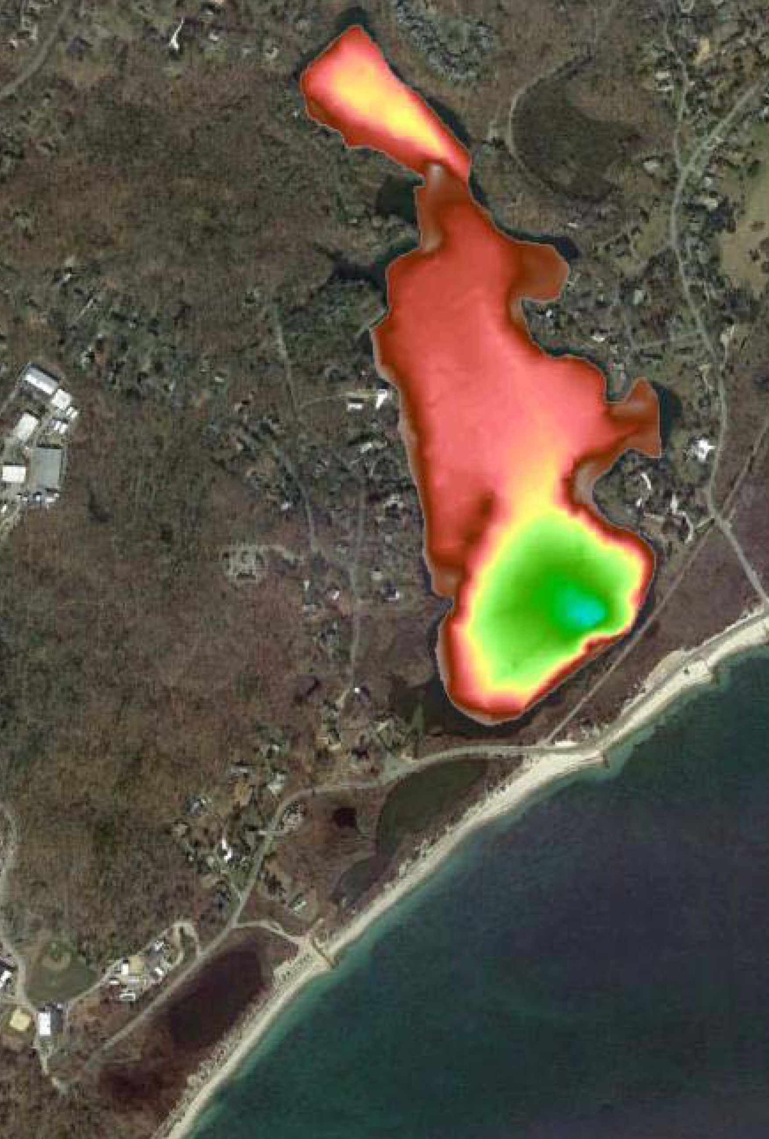
Sedimentary Records of Hurricane Strikes
K.O. Emery
Alfred C.
Redfield
25 cm
WHOI

Slide 47
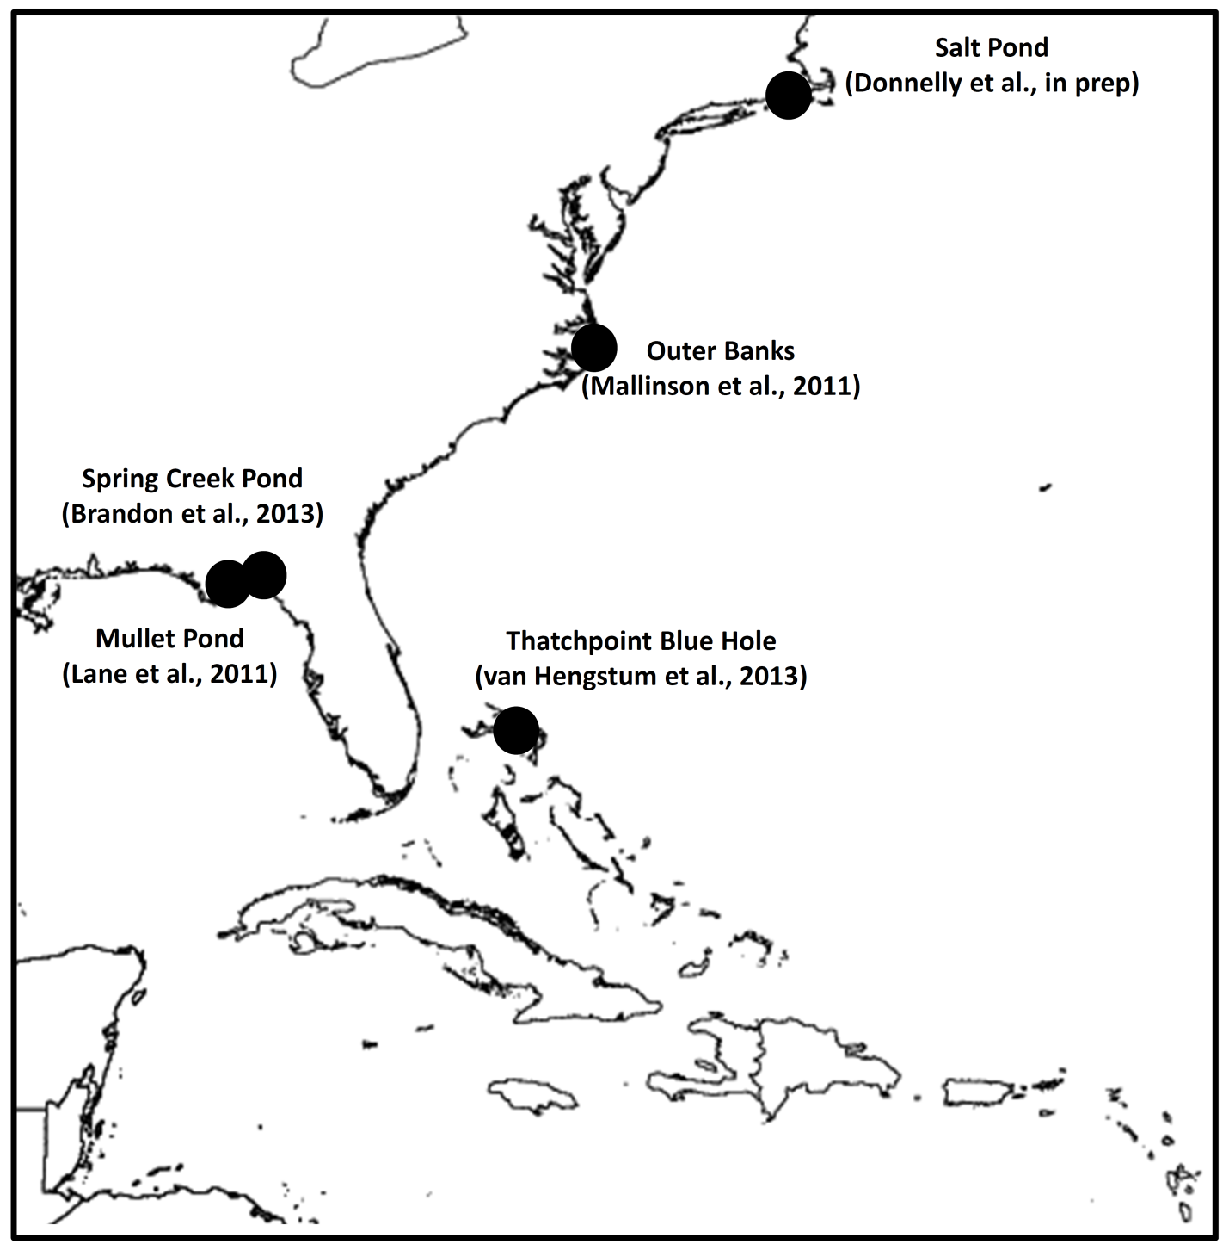
Sedimentary Records of Hurricane Strikes

Slide 48
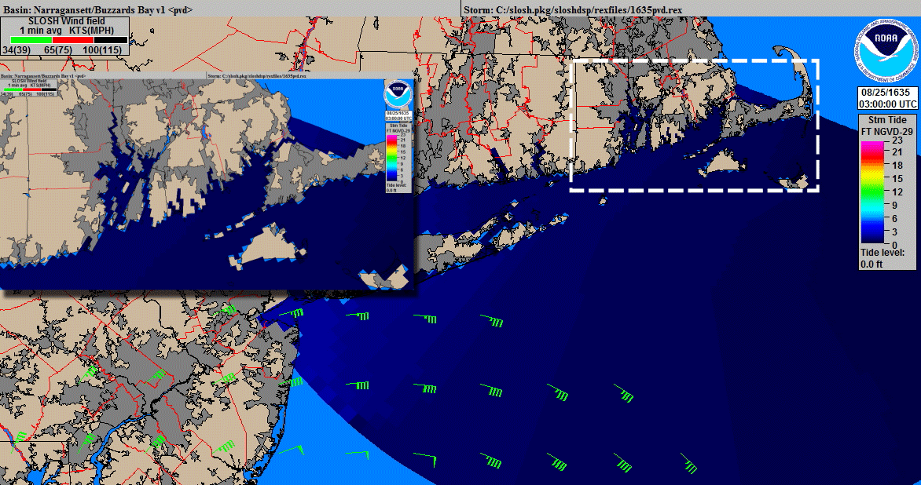
Storm surge from the Great Colonial Hurricane of 1635

Slide 49
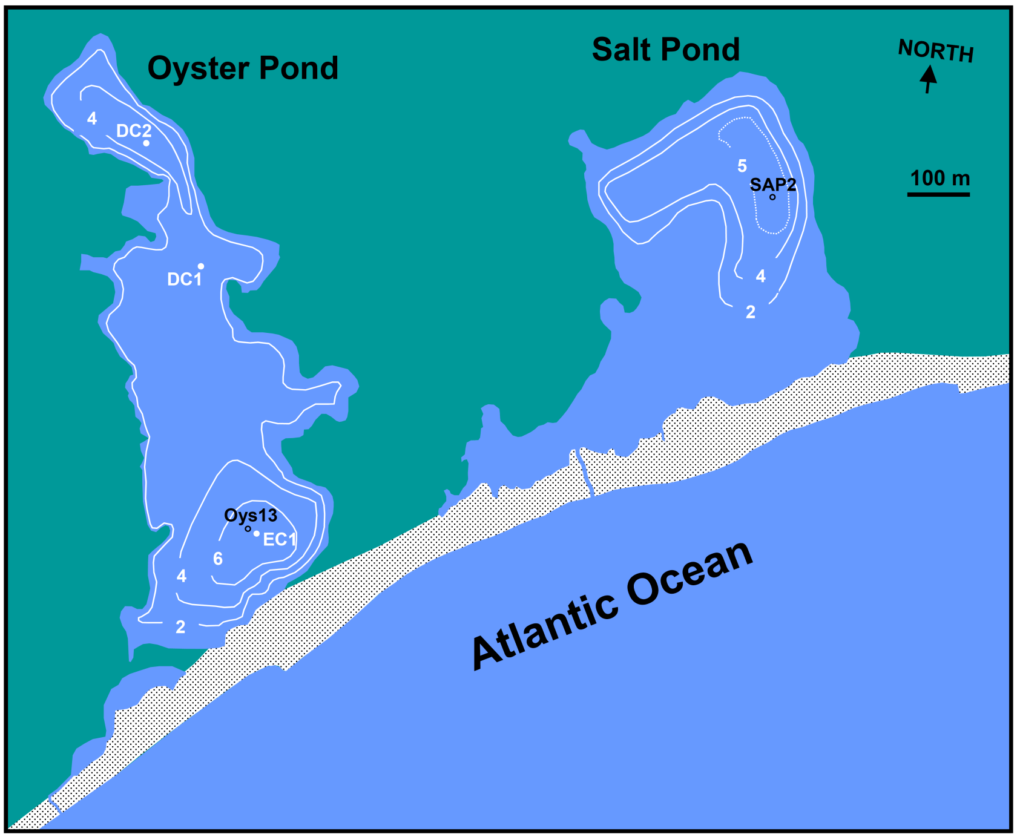
Salt Pond, Massachusetts

Slide 50
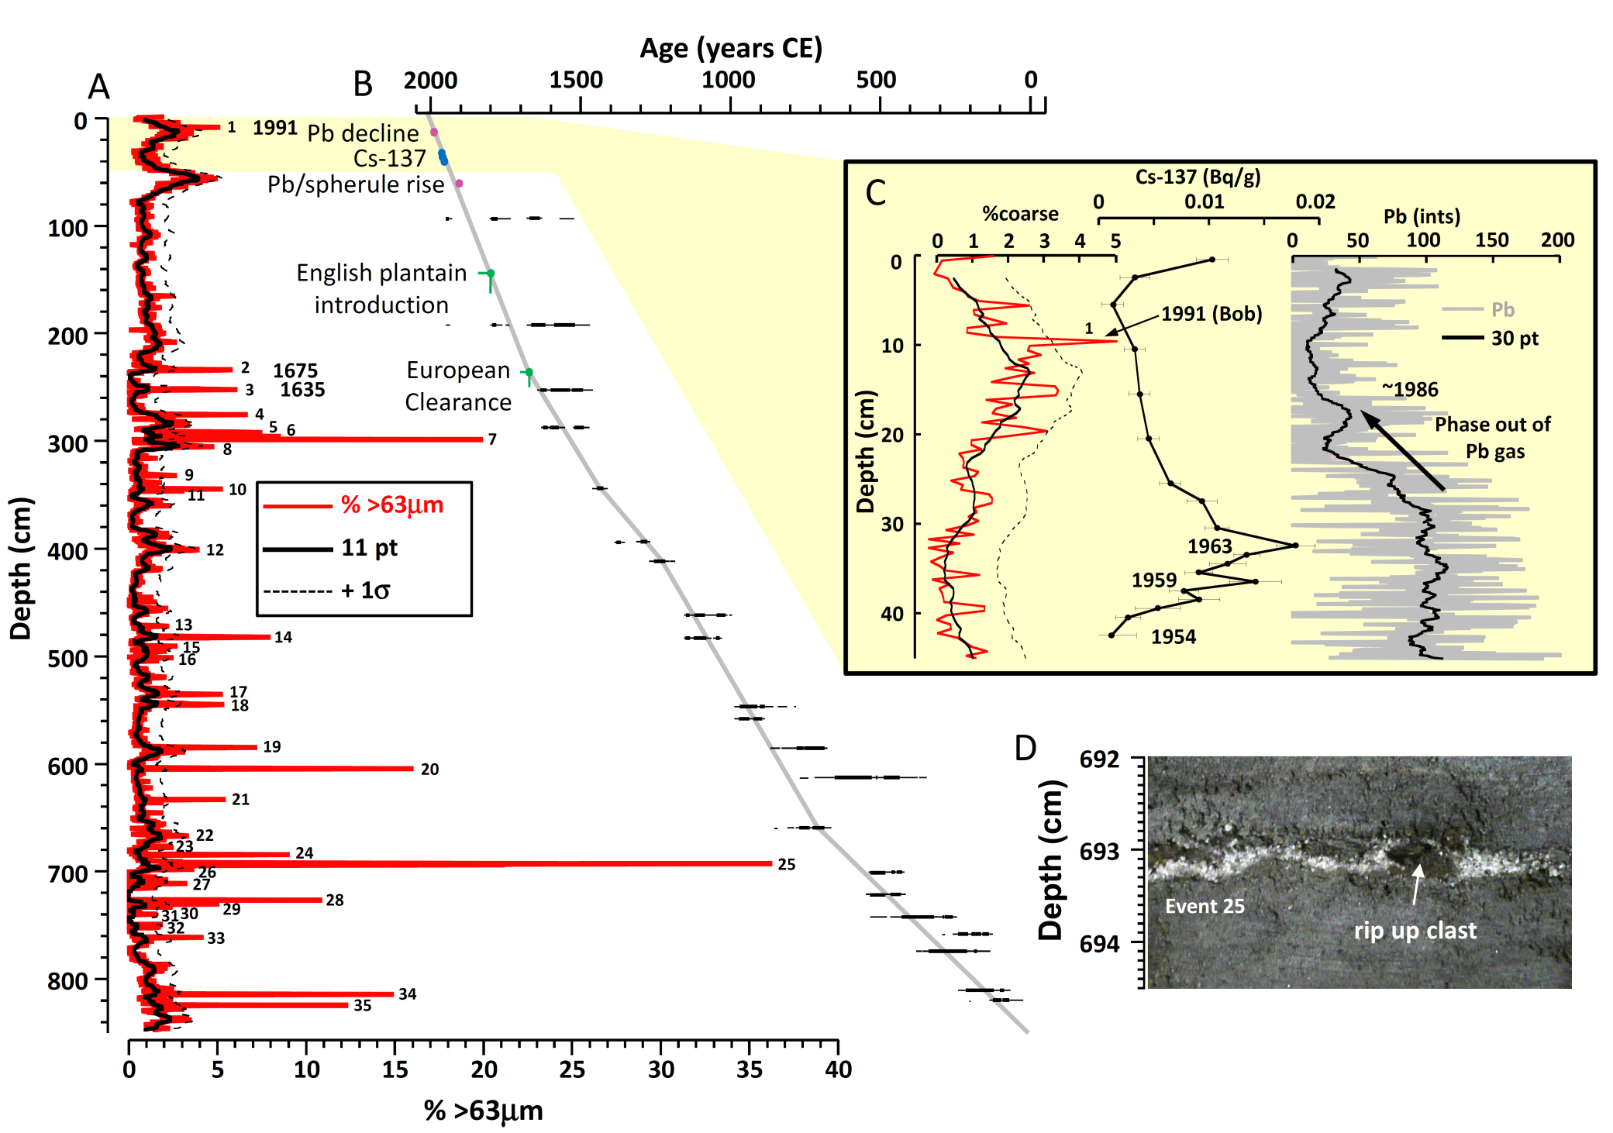
Salt Pond Reconstruction
≥D99

Slide 51
Assessing Significance
Probability ≥ events/century
3 events
in 393 years
BT cat2 or >
per 65 km
ʎ = 0.76
ʎ = 0.86
5
0.001
0.002
4
0.008
0.012
3
0.042
0.056
Events per century
2
0.177
0.213
1
0.532
0.577
0
1.000
1.000
0
500
1000
1500
2000
Age CE

Slide 52
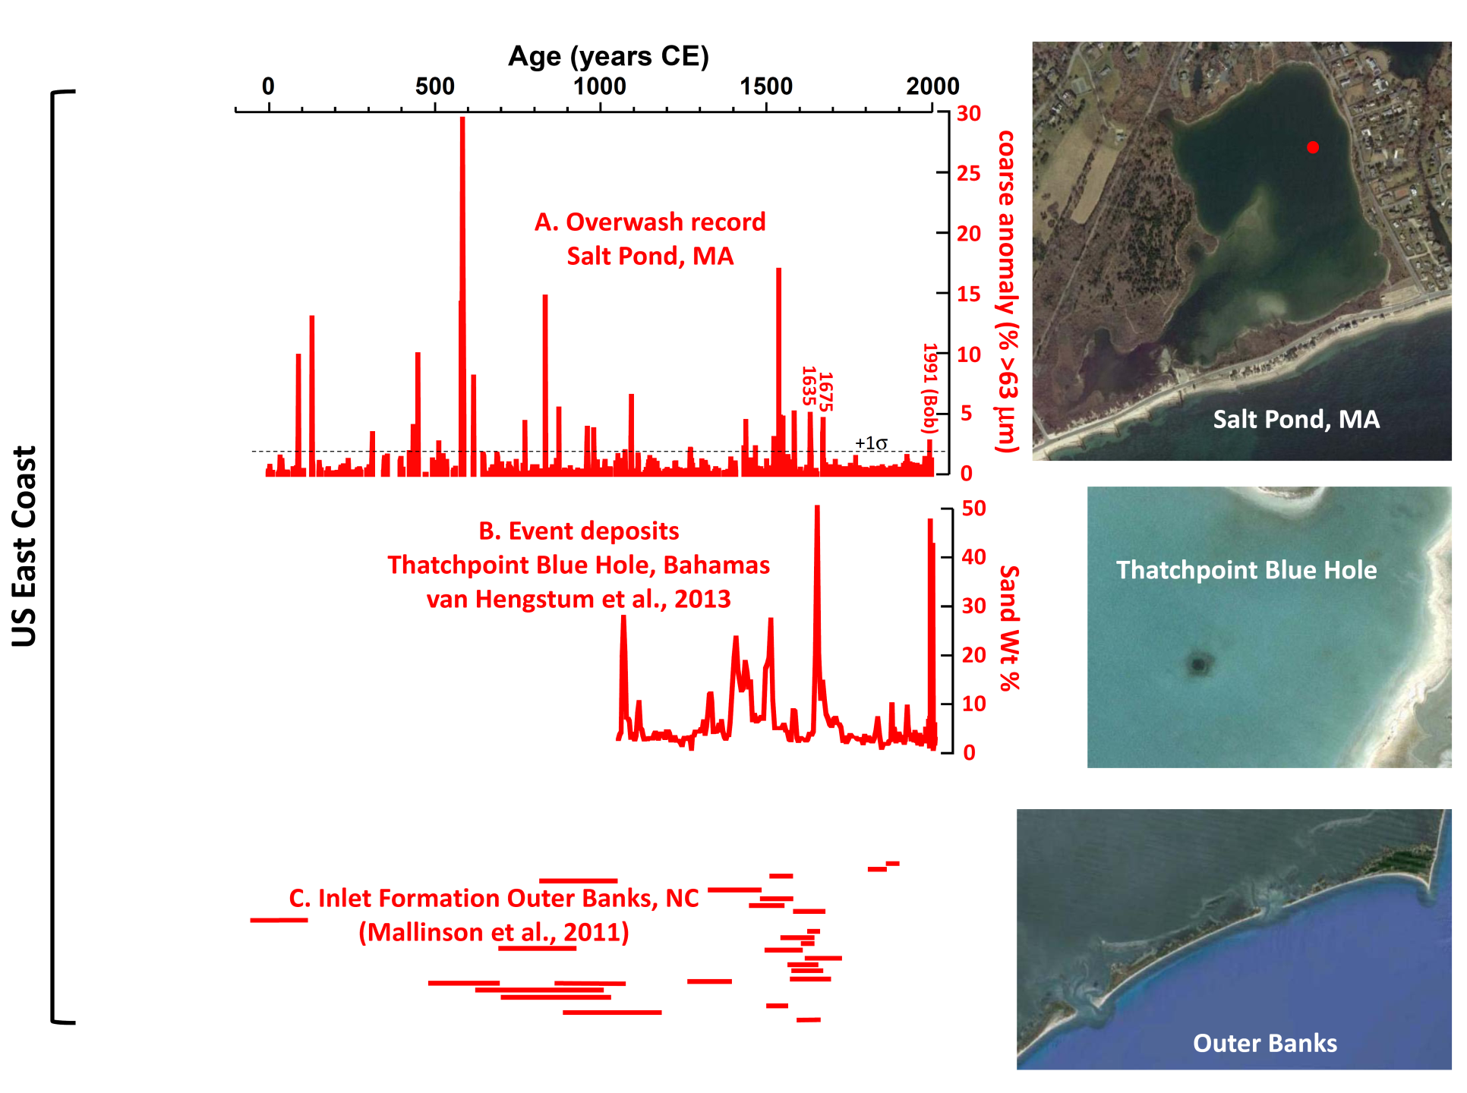
Evidence of East Coast Intense Hurricanes

Slide 53
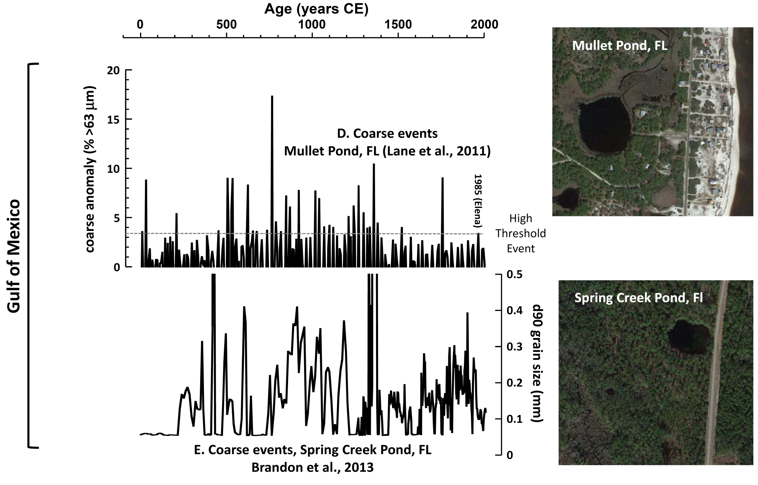
Evidence of Gulf Coast Intense Hurricanes

Slide 54
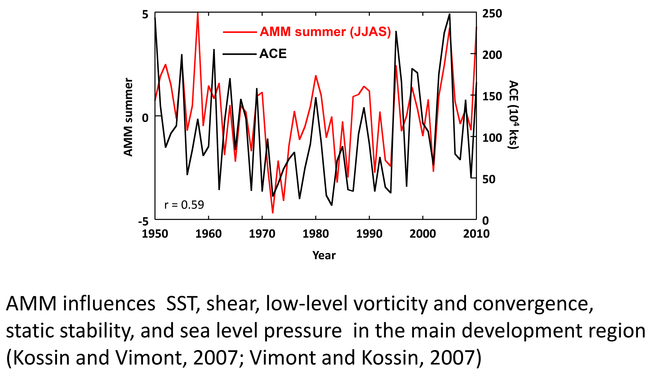
Atlantic Meridional Mode (AMM) and Hurricanes

Slide 55
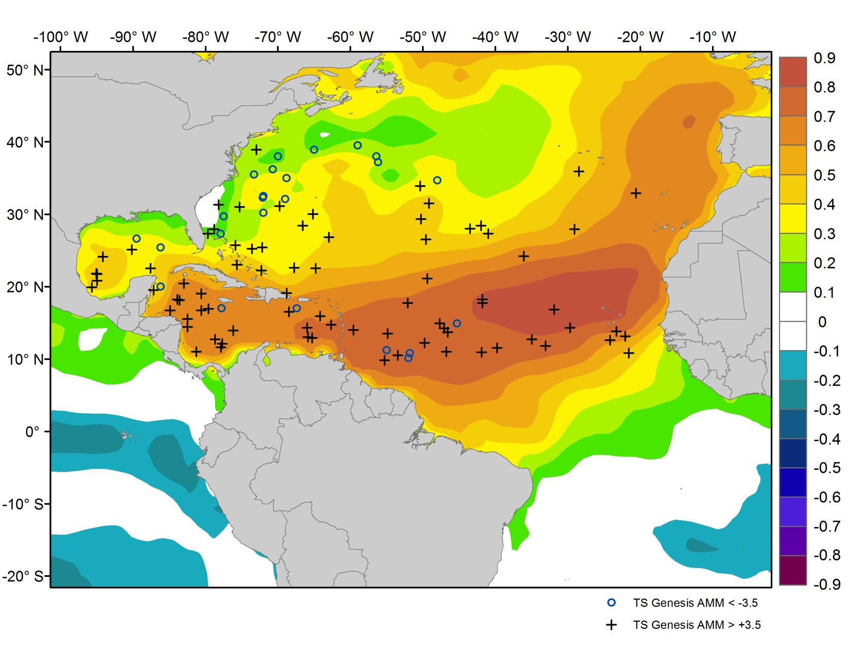
Atlantic Meridional Mode (AMM) and Hurricanes
AMM correlation with SST

Slide 56
Centennial AMM like forcing of Hurricanes?
de Menocal et al., 2000
AMM correlation with SST

Slide 57
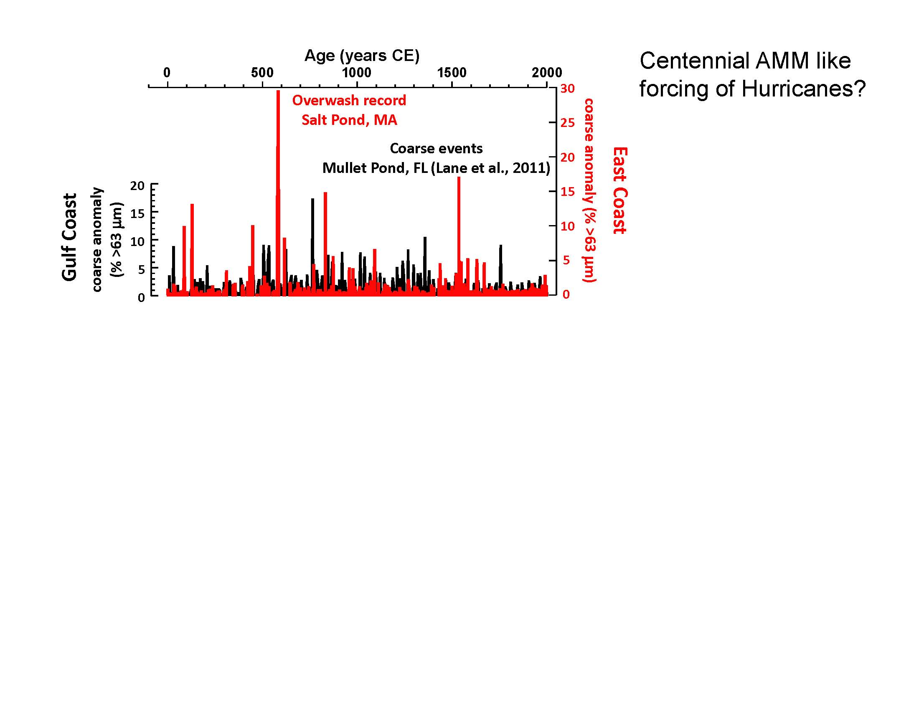

Slide 58
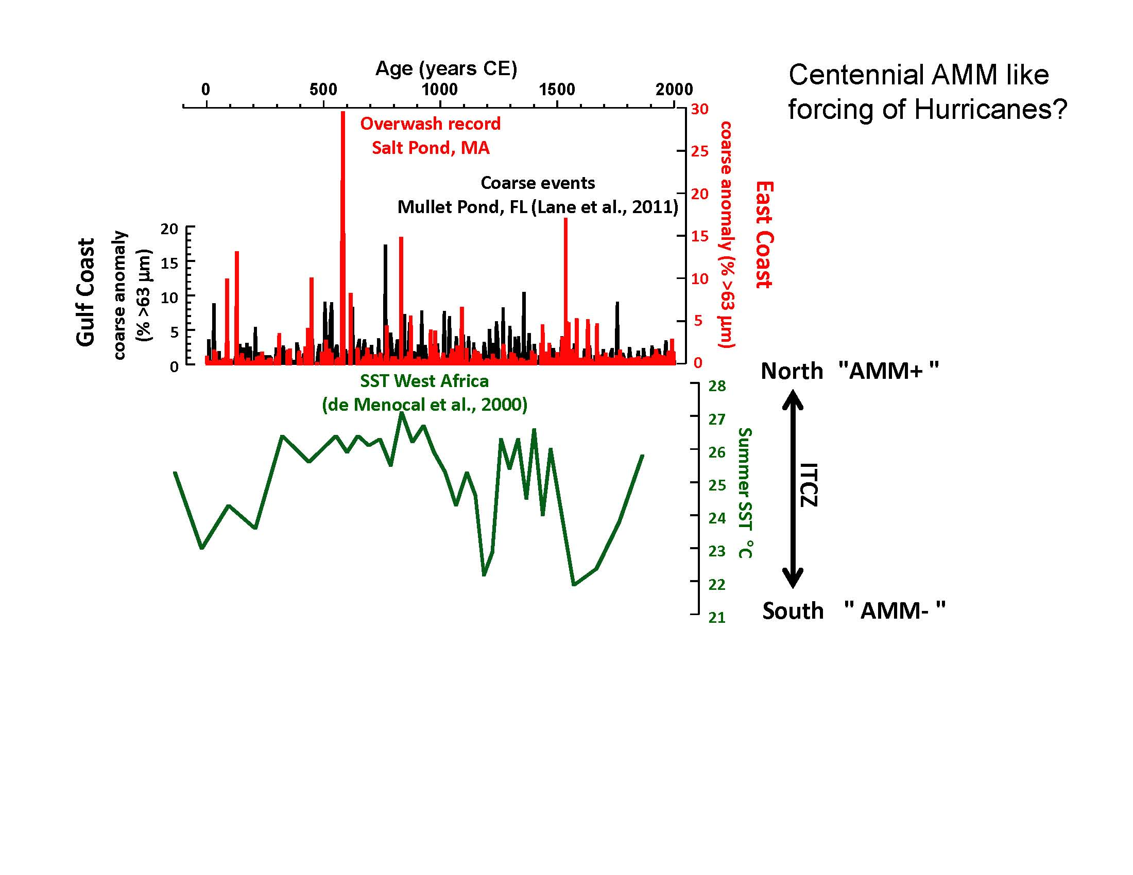

Slide 59
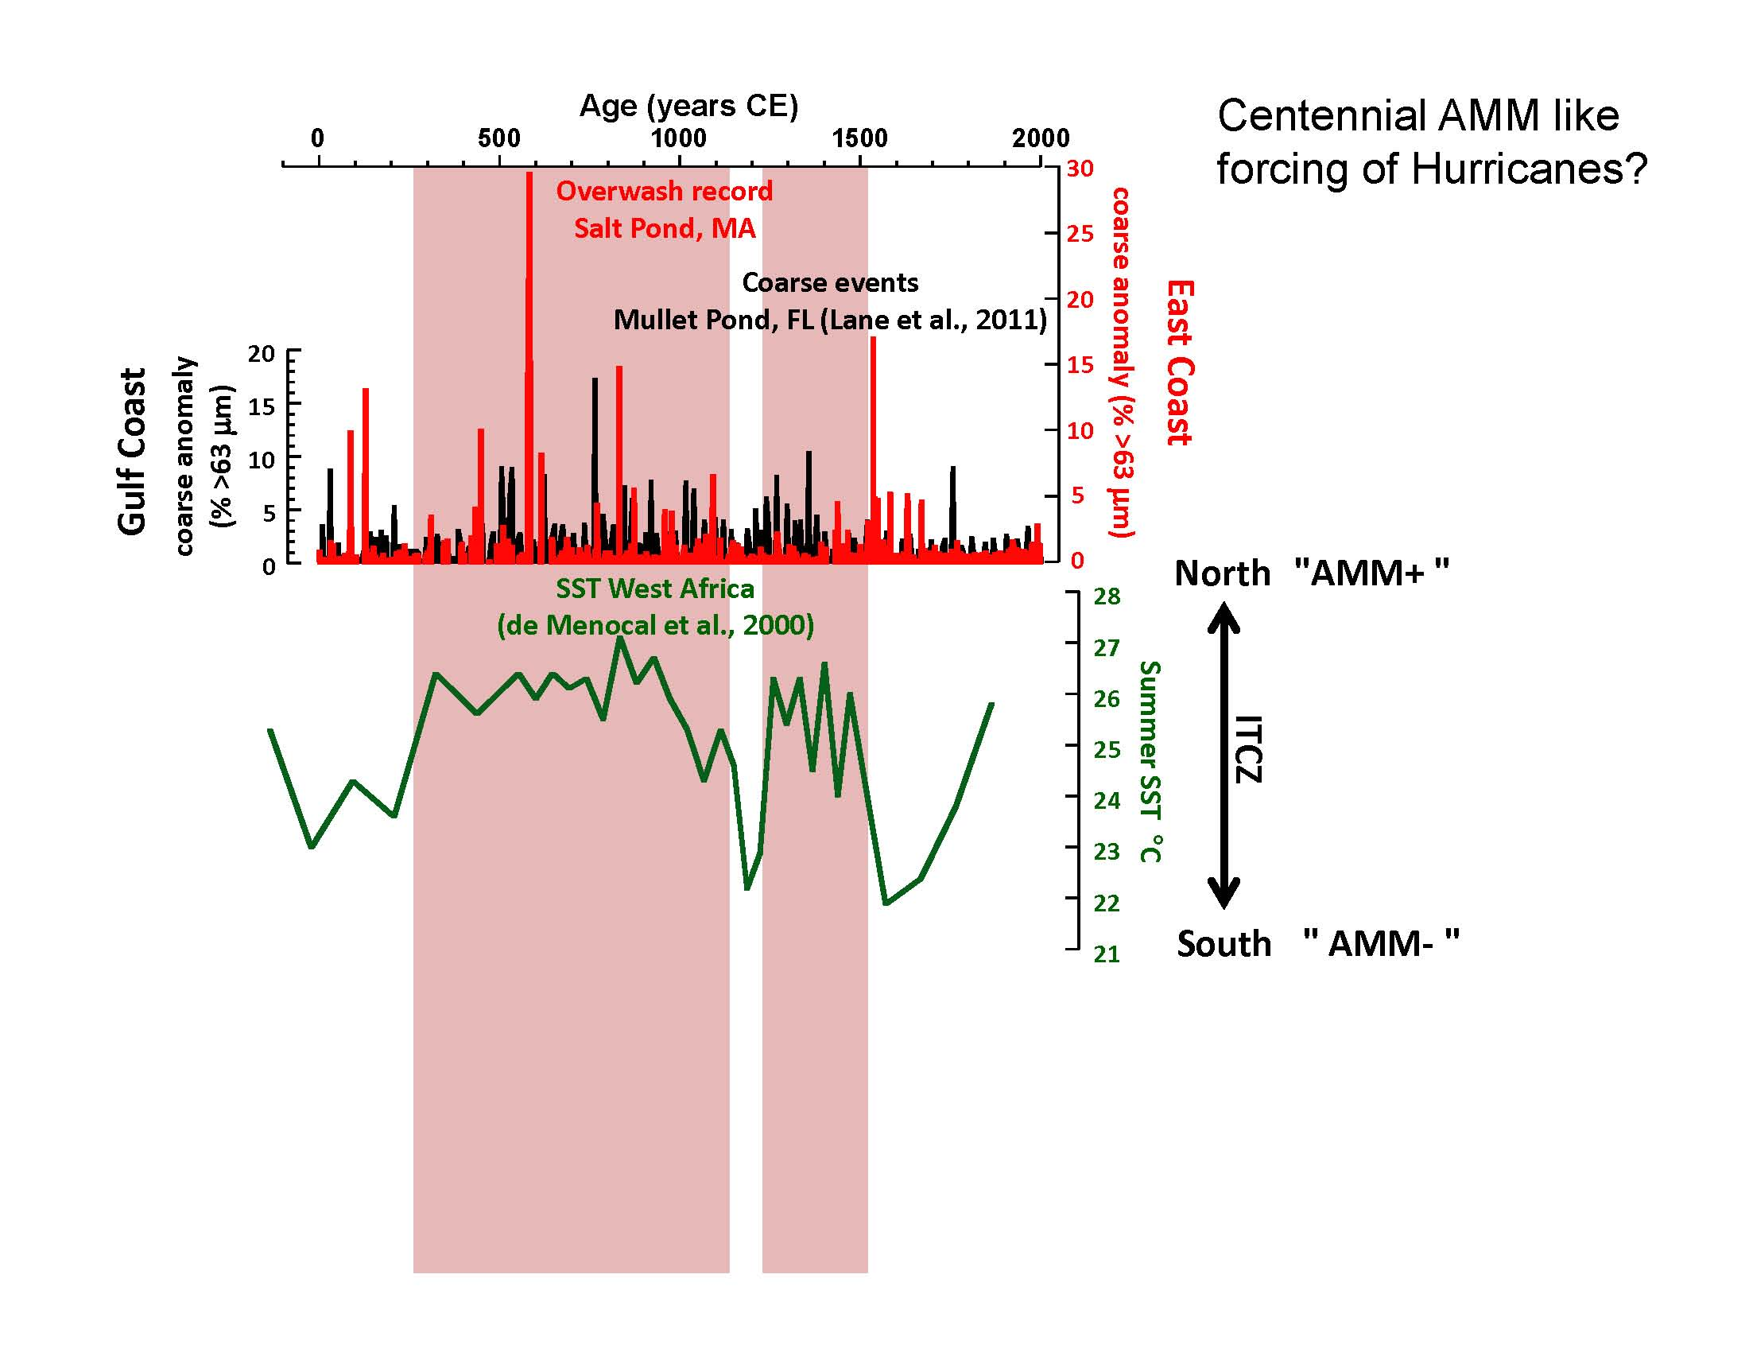

Slide 61
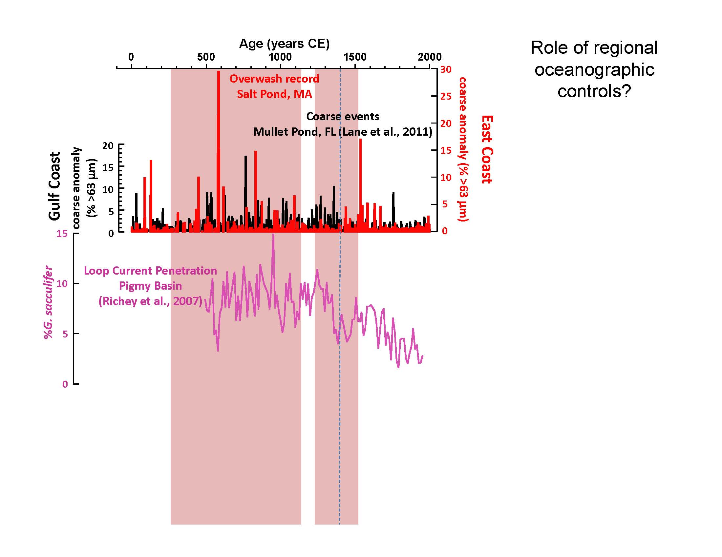

Slide 62
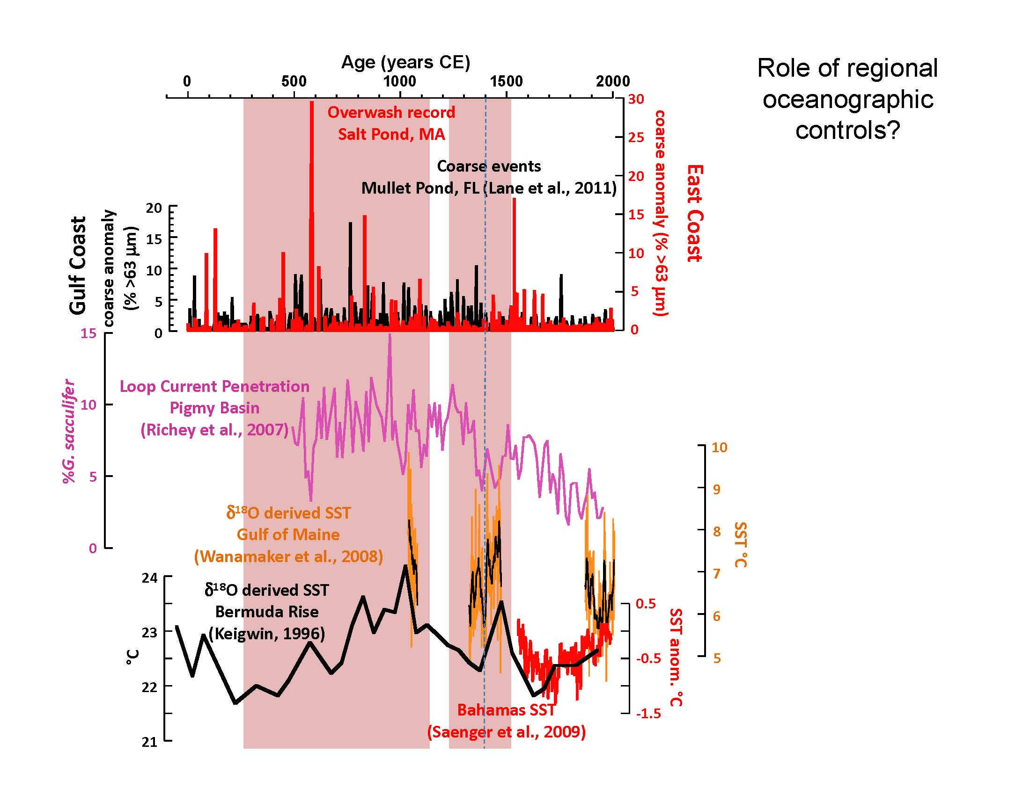

Slide 63
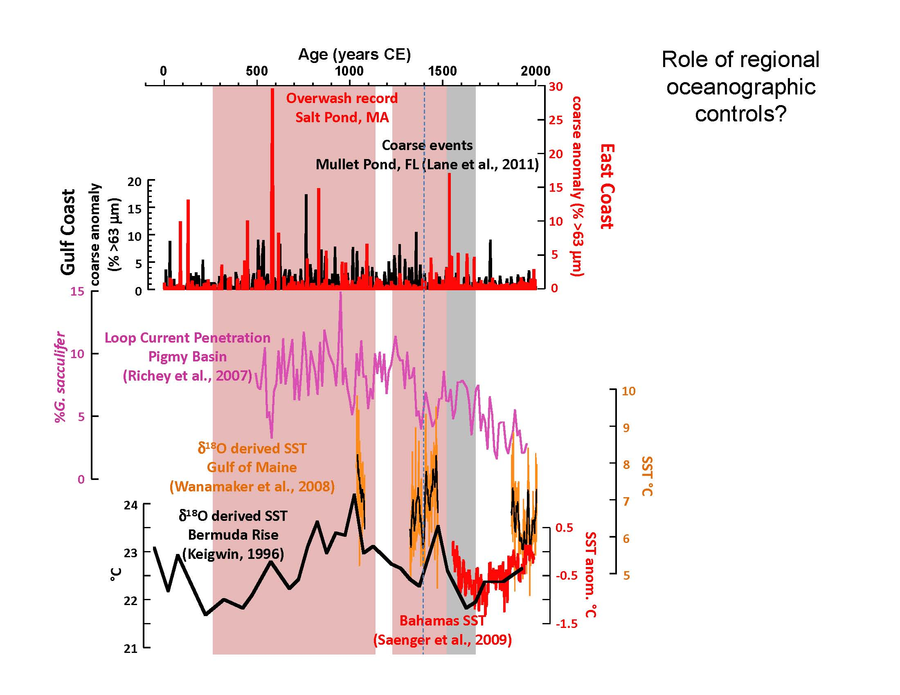

Slide 64
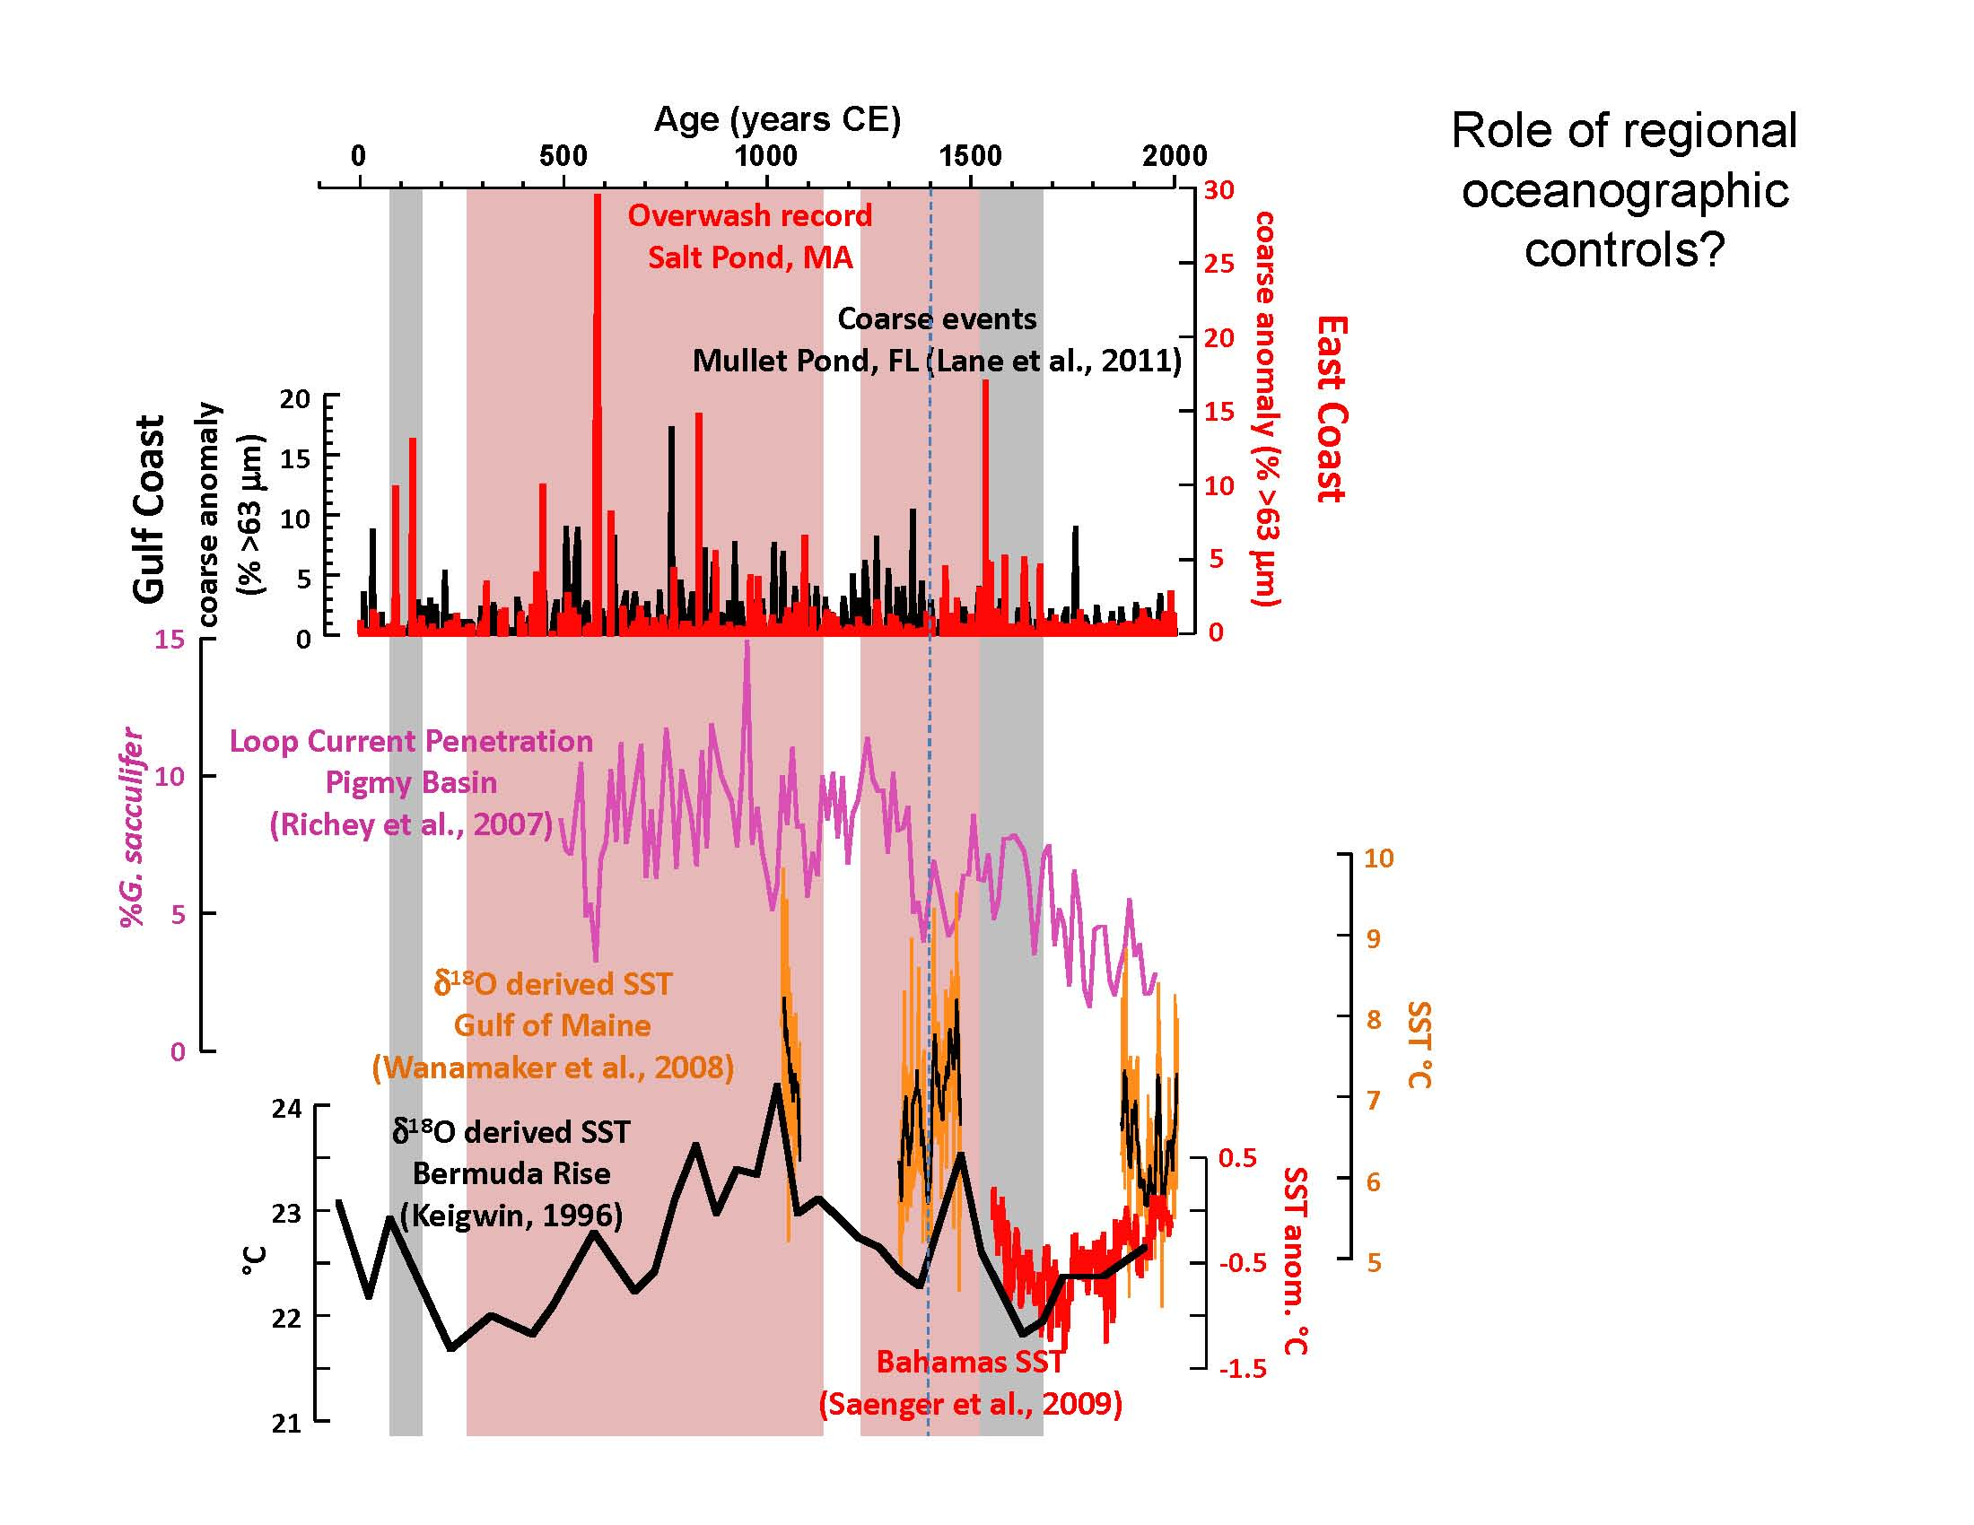

Slide 65
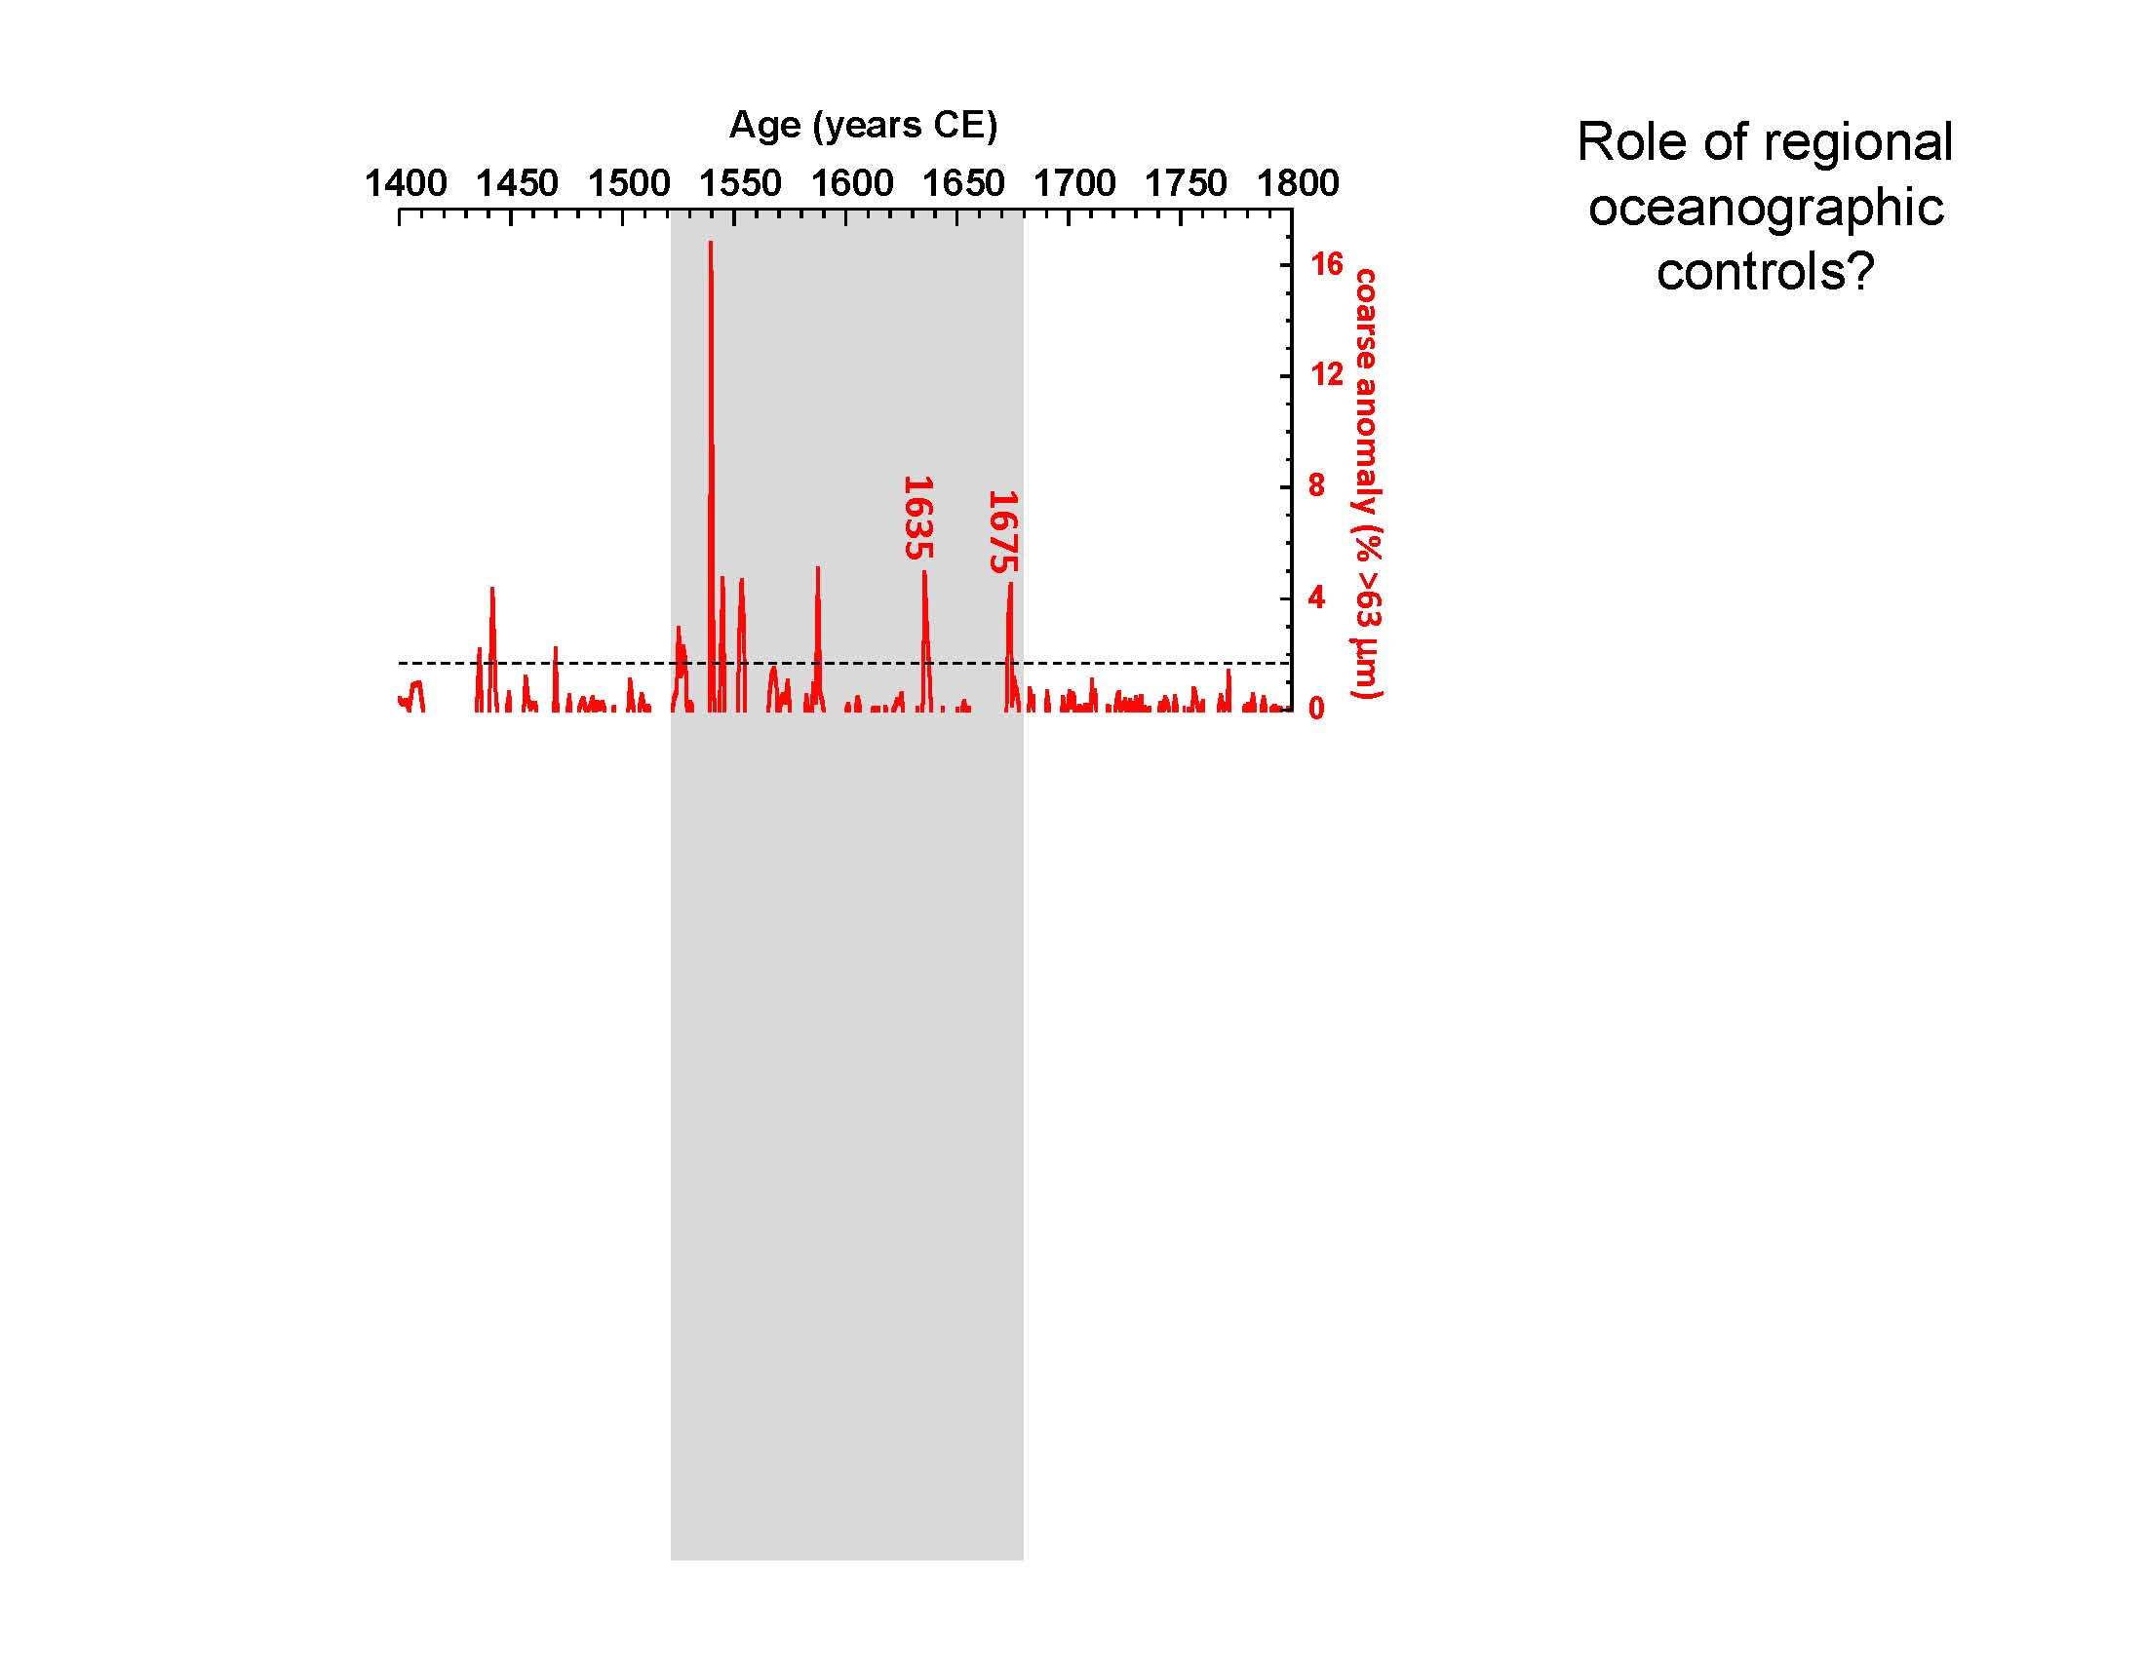

Slide 66
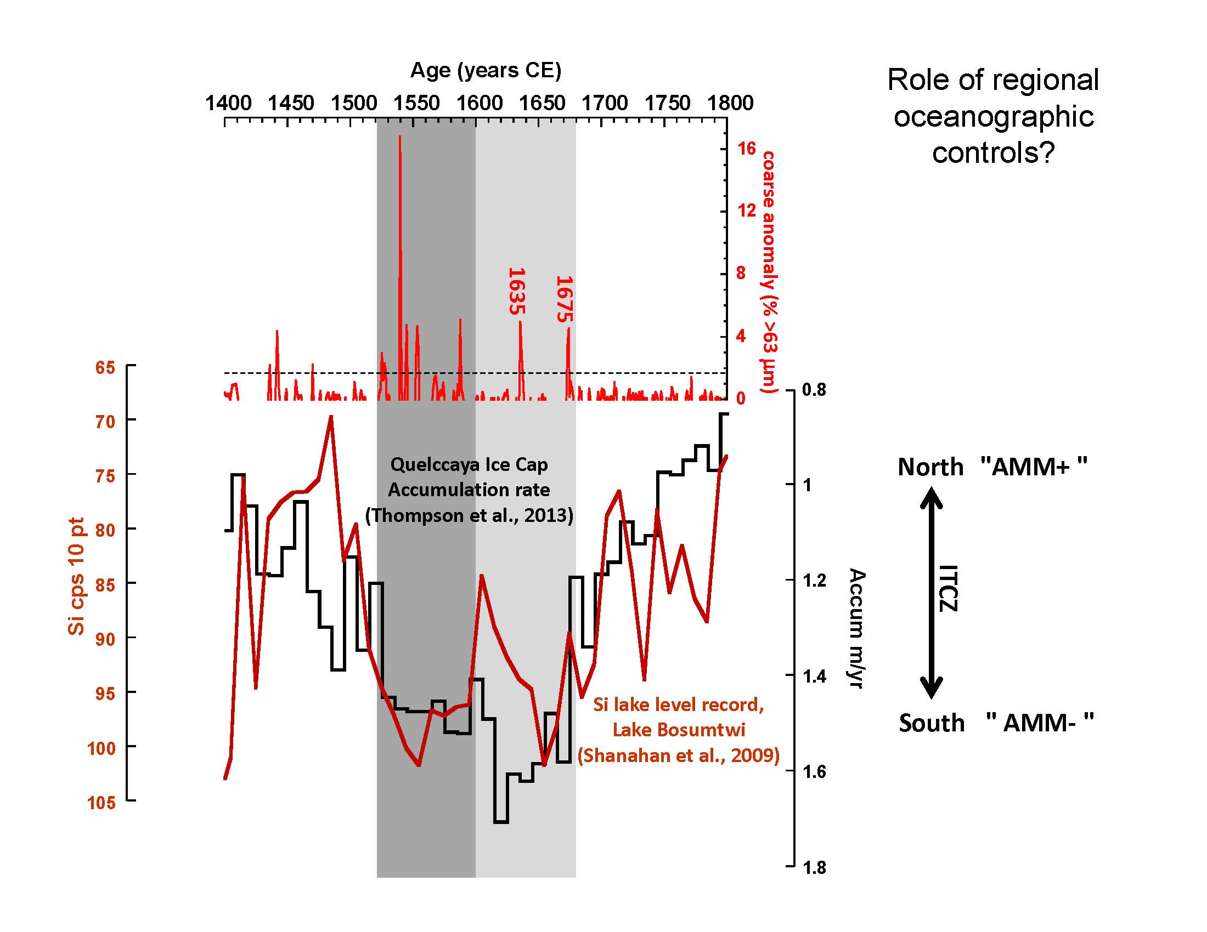

Slide 67
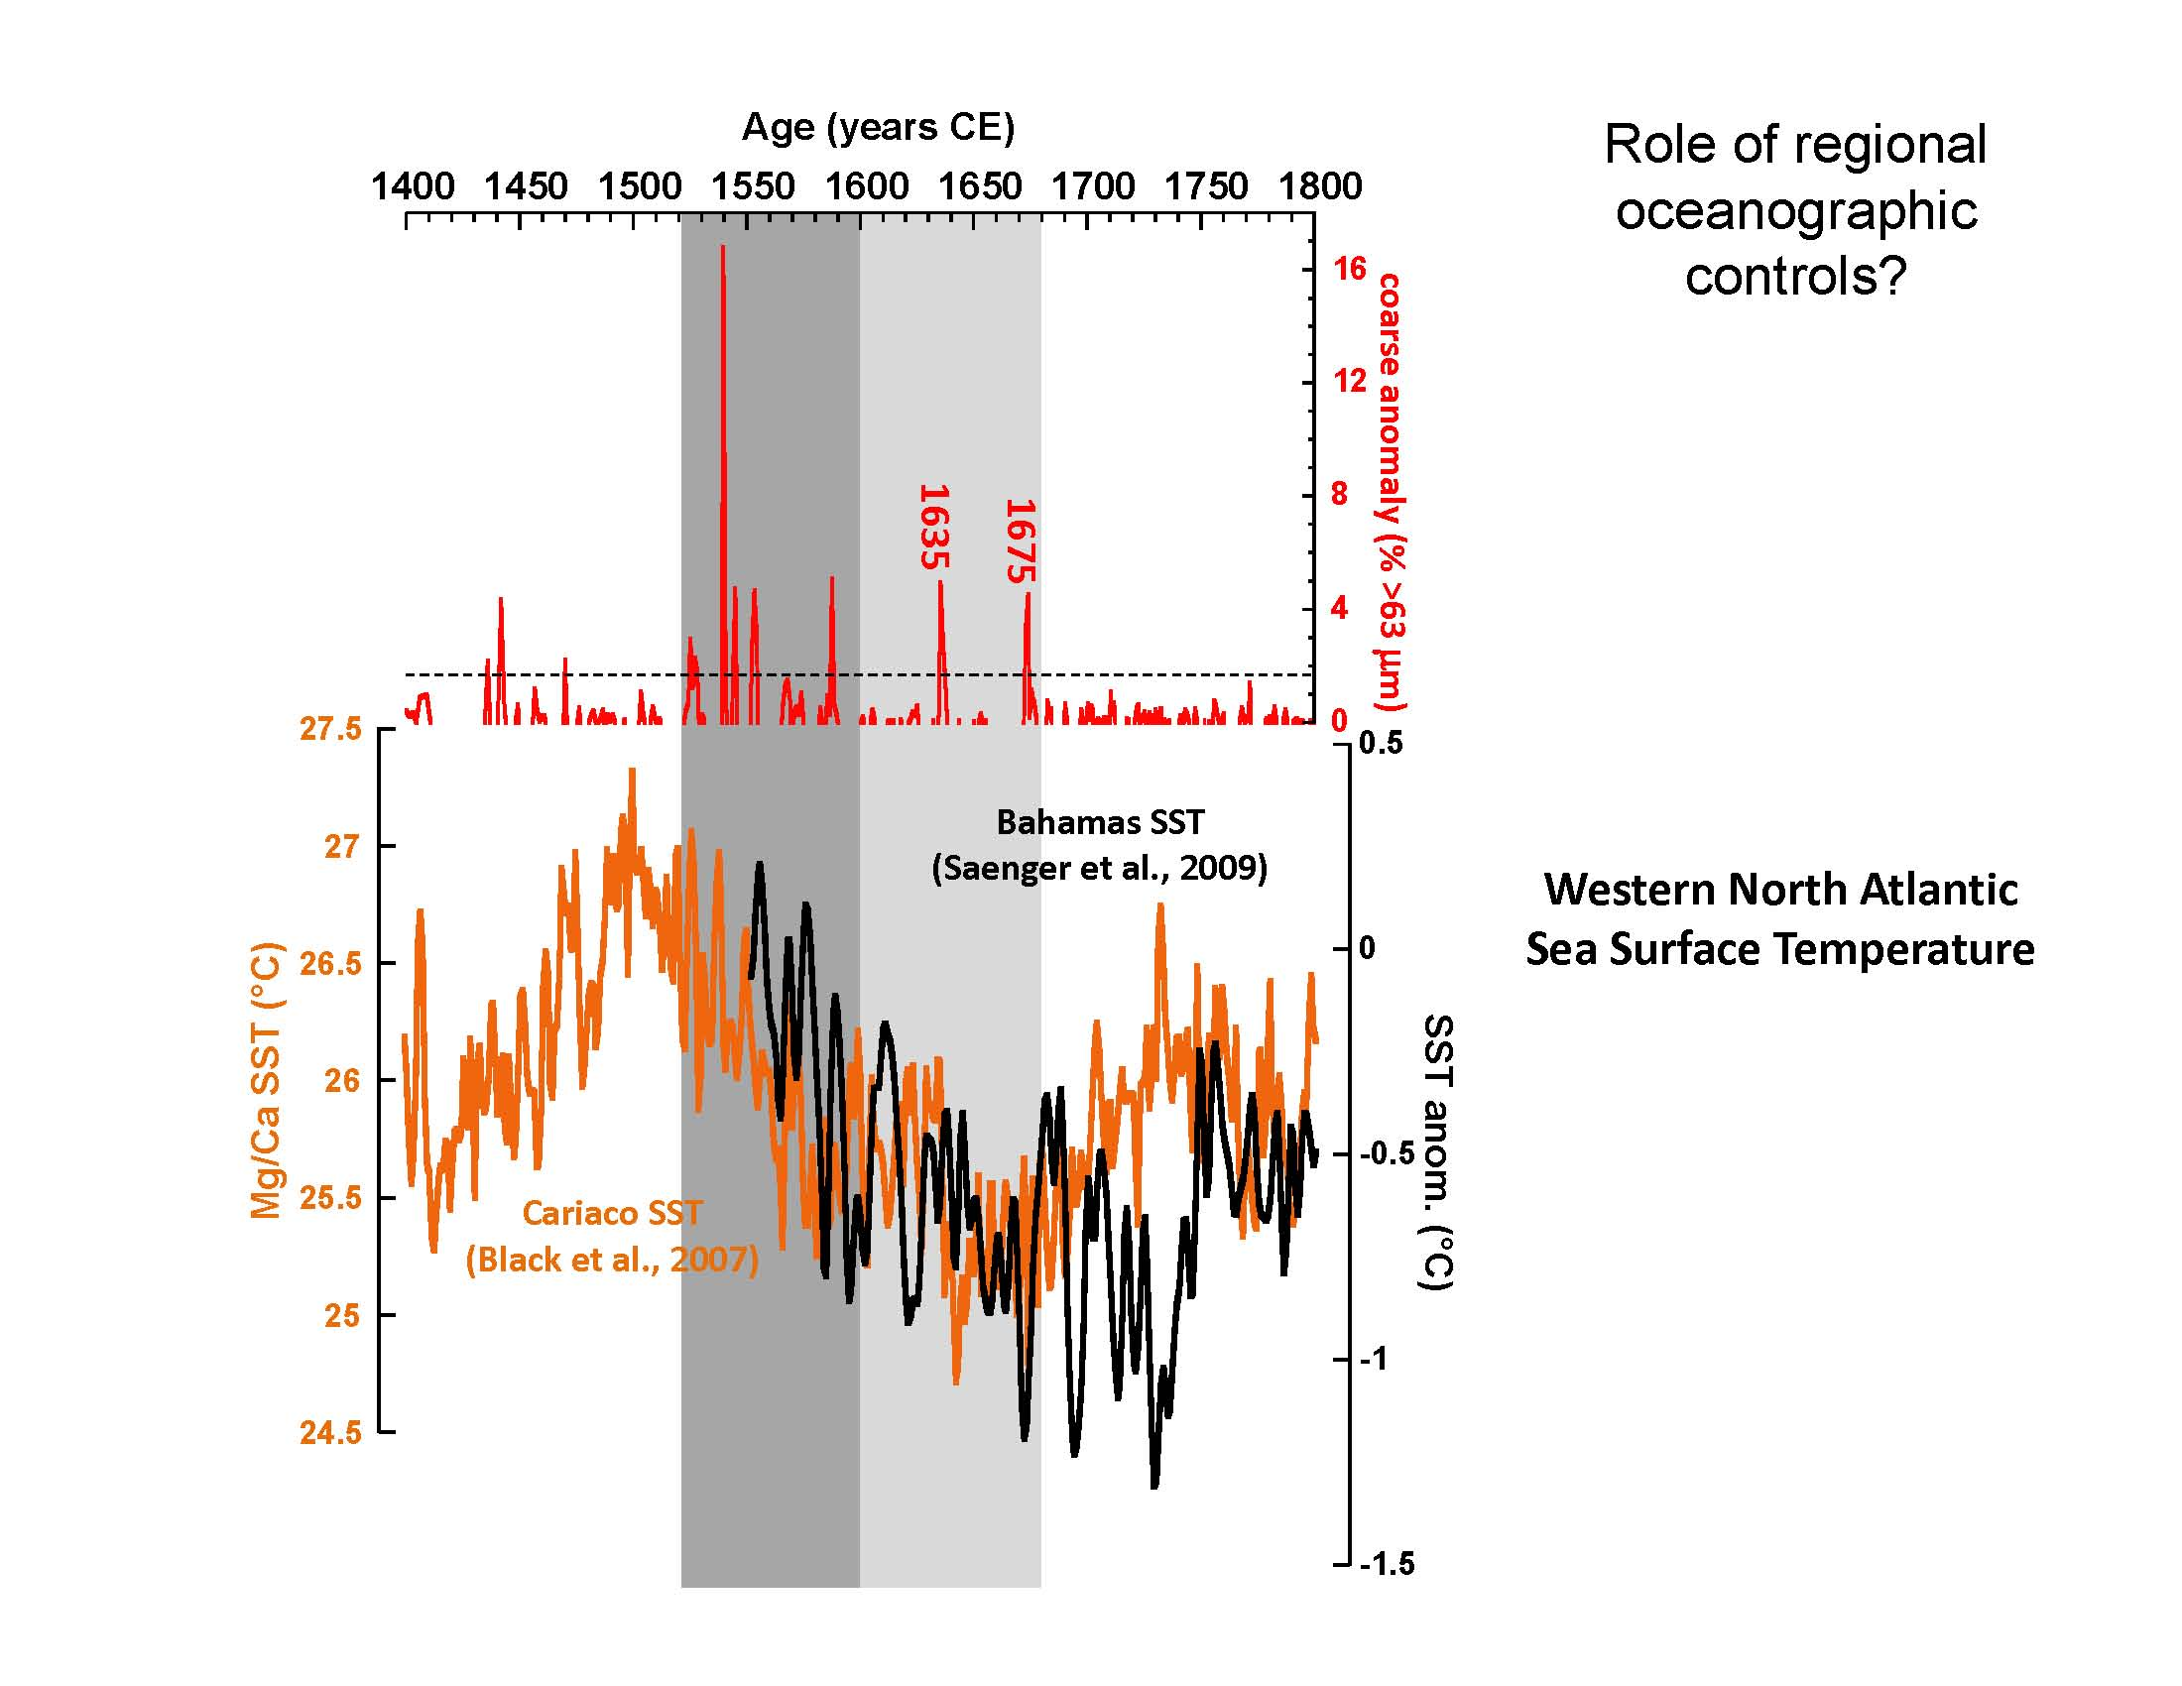

Slide 68
What Might the Future Hold?

Slide 69
What Might the Future Hold?
Rate of sea-level rise will continue to accelerate
IPCC AR5

Slide 70
What Might the Future Hold?
N. Atl. Tropical SST
N. Atl. Tropical Cyclones
N. Hem. Mean Temp
From
Coumou and Rahmstorf, 2012
Nature Climate Change

Slide 71
What Might the Future Hold?
N. Atl. Tropical SST
Frequency of
hurricanes
may increase
(particularly
intense storms)
N. Atl. Tropical Cyclones
N. Hem. Mean Temp
Using IPCC AR4 models
“Worst Case”
“Best Case”
Modern

Slide 72
What Might the Future Hold?
Frequency of
hurricanes
may increase
(particularly
intense storms)
From Emanuel, 2013 PNAS
Using IPCC AR5 models

Slide 73
Summary
NY and NJ had been relatively
fortunate over the last 100+ years
(unfortunately this was a time of unprecedented coastal development)

Slide 74
Summary
NY and NJ had been relatively
fortunate over the last 100+ years
(unfortunately this was a time of unprecedented coastal development)
Storms of far greater intensity than
Hurricane Sandy (and Bob) impacted
the region historically (and prehistorically)

Slide 75
Summary
NY and NJ had been relatively
fortunate over the last 100+ years
(unfortunately this was a time of unprecedented coastal development)
Storms of far greater intensity than
Hurricane Sandy (and Bob) impacted
the region historically (and prehistorically)
Historically unprecedented
intense hurricane activity occurred
over the last two millennium

Slide 76
Summary
NY and NJ had been relatively
fortunate over the last 100+ years
(unfortunately this was a time of unprecedented coastal development)
Storms of far greater intensity than
Hurricane Sandy (and Bob) impacted
the region historically (and prehistorically)
Historically unprecedented
intense hurricane activity occurred
over the last two millennium
Thus assessments based on historical archives may
significantly underestimate the risk

Slide 77
Summary
Both basin-wide and regional changes in ocean/atmospheric dynamics appear to have played a role in driving intense hurricane activity over the last few millennia

Slide 78
Summary
Both basin-wide and regional changes in ocean/atmospheric dynamics appear to have played a role in driving intense hurricane activity over the last few millennia
Centennial-scale shifts in meridional SSTs and associated migration of the ITCZ (akin to AMM) played an important role in driving basin-wide changes in intense hurricane activity.
Shift in intense hurricane activity from the Gulf Coast to the East Coast around 1400 CE (the onset of the Little Ice Age) was likely forced by regional changes in ocean circulation (Loop Current and Gulf Stream dynamics).
The interval of heightened intense hurricane activity along the eastern seaboard of the US between 1450 and 1675 CE may have been driven by increased cyclogenesis and elevated SSTs off the US east coast.

Slide 79
Summary
Increased hurricane activity along the eastern US seaboard is possible (perhaps even likely) in the coming decades
The impacts of future hurricane activity will be
greatly exacerbated by continuing sea-level rise
and coastal population growth, regardless of whether or not we experience significant increases in hurricane landfalls

Slide 80
What if the1635 hurricane hit today?
Falmouth
3.6 m of inundation

Slide 81
What if the1635 hurricane hit today?

Slide 82
What if Sandy hit SE New England?
Sandy

Slide 83
What if Sandy hit SE New England?
~1.4 m of surge at Woods Hole

Slide 84
What if Sandy hit SE New England?
Woods Hole, MA
Monthly highest water Woods Hole tide gauge (above MHW)
SLOSH simulation for Woods Hole (above MHW)
SLOSH simulation for Woods Hole (above astronomical tide)
Hypothetical SE New England Sandy landfall
feet
meters
1635
15
4
1815
1954
(Carol)
3
1938
10
1944
1960 (Donna)
1991 (Bob)
Sandy
2
1727
1869
1804
Irene
5
1
0
0
1940
1945
1950
1955
1960
1965
1970
1975
1980
1985
1990
1995
2000
Year
Boldt et al. (2010)

