Slide 1
Taiwan Side Pilot Study:
Preliminary Results of Acoustics Experiment and Simulation
&
2009 Experiment Plan:
Measurement, Instrument, Deployment
Chi-Fang Chen Hsiang-Chih Chan Yung-Sheng Chiu
Yuan-Ying Cheng Chen-Fen Huang
(National Taiwan University)
Ruey-Chang Wei
(National Sun Yat-sen University)
Tony Chun-Wu Wang
(Taipei Maritime Technology Institute)

Slide 2
Outline
Preliminary results from the Pilot Study Experiment
  TL measurement and NL statistical distribution
  water depths comparisons of database and EK-500 indications
N x 2D TL simulation with 3D ocean environments
  propagation ranges in azimuths of low frequency source
  ocean environmental effects: SSP, sediment
Taiwanese experiment plan for ocean and seabed acoustics
  TL & NL measurement
  sediment and geoacoustic investigation

Slide 3
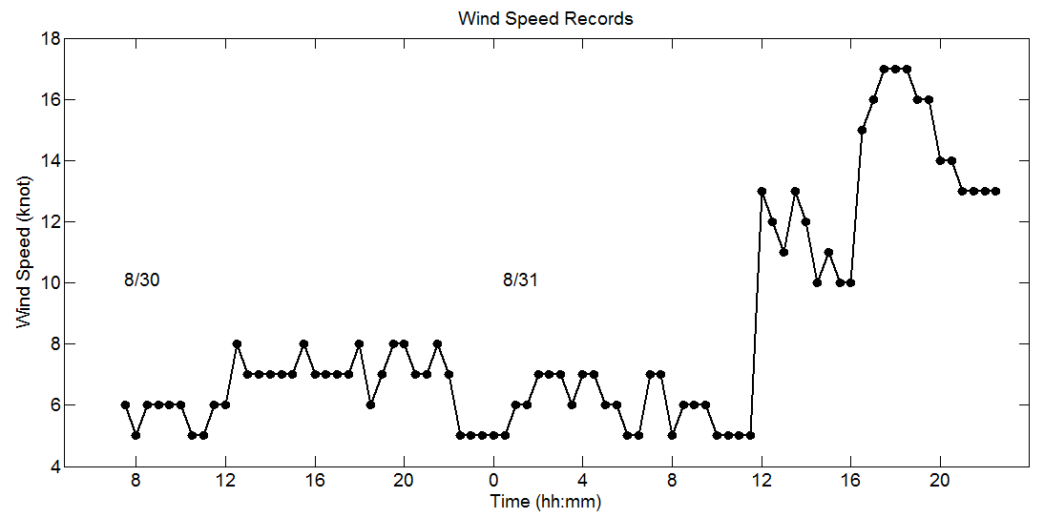
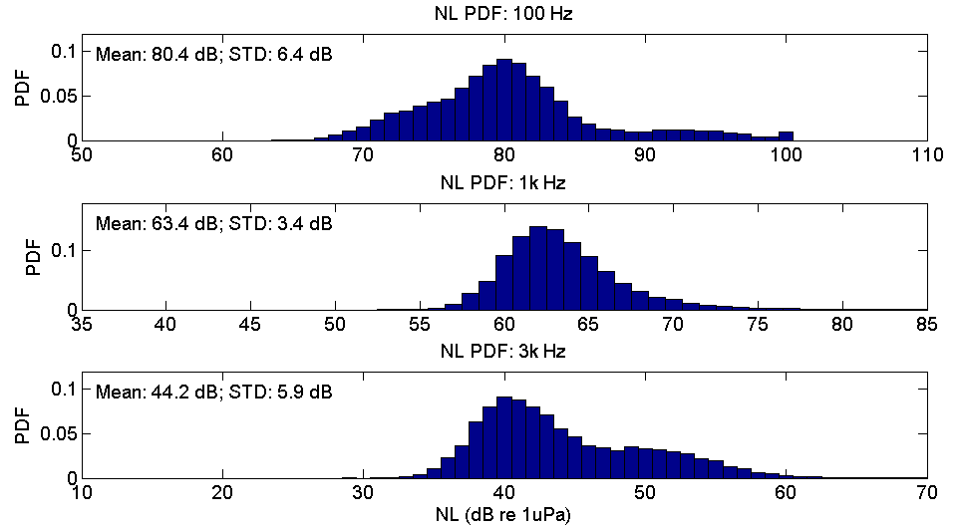
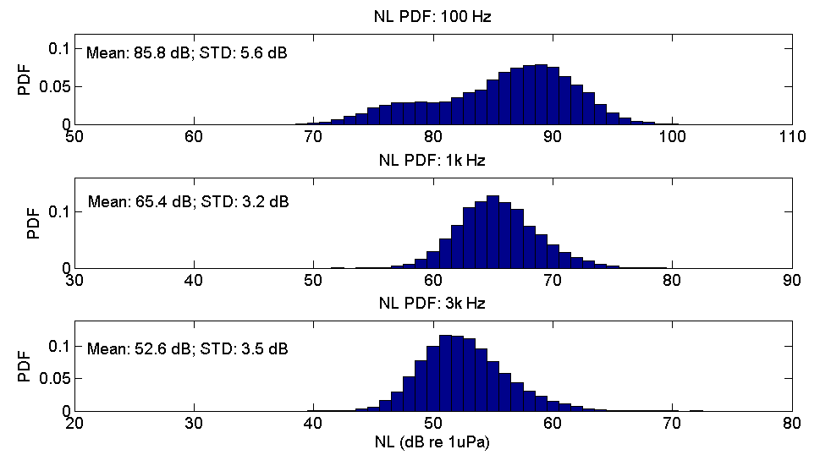
Ambient Noise Levels (April, 2008)
7節風速
16節風速

Slide 4
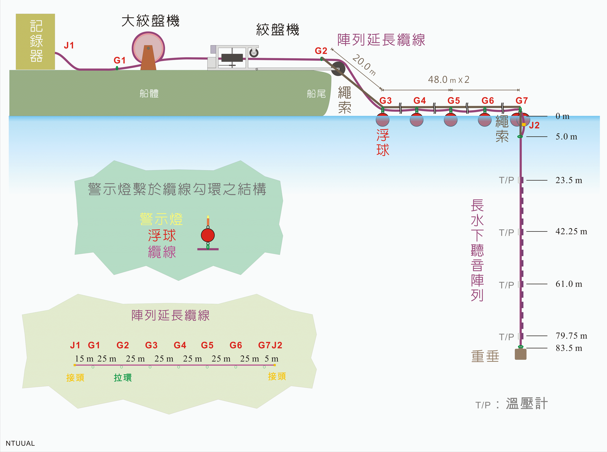

Slide 5
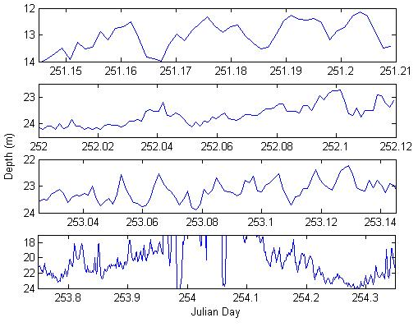
Vertical Displacements – Top Phone
14.4 mins
28.8 mins
28.8 mins
144 mins

Slide 6
Array Tilting
Task 1
Task 2
Task 3
Task 4

Slide 7
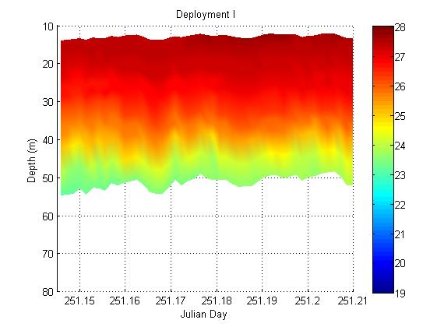
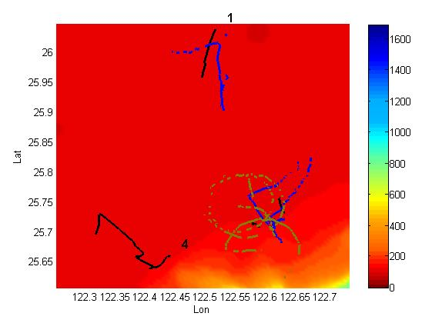
Temperature Data

Slide 8
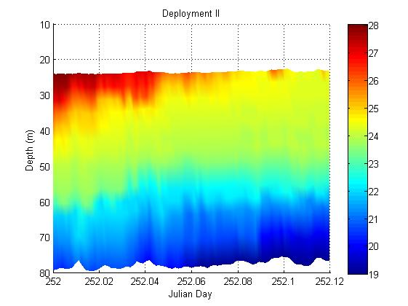
Temperature Data

Slide 9
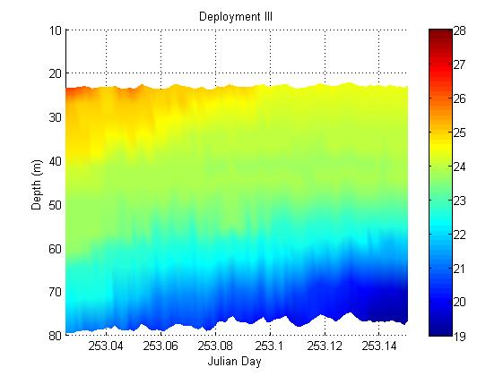
Temperature Data

Slide 10
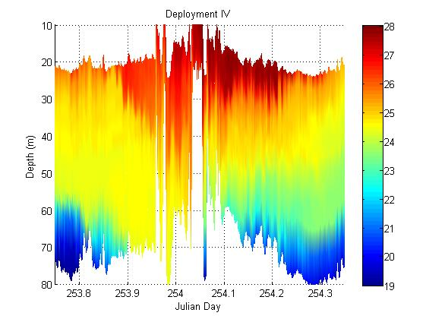
Temperature Data

Slide 11
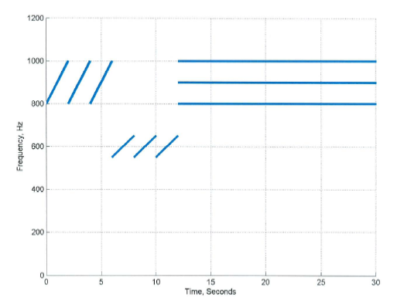
Source Signal
SL: 149.7 dB
SL: 142 dB
SL: 141 dB
SL: 139 dB
SL: 143.5 dB

Slide 12
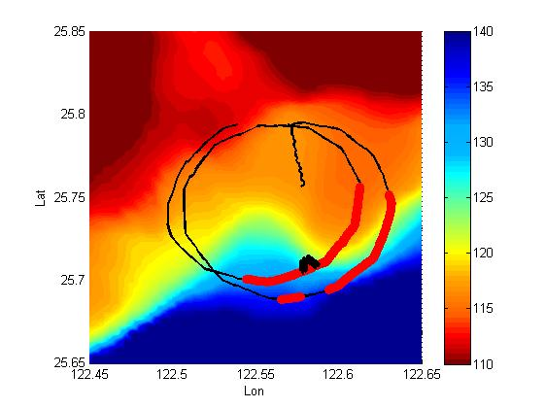
OMAS Run Event 4A

Slide 13
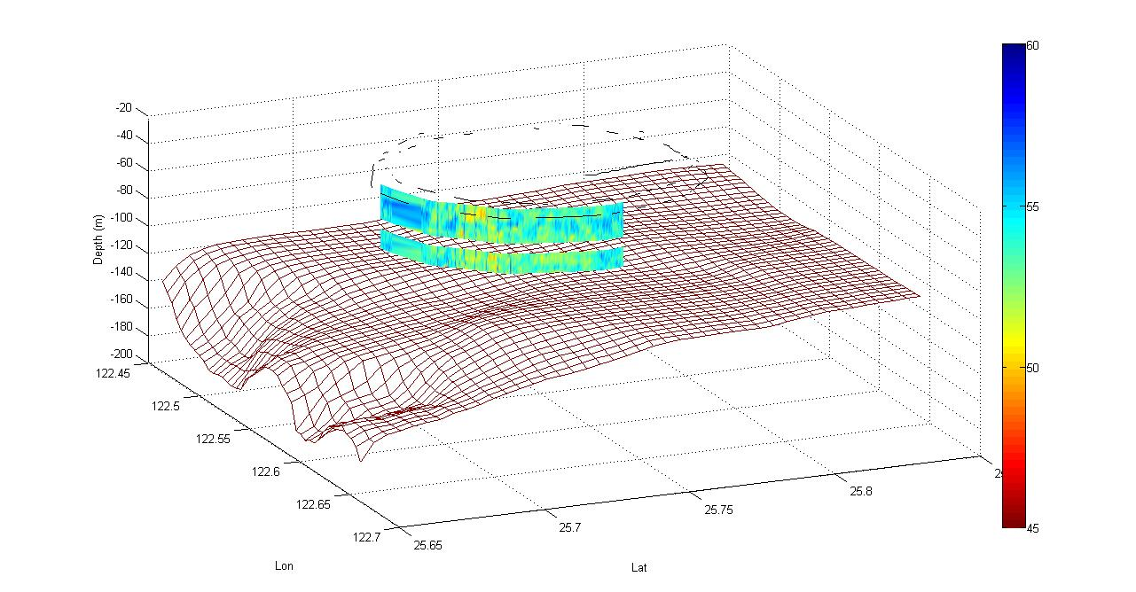
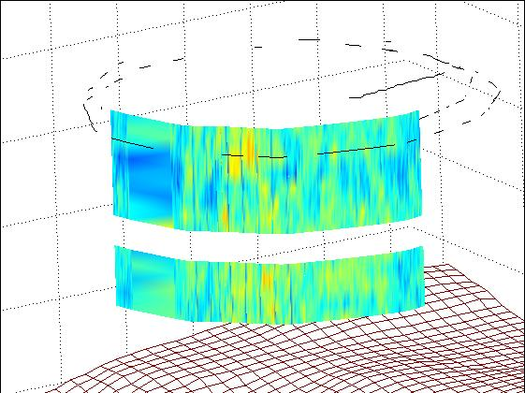
1100 Hz HFM

Slide 14
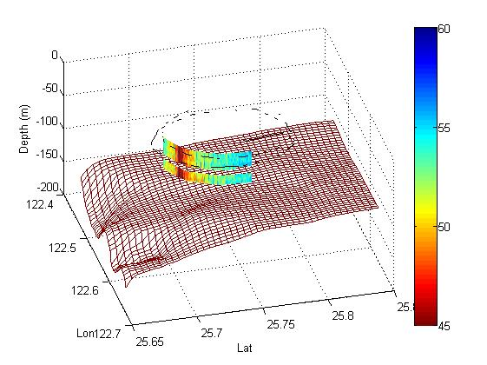
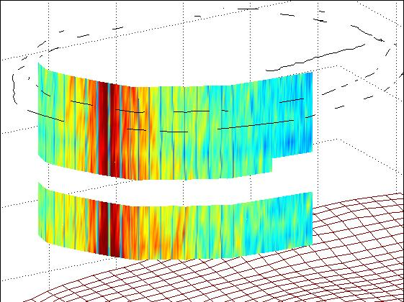
1100 Hz HFM

Slide 15
Simulation
NCOR Bathymetry
Hamilton interpolation geo-parameter curves (range dependent)
CTD SSP profile
2D PE Calculation

Slide 16
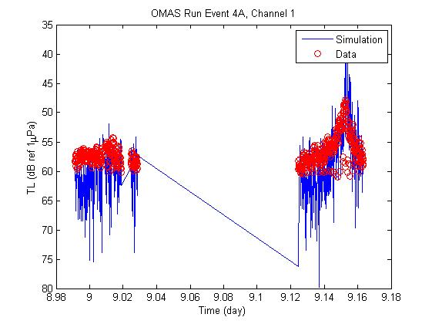
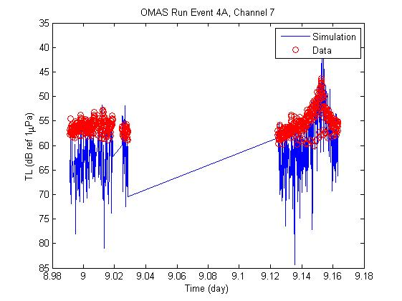
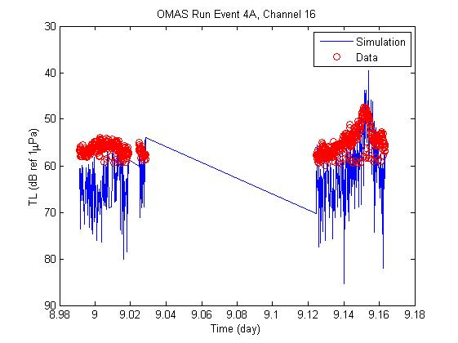
Simulation
Channel 1
Channel 7
Channel 16

Slide 17
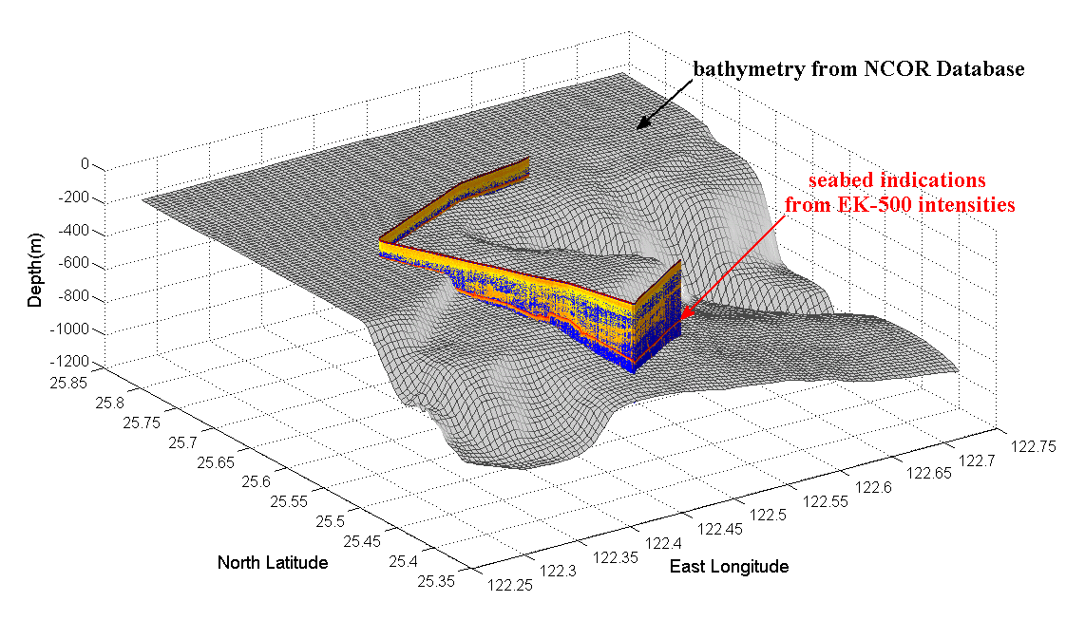
Uncertainty on Bathymetry

Slide 18
N x 2D TL Simulation
3D ocean environments
  sound speeds obtained from CTD casting
  density and sound speeds estimated by sediment sampling
  bathymetry data from NCOR of Taiwan
N x 2D TL Modeling
  acoustic modeling: RAM 1.5
  TL contour in azimuths at acoustic source depths
  propagation ranges of specific TL values (-80, -90, -100 dB)

Slide 19
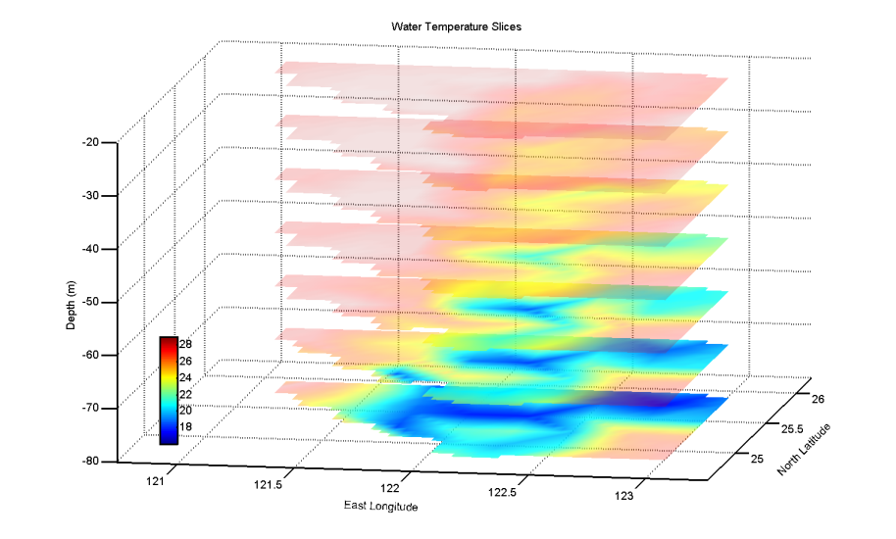
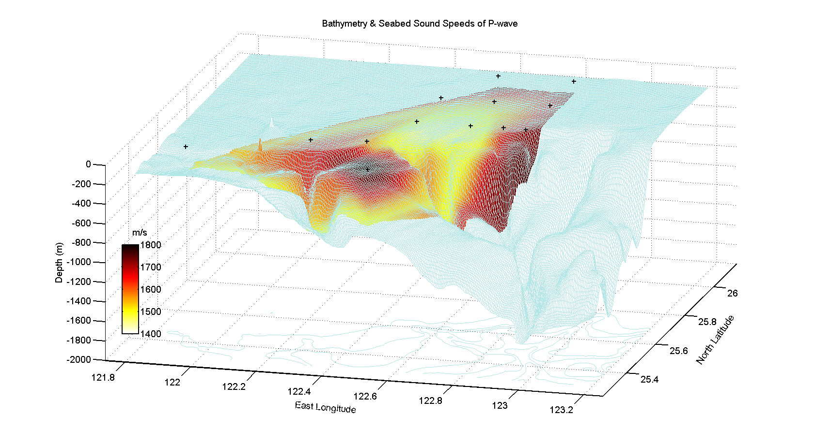
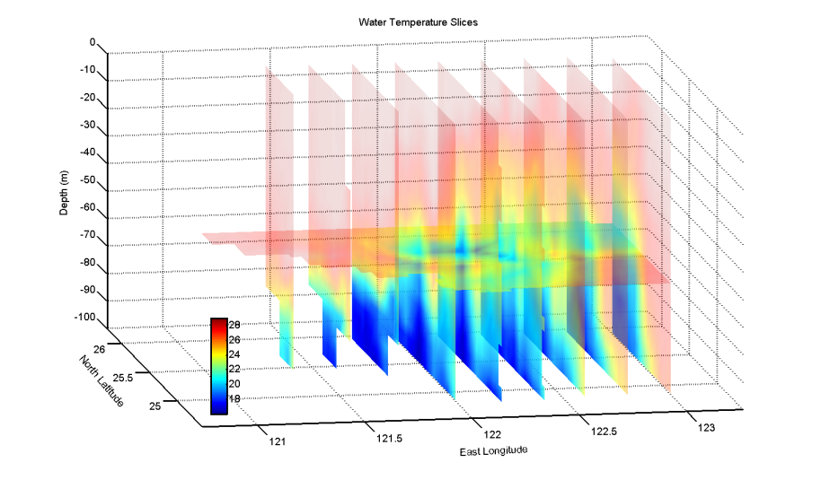
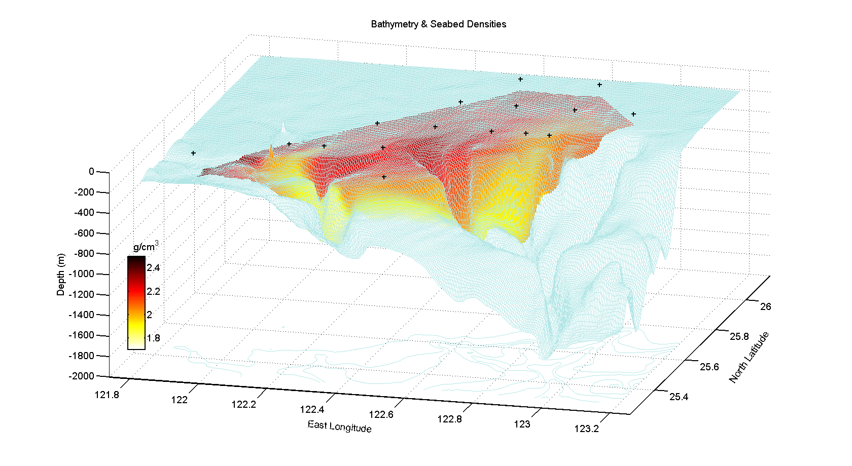
Ocean Environments
water temperature slices
sediment sound speeds & densities

Slide 20
Model Scheme
0
r
SSP
20 km
z
rz=10 m
sz
water depth
range-dependent environments
ρ_{s}
c_{s}
α_{s}
ρ_{s}=1.6~2.6 g/cm³
c_{s}=1400~1800 m/s
α_{s}=0.6 dB/λ
sediment depth
100 m
ρ_{b}=2 g/cm³
c_{b}1800 m/s
α_{b}=10 dB/λ
bottom depth
(artificial)
100 m
ρ_{b}
c_{b}
α_{b}

Slide 21
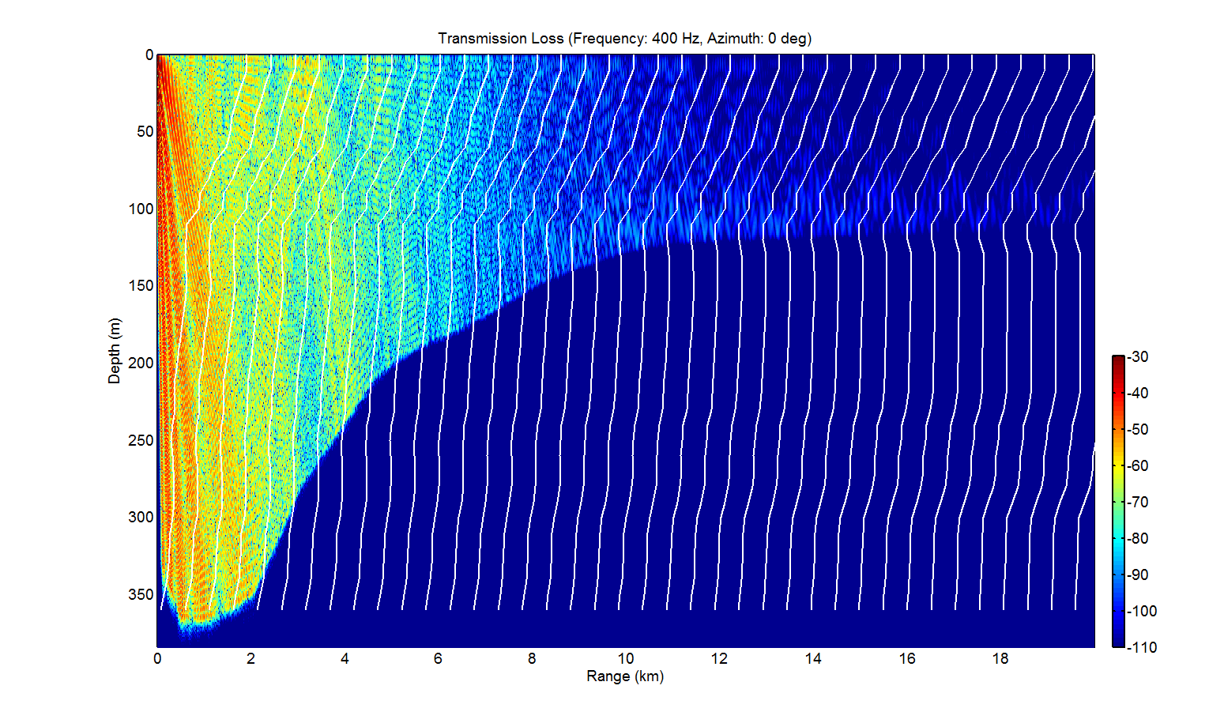
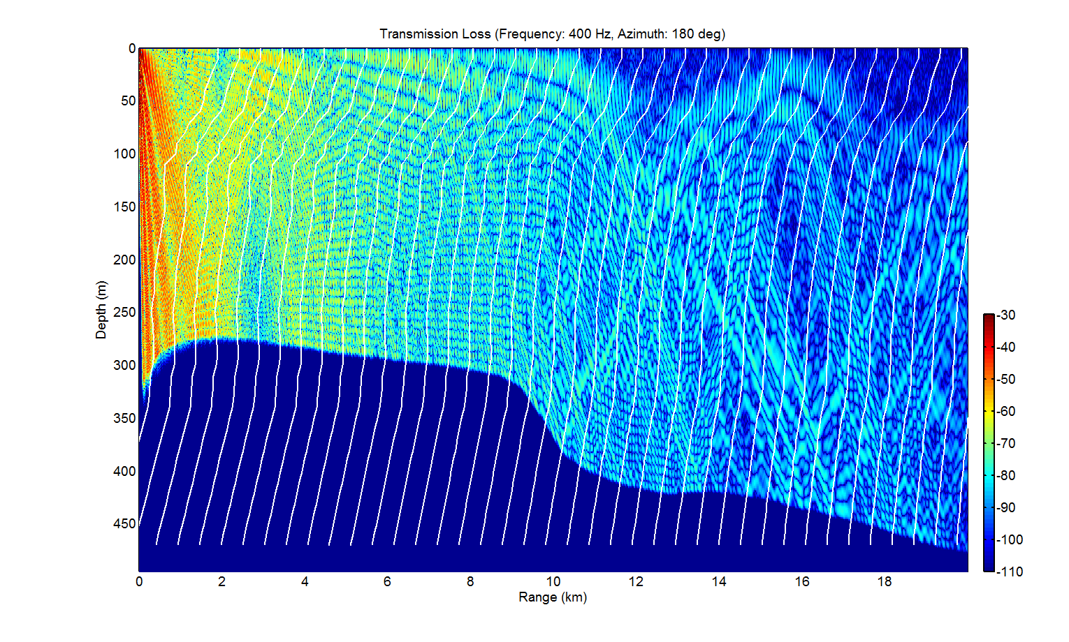
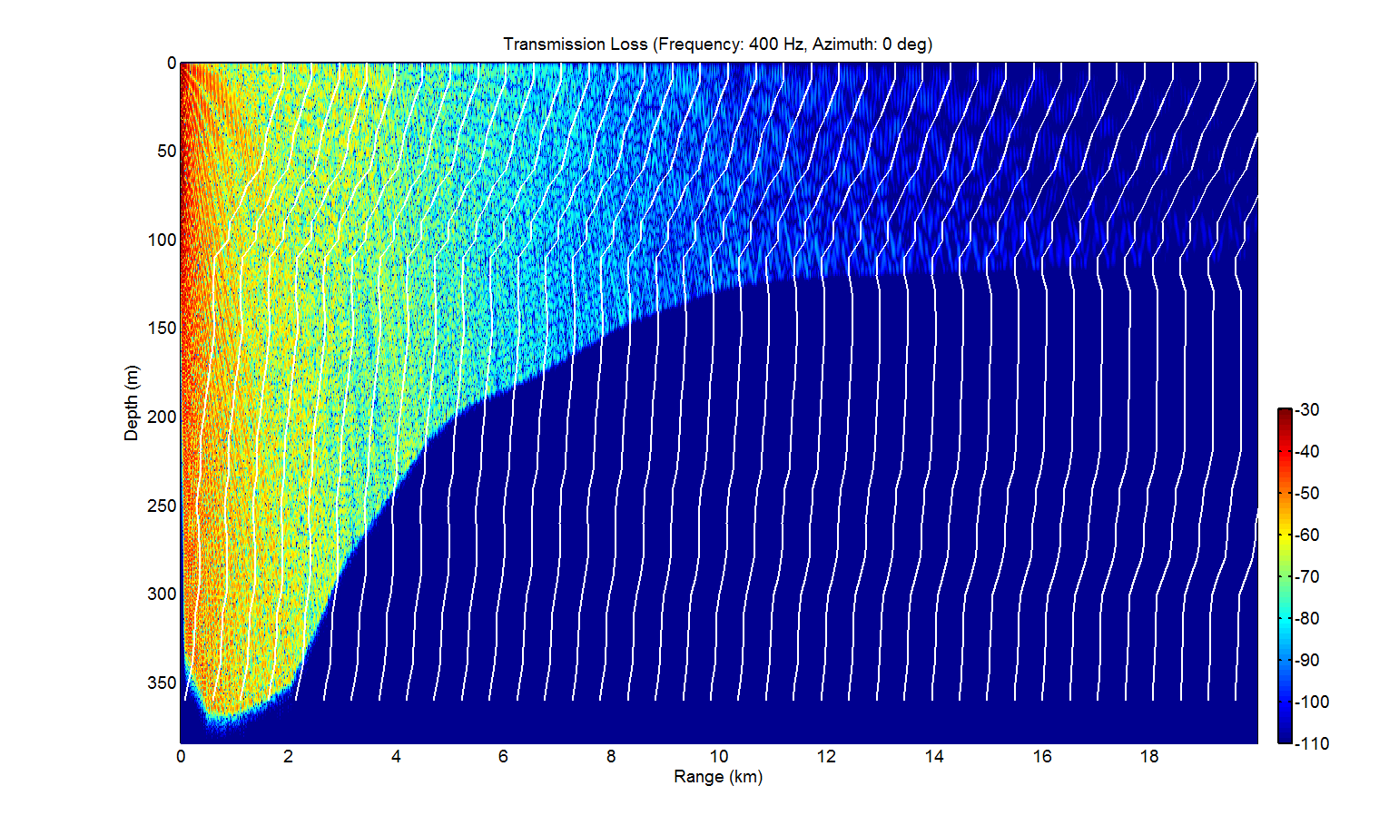
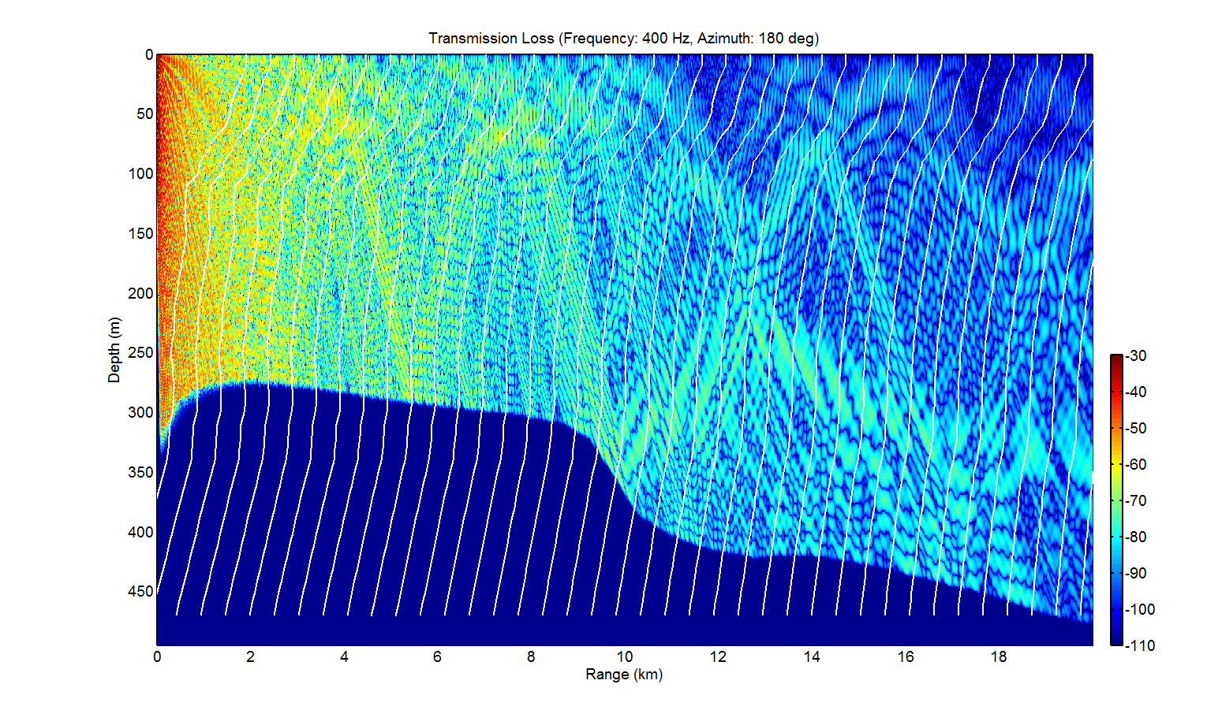
TL in Range-dependent Environments
SZ=10 m
SZ=60 m

Slide 22
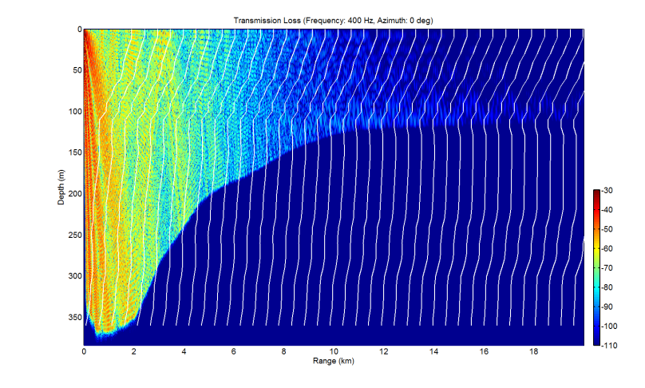
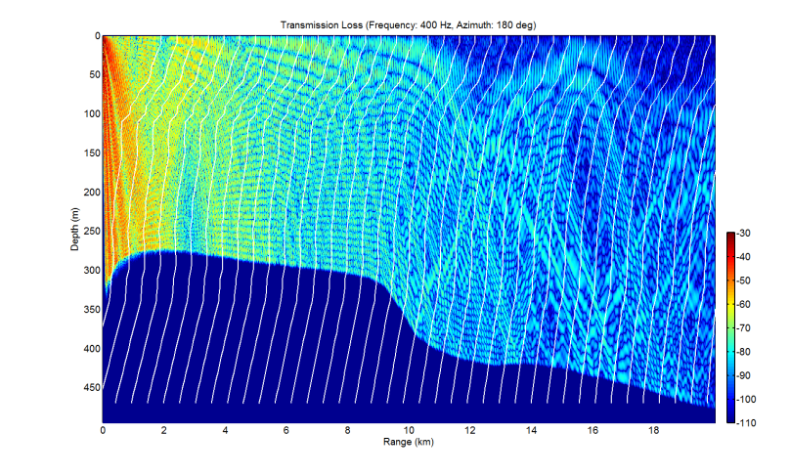
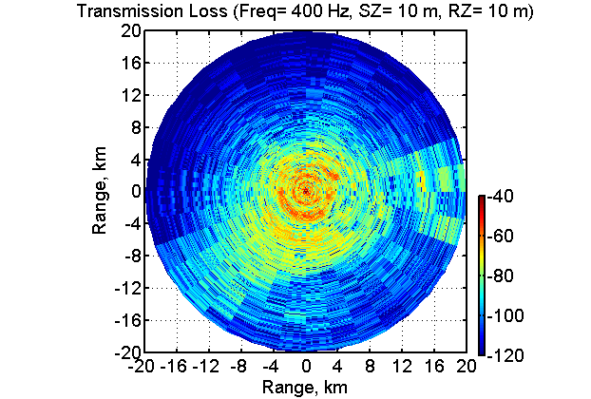
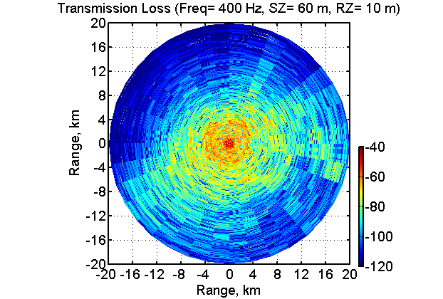
Transmission Loss at Azimuths

Slide 23
Modeling Conditions
Acoustic sources & receivers setting
  specific source depths: -10, -60, -110, -160 m
  consisted receiving depths: -10 m
  maximum propagation ranges: 20 km
Acoustic source locations
  inside cold dome (18 ℃ at 60 m deep)
  in the hot water (24 ℃ at 60 m deep)
  in the shallow water (continental-shelf)
  in the deep water (inside canyon)

Slide 24
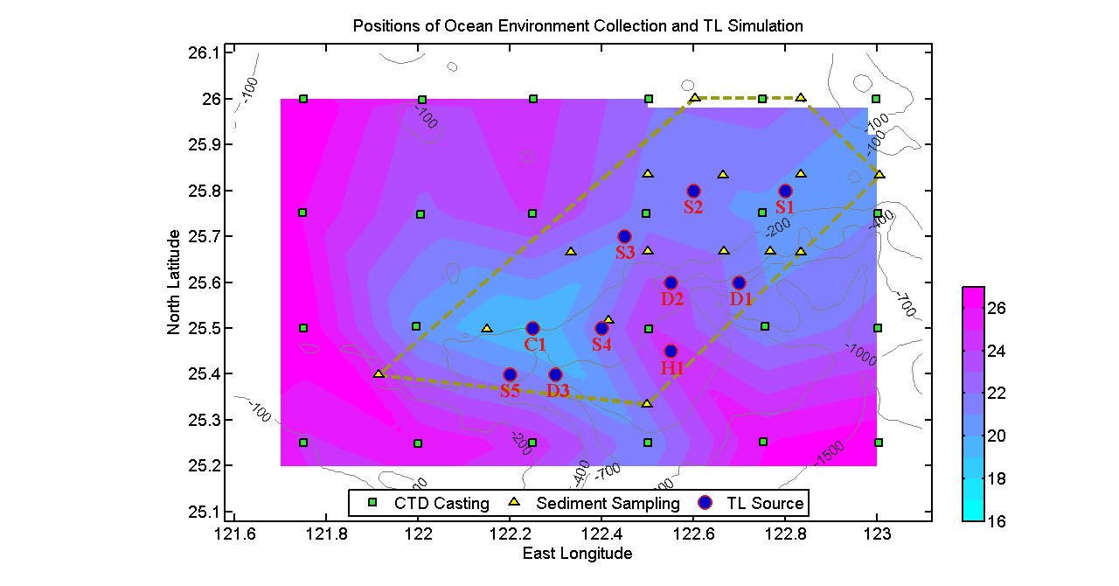
Simulation Locations
temperature contour at -60 m deep

Slide 25
Simulation Results
sz=10 m
sz=60 m
sz=110 m
sz=10 m
sz=60 m
sz=110 m
sz=10 m
sz=60 m
sz=110 m
sz=10 m
sz=60 m
sz=110 m
sz=10 m
sz=60 m
sz=110 m
sz=10 m
sz=60 m
sz=110 m
sz=10 m
sz=60 m
sz=110 m
sz=10 m
sz=60 m
sz=110 m
sz=10 m
sz=60 m
sz=110 m
sz=10 m
sz=60 m
sz=110 m

Slide 26
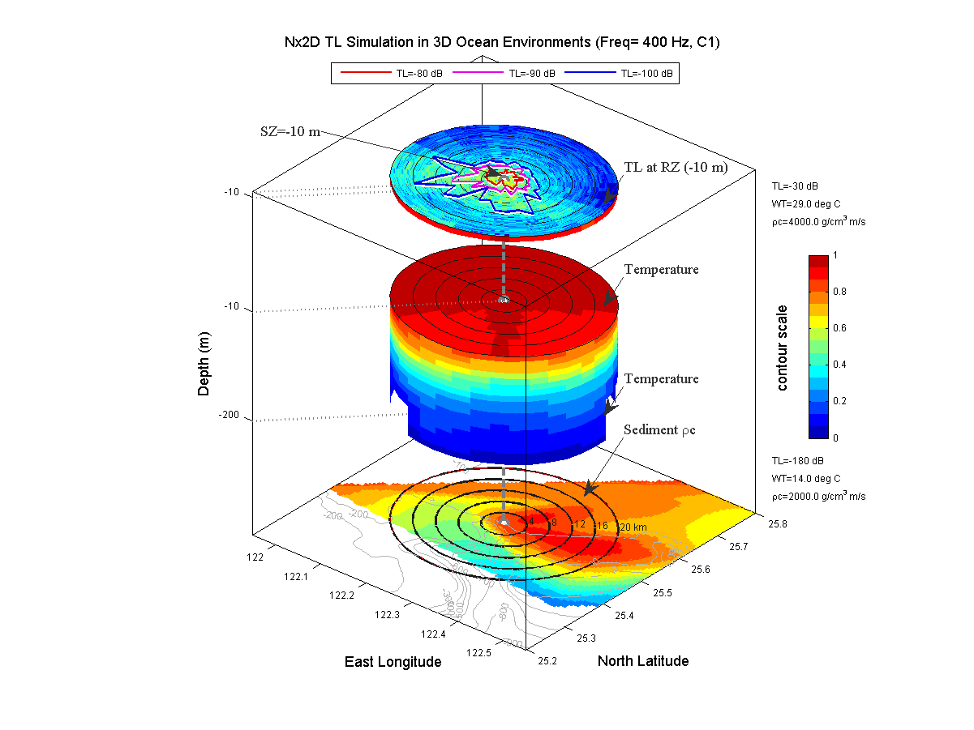
back

Slide 27
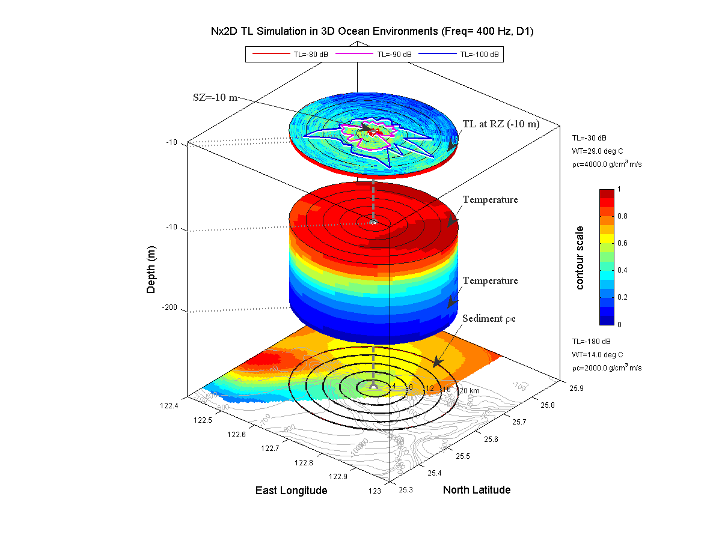
back

Slide 28
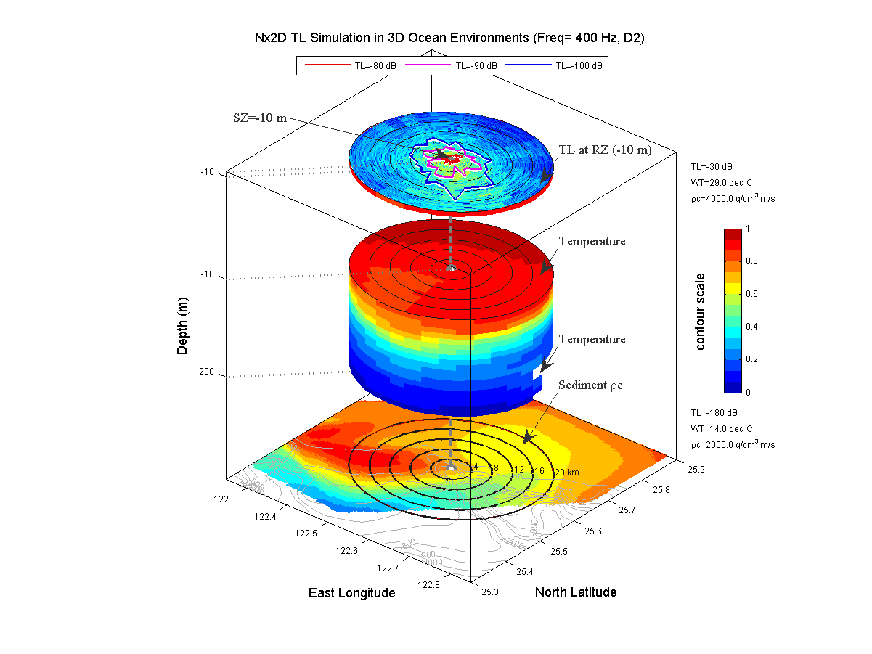
back

Slide 29
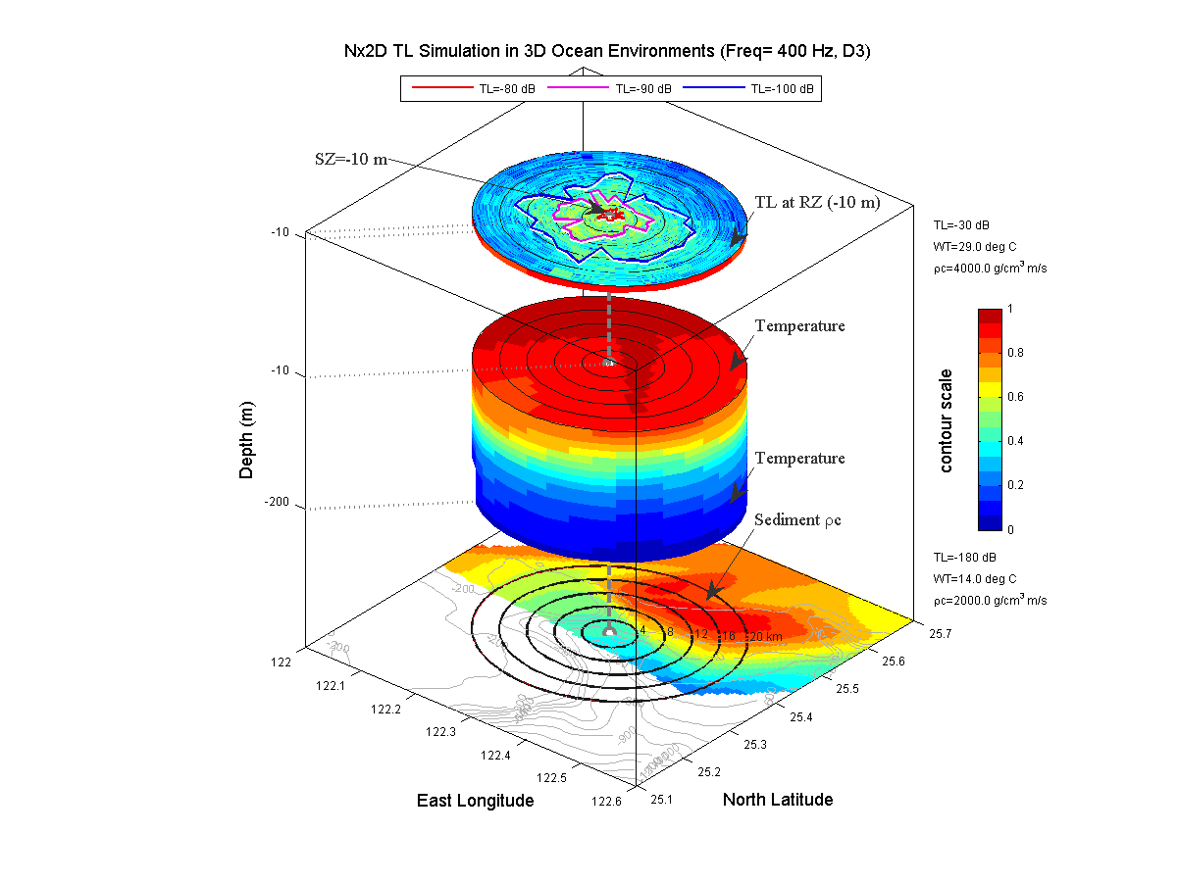
back

Slide 30
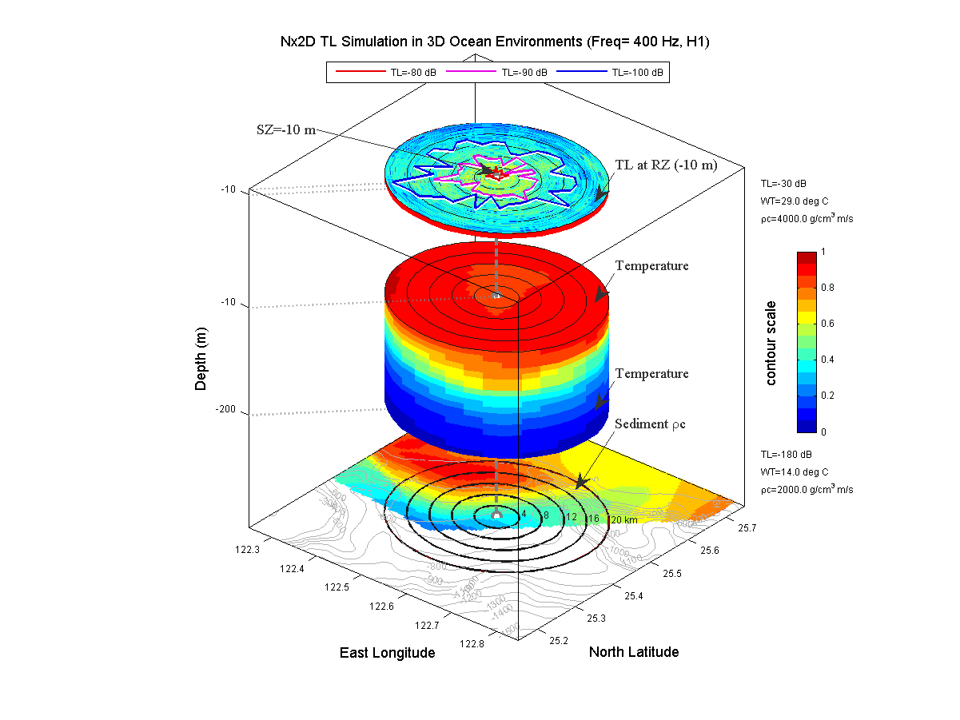
back

Slide 31
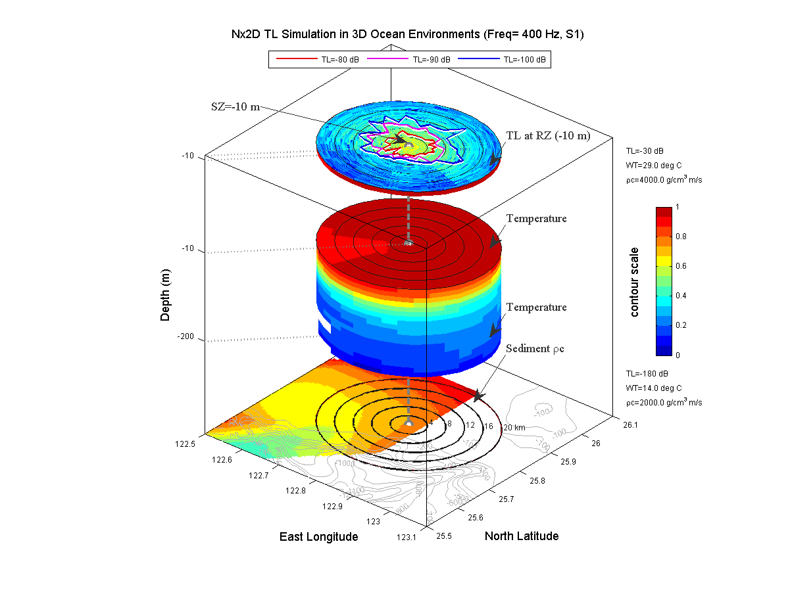
back

Slide 32
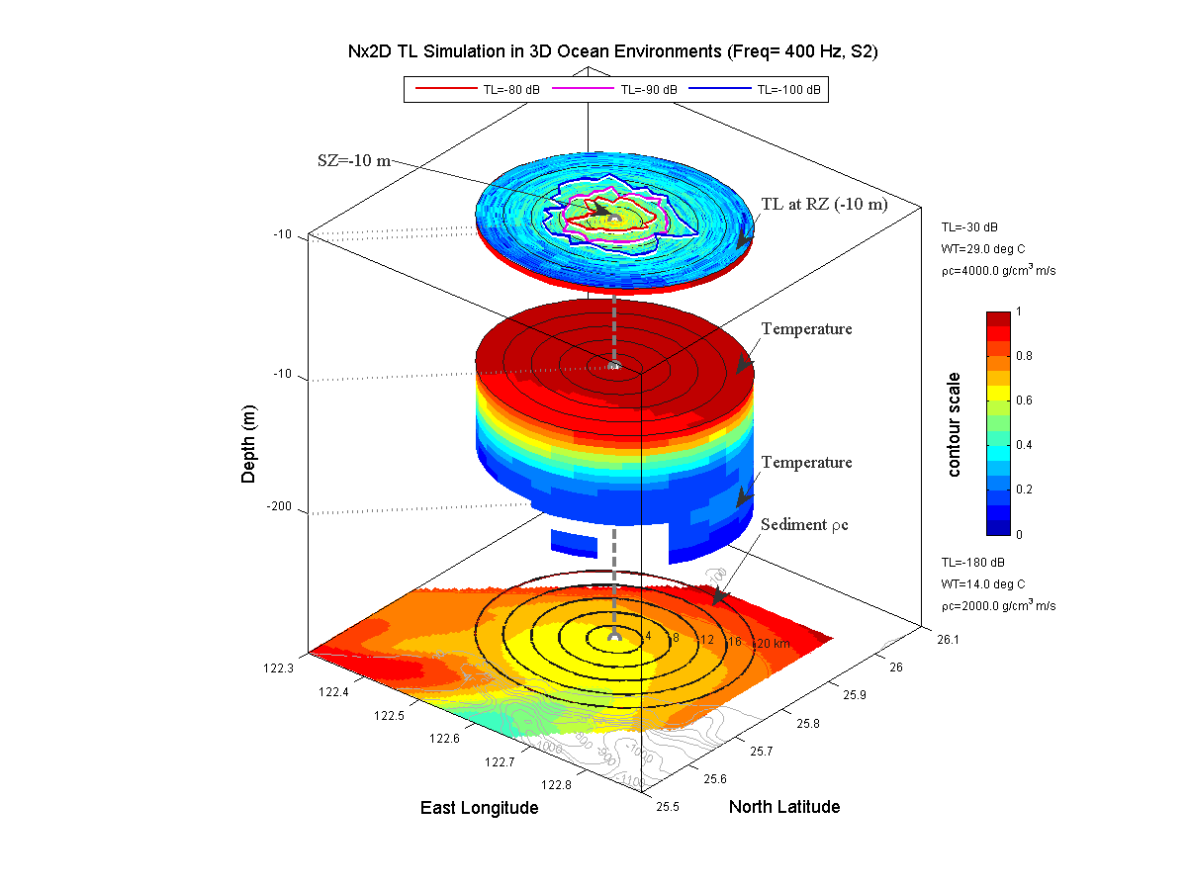
back

Slide 33
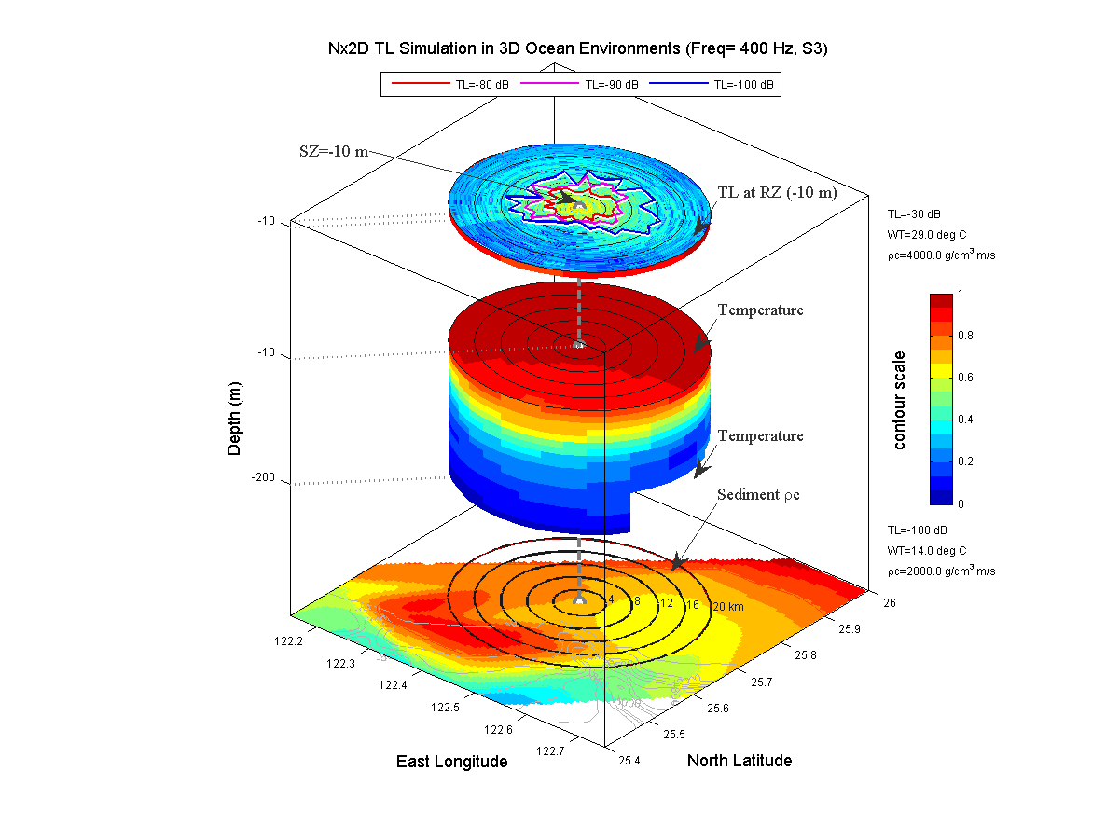
back

Slide 34
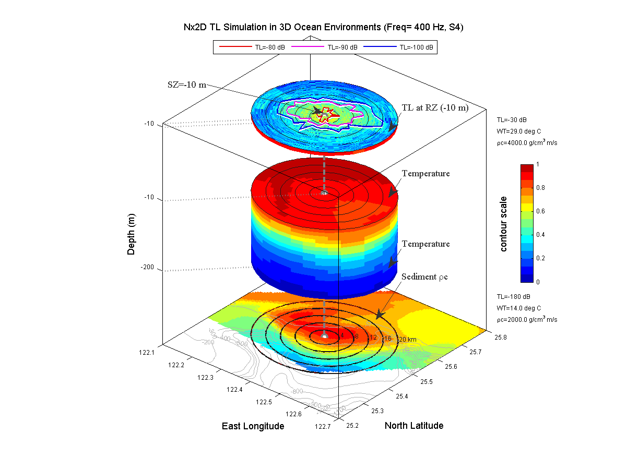
back

Slide 35
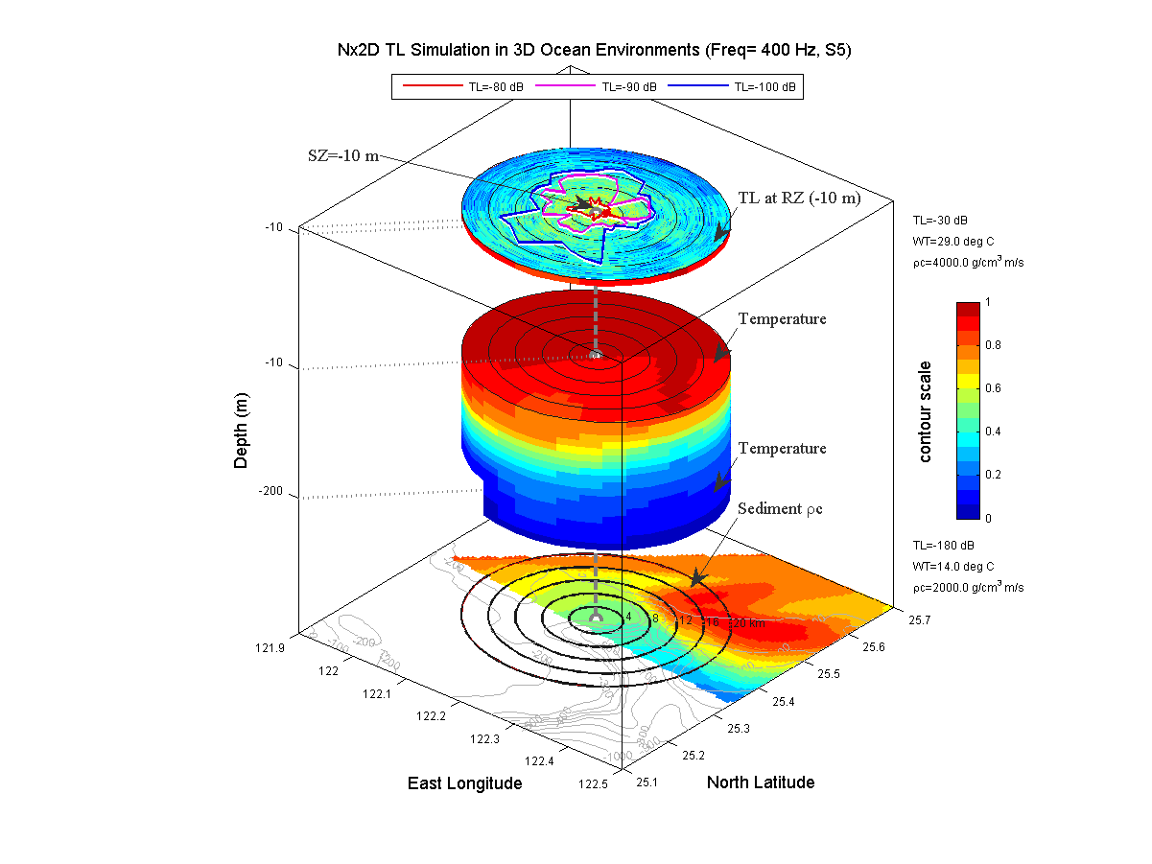
back

Slide 36
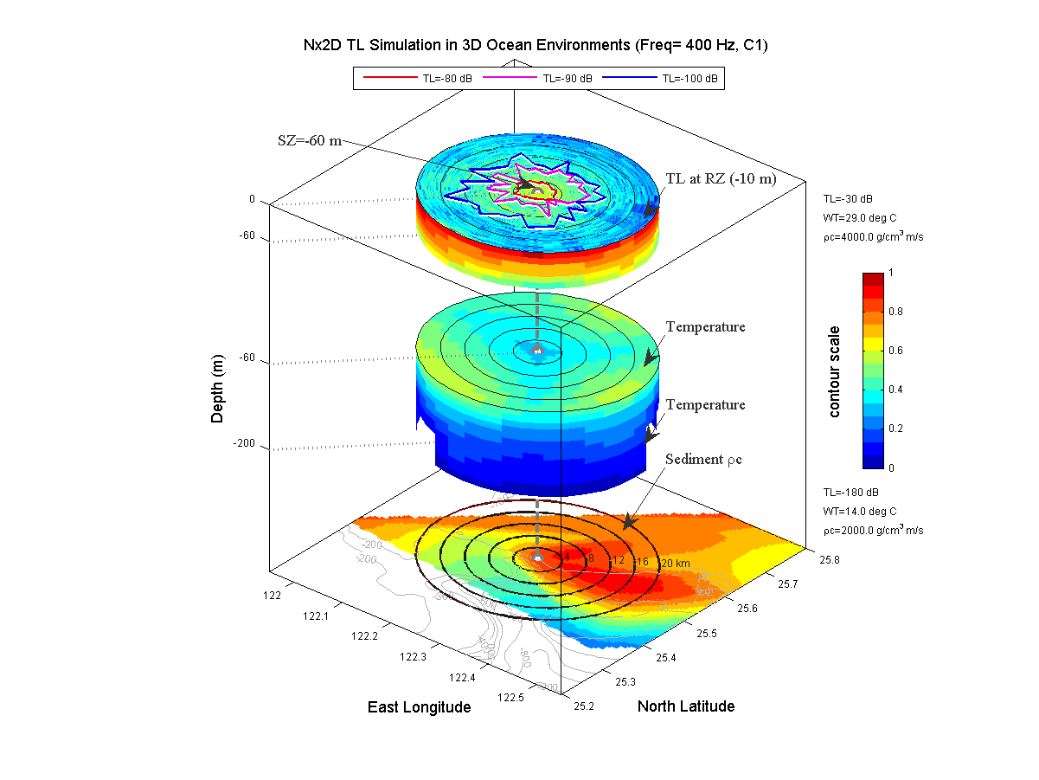
back

Slide 37
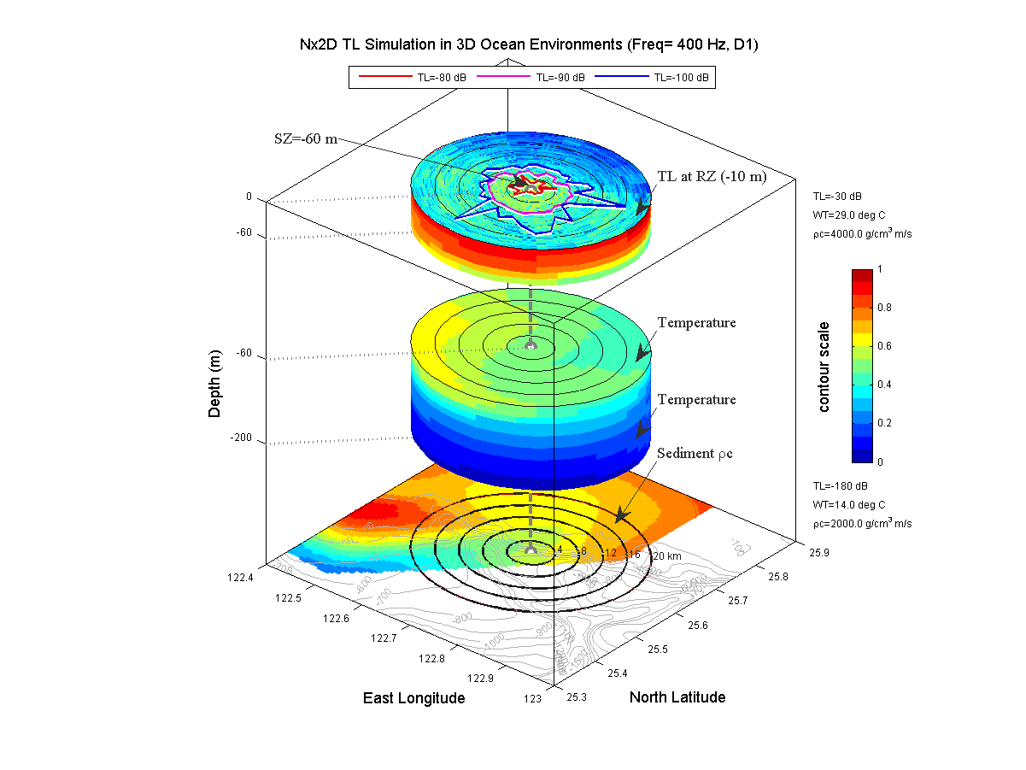
back

Slide 38
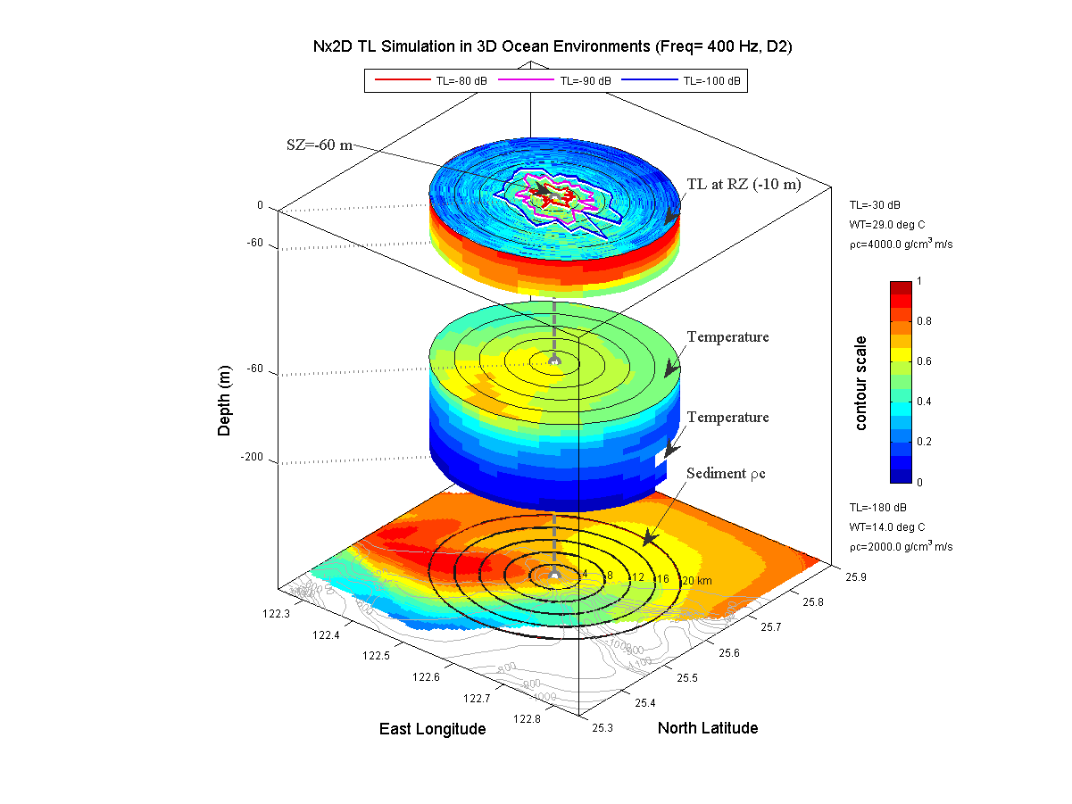
back

Slide 39
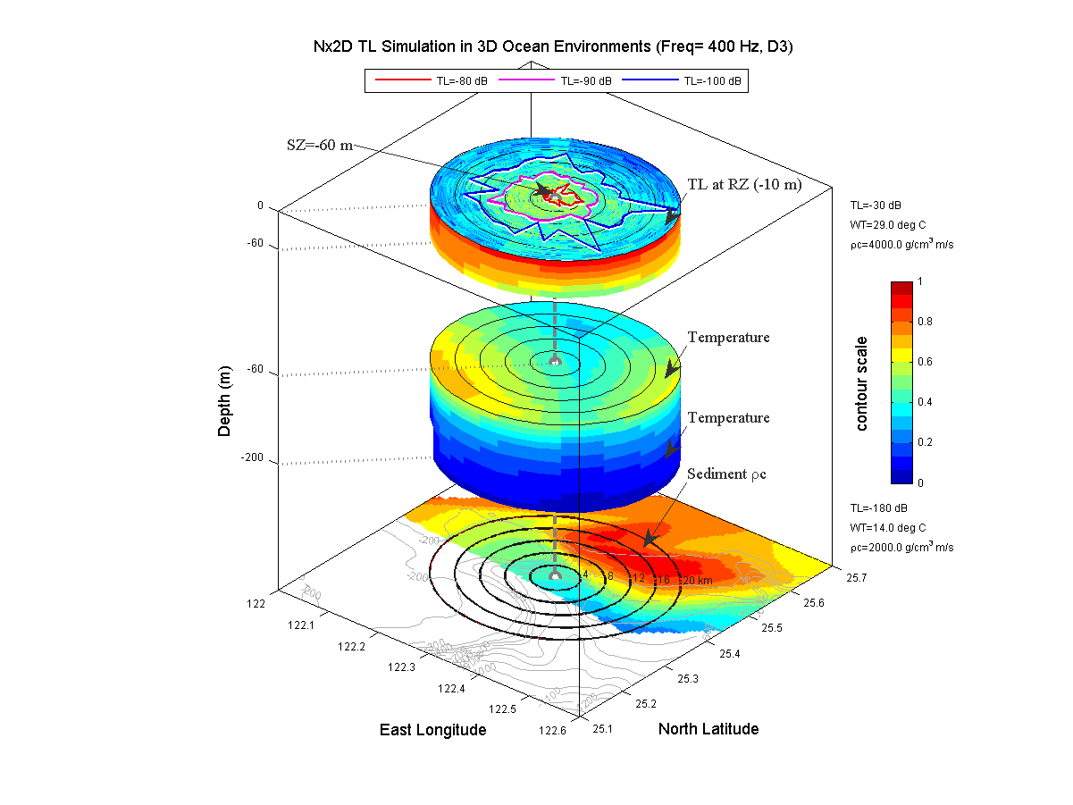
back

Slide 40
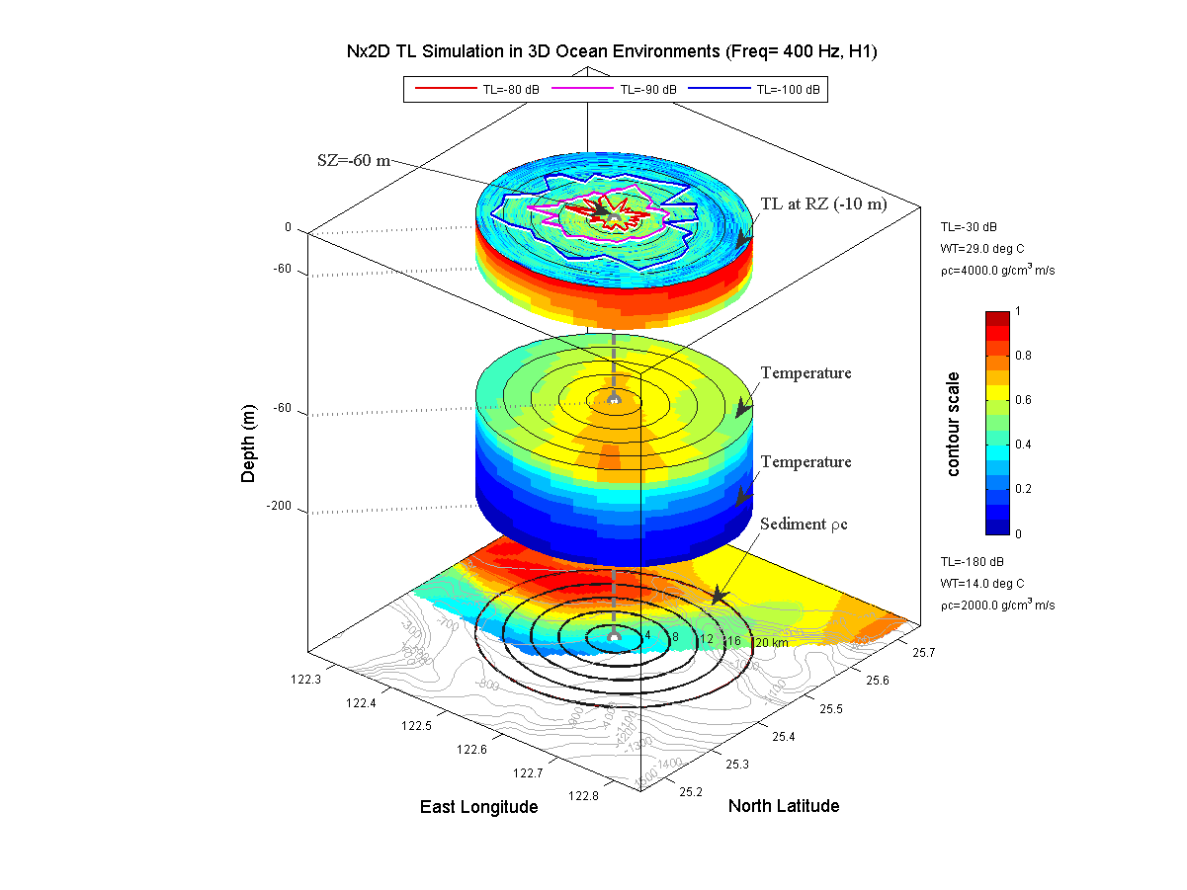
back

Slide 41
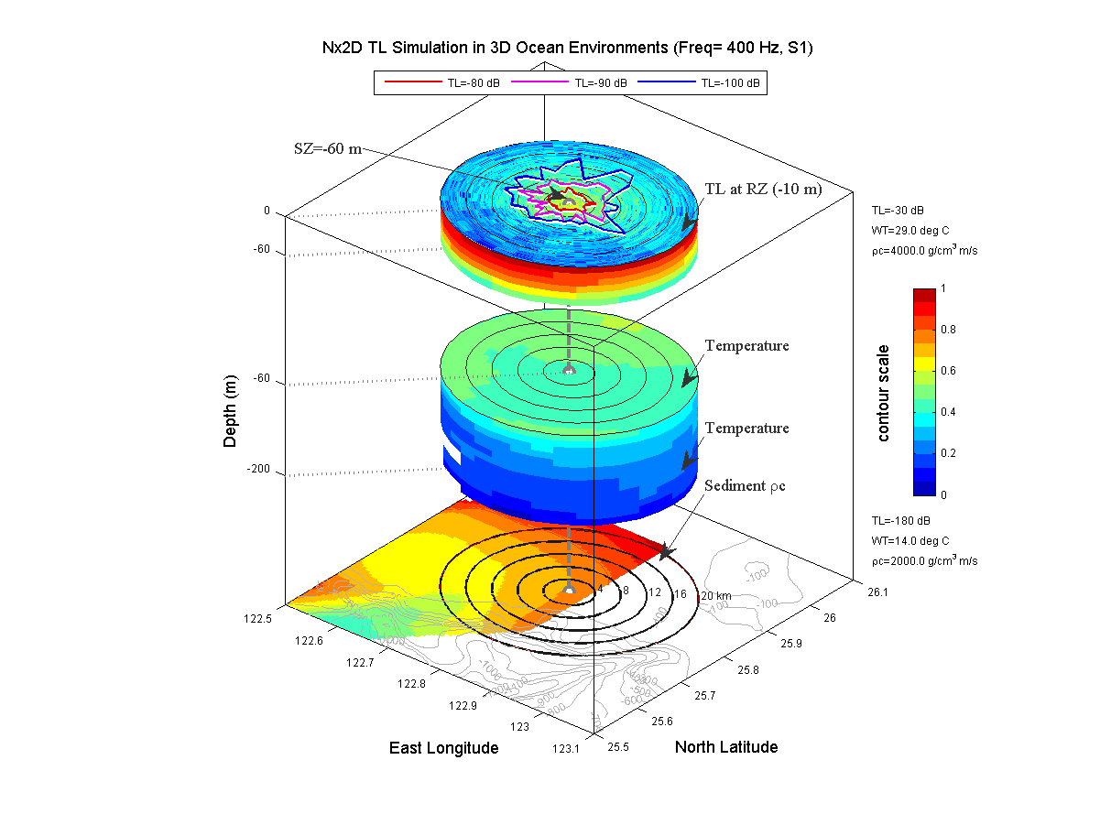
back

Slide 42
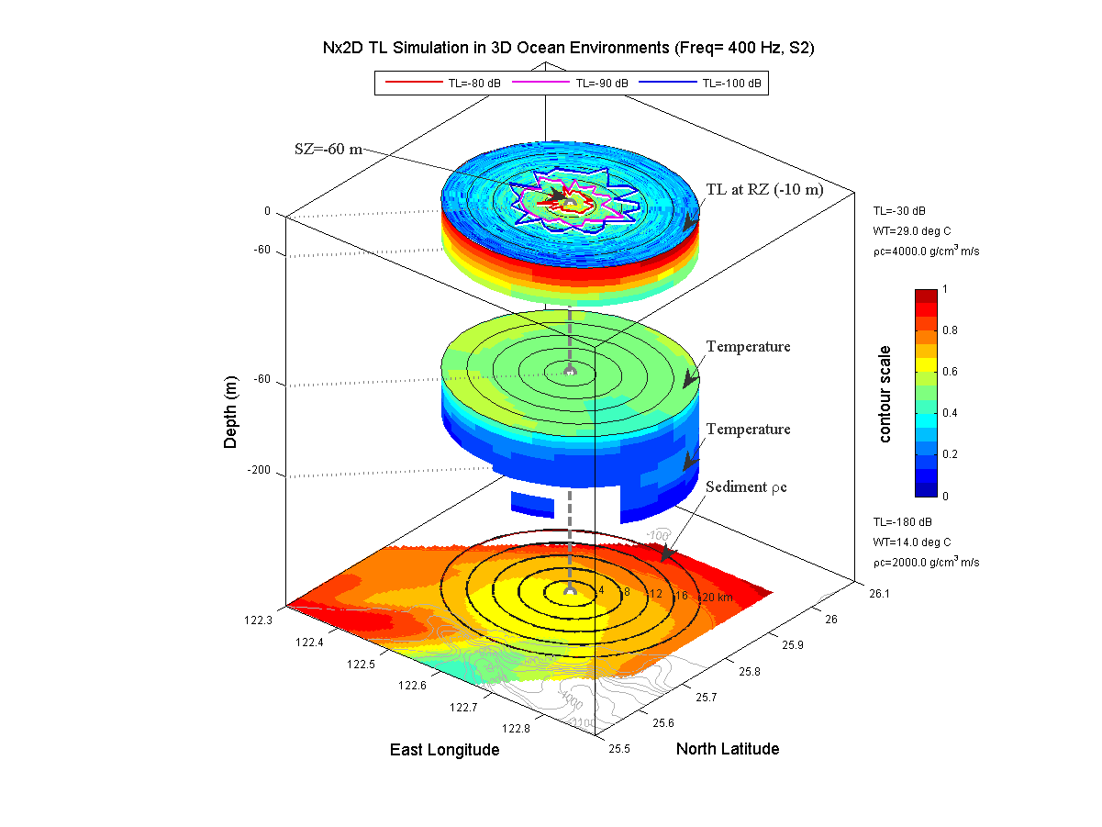
back

Slide 43

back

Slide 44

back

Slide 45

back

Slide 46

back

Slide 47

back

Slide 48

back

Slide 49

back

Slide 50

back

Slide 51

back

Slide 52

back

Slide 53

back

Slide 54

back

Slide 55

back

Slide 56




Propagation Ranges in Specific TL

Slide 57





2009 Experiment Plan

Slide 58


Measurement of Seabed Reflection Coef.
Collaborated with Charles Holland
SHRU
sampling freq.: 9765.625 Hz
operation time: 30 days
max. depth: 1,000 ft

