Slide 1
2018-2019 Tioga Working group
Final Report

Slide 2
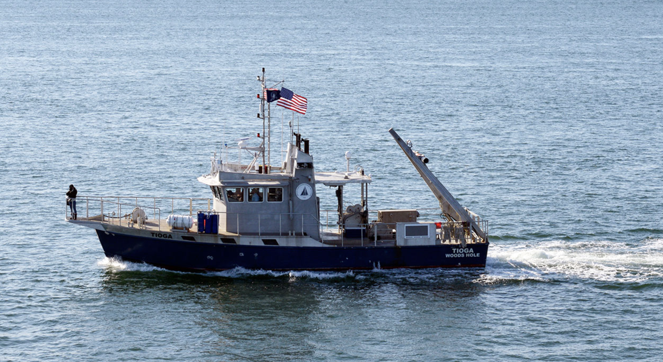
A Pertinent History of the R/V Tioga
April 2004
WHOI receives the purpose-built research vessel
60’ length
18 knot cruising speed
Full A-frame, science packages
Notes:
The first major installation will be relatively close to WHOI in the midst of a number of ongoing research activities.

Slide 3
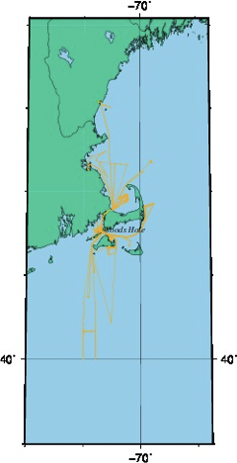
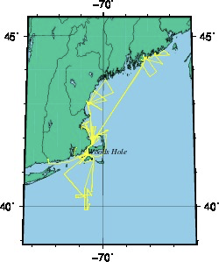
A Pertinent History of the R/V Tioga
Regional influence:
2012
2011

Slide 4
A Pertinent History of the R/V Tioga
2014
Fall 2016
June 2017
Fall 2017
May 8th, 2018
After a decade of service to the institution, the engines – twin turbo-charged Detroit Diesels -- are seen to be problematic, with multiple failures and higher than anticipated maintenance requirements.
The Tioga is laid up for 5 months due to an engine failure.
Mechanical failures limit operations for 3-4 weeks.
Re-powering the vessel (i.e. a total replacement of both engines,~$1M) is requested as part of the 2018 budget.
50 NM offshore in route to the shelf break, the starboard engine suffers a catastrophic failure.

Slide 5
A Pertinent History of the R/V Tioga
Late May 2018
June 2018
July 2018
September 2018
October 2018
November 2018
December 2018
A new replacement of the old type (Engine A) is purchased for delivery in September.
A used engine (Engine B) is located and purchased.
Engine B is installed. Existing Crew (Houtler and Hanley) resign.
The vessel completes its first successful trip.
Staff council approves re-powering.
Engine A is received and placed into storage.
New Captain hired.
WHOI Dive Safety Officer suspends all dive operations from vessel citing continued mechanical issues and crew training as concerns.
Tioga enters shipyard, until April 2019.

Slide 6
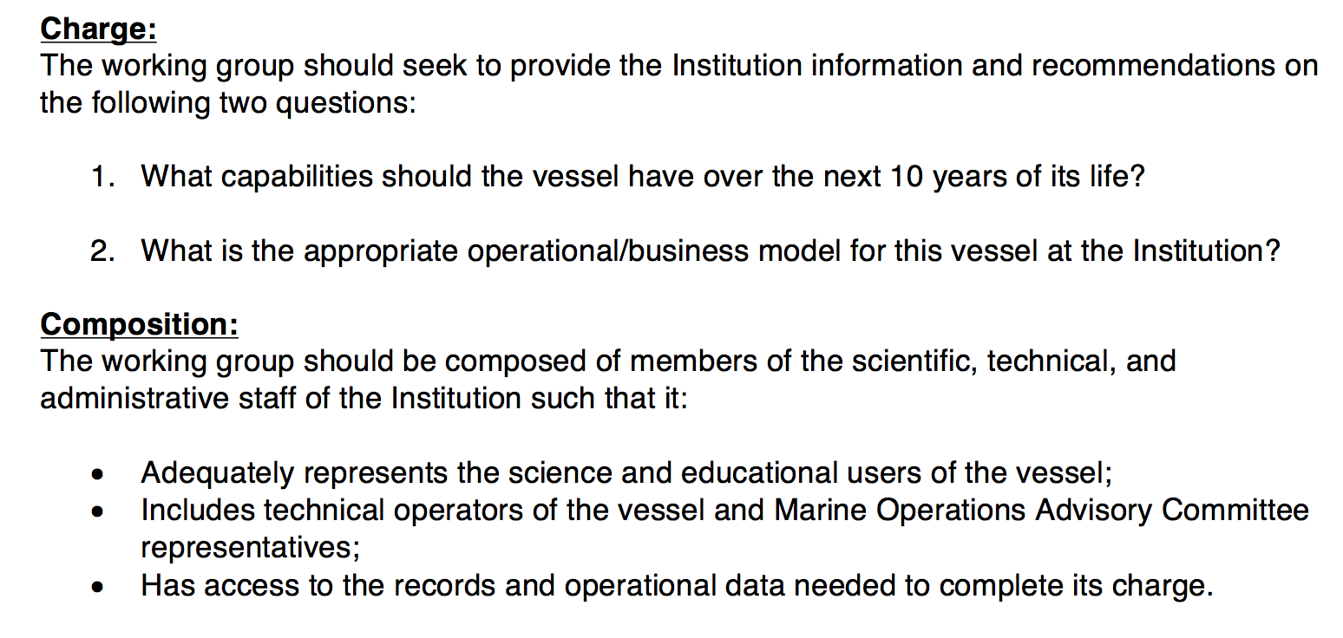
Background

Slide 7
Findings:
The Tioga is a highly-valued facility of the institution which is uniquely equipped to support our mission.
Users currently have low confidence in: the vessel’s reliability, administration of the vessel, and crew experience.
The business model for the vessel is not sustainable in its current form.

Slide 8
Vessels-in-Class Comparison
Name | R/V Tioga | R/V Discovery | R/V Connecticut | R/V Gulf Challenger | R/V Scarlett Isabella | F/V Gloria Michelle
Owner | WHOI | Ryan Marine | U. CONN | UNH | Boston Harbor Cruises | NOAA
Size /Speed | 60’/18knots | 60’/12knots | 103’/10knots | 50’/18knots | 135’/10knots | 72’/ 11knots
Capabilities | CTD/other survey, mooring ops, vehicle ops On-board winches and sensors | Vehicle ops, Survey with own supplies, supply operations | CTD/other survey, mooring ops, vehicle ops On-board winches and sensors | CTD/other survey, mooring ops, vehicle ops On-board winches | Mooring ops with own supplies, Surveys with own supplies | Survey/other, with own supplies
Rates (full day equivalent) | $3700, 12-hr | $2700, 10-hr | $9000, 24-hr, doesn’t include transit from Groton (1 full day extra) | $2700, 8-hr. Doesn’t include transit from Portsmouth (1 full day extra) | $12-14K, 24-hr. Doesn’t include transit from Boston (2 full days extra) | $4400/day
Additional Charges | None | Fuel, loading time, weather days | CTD, ADCP, small boat, CTD Tech | CTD, CTD Tech, extended day/away from port +50% | Winch, accessories. | Not known
Operational Subsidies | Vessel capital costs |  | Vessel capital costs, Indirect is covered by University | Vessel capital costs, staff paid by University |  | Vessel costs, US Gov. vessel.
Appraised Value vs Tioga |  | Slower, Less capable for some tasks | Larger deck and A-frame, longer cruise times for comparable efforts, extra costs | Smaller deck, same speed/ capabilities, extra costs for sensors | Much larger deck, longer cruise times for similar efforts, BYO everything, no lab space | Nominally set up for trawl work only

Slide 9
Why the Tioga is Valuable to WHOI Scientists:
The Tioga is generally 50% faster than comparable vessels
Capable of the widest variety of at-sea tasks
Carries the widest suite of vessel-provided sensors and equipment
Has a competitive day rate as published.
When factoring overall trip costs versus a replacement vessel, the day rate becomes highly advantageous.
Relies on the smallest number of operational subsidies of the institution-run research vessels in class.

Slide 10
User Feedback
Most users expressed appreciation for the capabilities of the vessel and frustration over the state of the vessel.
Scheduling was an issue, explicitly for more infrequent users.
User valuations of a day on the Tioga were highly variable and strongly related to task.
The only significant need reported was for support of side-based instrument recoveries.

Slide 11
The Business Model
Costs (projected):
Income (actual):
 | TIOGA Budget Summary | 2018 | 2017 | 2016 | 2015 | 2014 | 2013
Vessel Operations |  | $496,356.0 | $475,403.00 | $471,137.0 | $527,856.00 | $474,735.00 | $439,008.00
 | Technical Operations | $25,839.00 | $27,914.00 | $23,059.00 | $23,450.00 | $28,005.00 | $24,917.00
 | Totals per year | $524,213.0 | $505,334.00 | $496,212.0 | $553,321.00 | $504,754.00 | $465,938.00
Year | Total Hours | 1/2 Days | Full Days | Extended Days | Income
2013 | 766.90 | 28.00 | 63.00 | 5.00 | $251,678.00
2014 | 647.40 | 20.00 | 58.00 | 9.00 | $259,007.00
2015 | 629.05 | 20.00 | 59.00 | 9.00 | $282,144.00
2016 | 416.85 | 17.00 | 26.00 | 5.00 | $158,835.00
2017 | 648.00 | 28.00 | 53.00 | 12.00 | $339,437.00
Notes:
400 MW, the first block that goes on sale this summer (today!)
Every day, we develop and use cutting edge techniques and engineering solutions to achieve our mission.

Slide 12
The Business Model
Costs (projected):
Income (actual):
 | TIOGA Budget Summary | 2018 | 2017 | 2016 | 2015 | 2014 | 2013
Vessel Operations |  | $496,356.0 | $475,403.00 | $471,137.0 | $527,856.00 | $474,735.00 | $439,008.00
 | Technical Operations | $25,839.00 | $27,914.00 | $23,059.00 | $23,450.00 | $28,005.00 | $24,917.00
 | Totals per year | $524,213.0 | $505,334.00 | $496,212.0 | $553,321.00 | $504,754.00 | $465,938.00
Year | Total Hours | 1/2 Days | Full Days | Extended Days | Income
2013 | 766.90 | 28.00 | 63.00 | 5.00 | $251,678.00
2014 | 647.40 | 20.00 | 58.00 | 9.00 | $259,007.00
2015 | 629.05 | 20.00 | 59.00 | 9.00 | $282,144.00
2016 | 416.85 | 17.00 | 26.00 | 5.00 | $158,835.00
2017 | 648.00 | 28.00 | 53.00 | 12.00 | $339,437.00
Notes:
400 MW, the first block that goes on sale this summer (today!)
Every day, we develop and use cutting edge techniques and engineering solutions to achieve our mission.

Slide 13
The Business Model
Costs (projected):
Income (actual):
 | TIOGA Budget Summary | 2018 | 2017 | 2016 | 2015 | 2014 | 2013
Vessel Operations |  | $496,356.0 | $475,403.00 | $471,137.0 | $527,856.00 | $474,735.00 | $439,008.00
 | Technical Operations | $25,839.00 | $27,914.00 | $23,059.00 | $23,450.00 | $28,005.00 | $24,917.00
 | Totals per year | $524,213.0 | $505,334.00 | $496,212.0 | $553,321.00 | $504,754.00 | $465,938.00
Year | Total Hours | 1/2 Days | Full Days | Extended Days | Income
2013 | 766.90 | 28.00 | 63.00 | 5.00 | $251,678.00
2014 | 647.40 | 20.00 | 58.00 | 9.00 | $259,007.00
2015 | 629.05 | 20.00 | 59.00 | 9.00 | $282,144.00
2016 | 416.85 | 17.00 | 26.00 | 5.00 | $158,835.00
2017 | 648.00 | 28.00 | 53.00 | 12.00 | $339,437.00
Notes:
400 MW, the first block that goes on sale this summer (today!)
Every day, we develop and use cutting edge techniques and engineering solutions to achieve our mission.

Slide 14
Recommendations:
The Operational Model of the Vessel must be changed to increase vessel reliability, usefulness, and user confidence.
The Business Model of the vessel must be changed to protect the vessel’s long term service to the institution
Notes:
This table shows a breakdown of the 8.3 GW of retirements; note the age of the individual facilities.

Slide 15
Operational Model
Recommendations:
Conduct a Focused effort on Crew Training
Identify and cultivate a replacement/backup crew capacity
Develop a Maintenance Plan with Oversight
Strive to improve communications with users
Streamline scheduling and revamp the reservation process

Slide 16
Business Model
Recommendations:
Conform daily rates to true costs
Decrease the services offered for the Base Rate
Fundraise for a Permanent Subsidy
Increase the Base Rate
Market the Vessel to increase the User Base

Slide 17
Working Group Composition
Anthony Kirincich, coordinator (PO, Scientist)
Eric Benway (Ship Ops)
Robbie Laird (SSSG)
Mark Baumgartner (Bio, Scientist)
Mike Purcell (AOPE, Scientist)
Emily Peacock (Bio, tech. staff)
Taylor Crockford (Bio, tech. staff)

